Slide 1
Social Accountability Intervention.
Uttar Pradesh Health System Strengthening Project

Slide 2
Intervention Design & Work Plan
Social accountability is a key component of the World Bank’s Uttar Pradesh Health Systems Strengthening Project (UPHSSP), which includes, support for introducing and strengthening social accountability mechanisms in order to stimulate community action to
Demand better services,
Enhance positive health behavior at individual and community level, and
Promote social audits of service delivery and resource allocation in the health sector.

Slide 3
Goal & Objectives of SA intervention
Project Goal:
To develop sustainable Social Accountability Mechanisms to improve the delivery of healthcare services in the catchment area of the facility including all sub-Centres in the project area
Objectives:
To inform the community of their health entitlements and enable the community to be partners in the process of improving the functioning of health system as envisaged by NHM.
To develop a design for the social accountability intervention at Block level and Village level to enable the community to be informed of their health entitlements.
To facilitate monitoring based on agreed benchmarks / indicators & enable feedback on the indicators to the health system to facilitate corrective action.

Slide 4
Timeline & Area of Operation
Tenure of the Social Accountability Intervention project 16 Months
Preparatory phase - 4-Months
Implementation Phase - 12 Months
Project starts from May, 2016
Area of operation - 12 Districts
51 blocks
4238 Gram Panchayats.

Slide 5
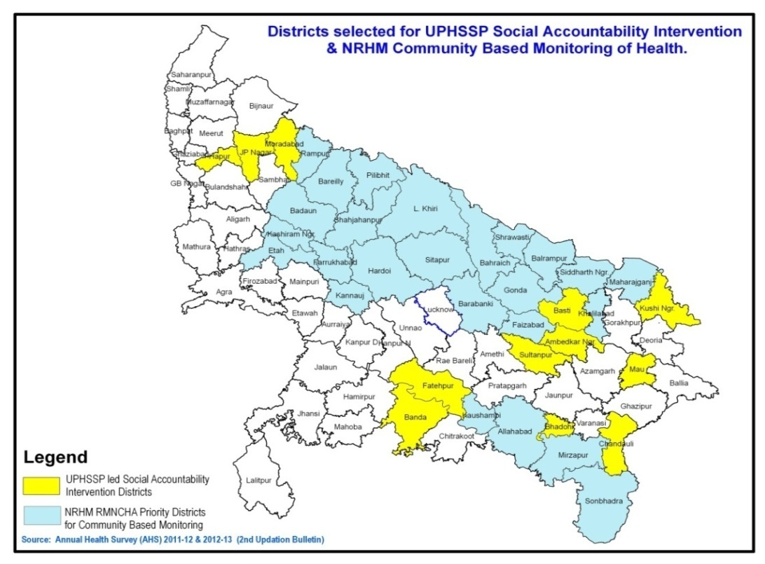
Project Coverage Area
Intervention Districts - 10 Districts (SIRD) 1.Banda 2.Ambedkar Nagar 3.Mau 4.Basti 5.Kushinagar 6.Chandauli 7.SR Nagar (Bhadohi) 8.Moradabad 9.Jyotiba Phule Nagar 10.Hapur (Panchsheel Nagar) RCT Districts 1.Sultanpur (20 GPs) 2.Fatehpur (20 GPs)
UPHSSP/TAP/CDA directly administer programs in 12 intervention districts with GPCs support & Sambodhi carries out research components in RCT Districts.
5

Slide 6
Expected outputs/outcomes of the Social Accountability Intervention:
VHSNC /PRI members/community members trained & enabled on issues of social accountability.
Automated generation of Consolidated Reports (from collation and consolidation of score cards) for feedback to the committee and health system.
Organization of Jan Samvaad or other interactive processes enabling engagement between Health System and community.
Responsiveness of the Health System in terms of action taken reports (ATRs) and monitoring by the committee at the next level

Slide 7
Steps/ Work Plan for implementation of Social Accountability Intervention
Recruitment and Training of Facilitators/trainers, SIRD-6,District Level Staff , DC-8 & Sub DC-17, GPC-316.
Capacity building of Master Trainers and key stakeholders on SA Intervention.
Capacity building of VHSNC members for community participation and engagement
Engaging with VHSNC members to establish SA mechanisms
Facilitation of ongoing SA activities
Collection of information / data for development of score cards and indicators
Monitoring of processes and reporting
Scale up

Slide 8
Implementing Agency - SIRD
Deen Dayal Upadhyay State Institute of Rural Development (SIRD) established in 1954 is a premier institute in rural development sector and an Apex body/ Institute of the State Government of Uttar Pradesh for undertaking various levels of the capacity building programmes of PRIs and other stakeholder from various development areas. Having a rich experience in the field of Action Research, Monitoring & Evaluation and Consultancy for the rural developmental programmes run by State Govt and Ministry of Rural development. SIRD headed by Director General a senior I.A.S official from the state government.

Slide 9
8
17
316

Slide 10
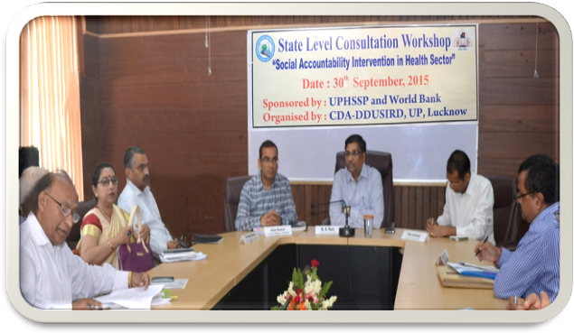
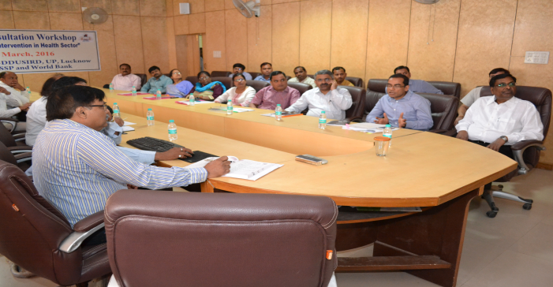
Key Activities – Under SA intervention
Key Activities – Under SA intervention
State level consultation workshop on formulation of training modules, Monitoring Formats, IEC materials, Guidelines & SOPs.
Customised IEC materials for effective operationalization of the intervention at different levels with a focus at the community level.
District level training of trainers of 12 project districts .
Sensitization workshop for district level officials (DPRO, CDO, CMO, ACMO, Dy. CMO, DHEIO, DIO, DPO, DPM and DCM).

Slide 11
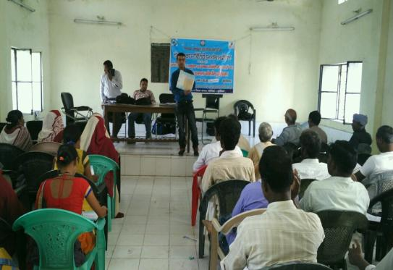
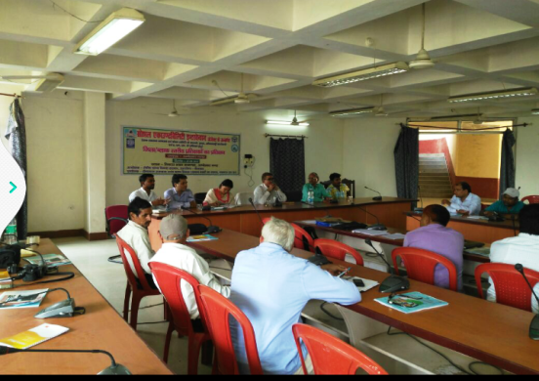
Key Activities – Under SA intervention
Block level training of VHSNC members (4238 GPs / 34000 VHSNC members ).
Sensitization and strengthening of Block Level Advisory Committees (BLAC) and District Health Society (DHS).
Coordination with state level partners ,NHM, UP-TSU SIFPSA and other stakeholders .
Undertake detailed process documentation of all activities under the Social Accountability Intervention

Slide 12
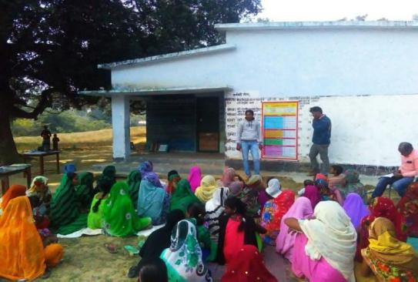
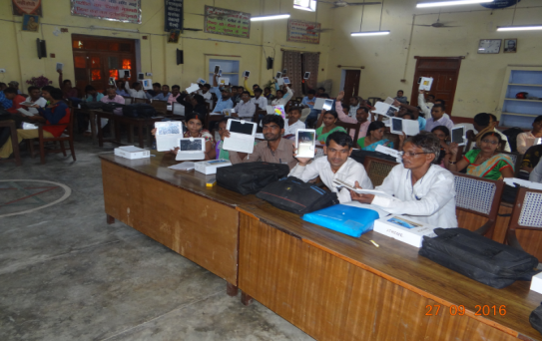
Key Activities – Under SA intervention
Implementation of community scorecard at GP level.
Initiated ‘Jan Samvaad’ and Action Taken Report,
Initiated ICT based reporting system for real-time monitoring of the project progress at block, district and state level.

Slide 13
Current Updates…
Formation of 4238 VHSNCs in 51 Blocks of 12 districts.
Activation of 3428 /4238 Village Health Sanitation & Nutrition Committees.
74% ( 25382/34000) VHSNC members has been trained.
13668 VHSNC meetings held at GP level.
17399 VHND session has been observed.
Android based reporting & monitoring has been initiated.
51 (BLAC) Block level advisory committee meetings held at block level.
District level review meetings initiated by CDO as nodal officer of project.
Community level campaign initiated at GP level.
Community Scorecard activity started.
Dissemination and display of IEC materials has been started.
Providers incentive camps initiated at block level.

Slide 14
Screen shots of App - SATHIUP
Social Accountability Tool in Health Intervention - UP

Slide 15
Screen shots of App - SATHIUP
Social Accountability Tool in Health Intervention - UP

Slide 16
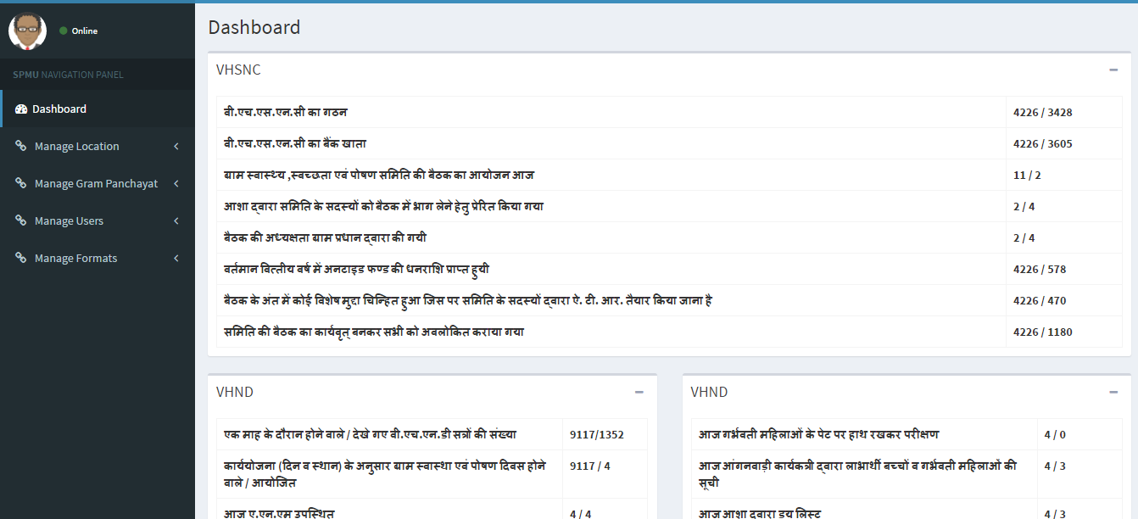
Dashboard

Slide 17
VHND Status
S.No | Name of District | Upto Oct 16 | Nov-16 | Dec-16 | Jan -17 | Total
1 | Ambedkar Nagar | 1564 | 348 | 297 | 276 | 2485
2 | Banda | 1286 | 231 | 193 | 161 | 1871
3 | Basti | 1488 | 332 | 321 | 330 | 2471
4 | Bhadohi | 1197 | 336 | 312 | 228 | 2073
5 | Chandouli | 677 | 128 | 136 | 98 | 1039
6 | Fatehpur* RCT | 33 | 13 | 20 | 18 | 84
7 | Hapur | 629 | 119 | 105 | 79 | 932
8 | JP Nagar | 407 | 127 | 144 | 124 | 802
9 | Kushi Nagar | 1302 | 226 | 243 | 182 | 1953
10 | Mau | 1231 | 248 | 222 | 145 | 1846
11 | Moradabad | 1118 | 199 | 235 | 212 | 1764
12 | Sultanpur* RCT | 21 | 20 | 20 | 18 | 79
 | Total | 10953 | 2327 | 2248 | 1871 | 17399

Slide 18
VHSNC Status
S.No | Name of District | Updates till 25th Jan 2017
 |  | VHSNC Meeting | No. of Created ATR | Total submitted ATR | Total compliance ATR
1 | Ambedkar Nagar | 1285 | 204 | 139 | 17
2 | Banda | 2304 | 856 | 783 | 456
3 | Basti | 1602 | 252 | 136 | 96
4 | Bhadohi | 2005 | 216 | 138 | 31
5 | Chandouli | 771 | 55 | 49 | 28
6 | Fatehpur* | 75 | 0 | 0 | 0
7 | Hapur | 988 | 118 | 114 | 36
8 | JP Nagar | 658 | 107 | 104 | 85
9 | Kushi Nagar | 1542 | 99 | 68 | 11
10 | Mau | 904 | 309 | 232 | 104
11 | Moradabad | 1403 | 540 | 398 | 234
12 | Sultanpur* | 131 | 5 | 3 | 1
 | Total | 13668 | 2761 | 2164 | 1099
*Random Control Trial Districts

Slide 19
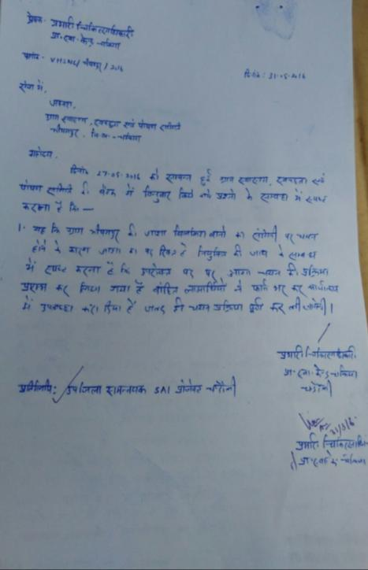
ATR & ATR Compliances

Slide 20
IEC Material

Slide 21
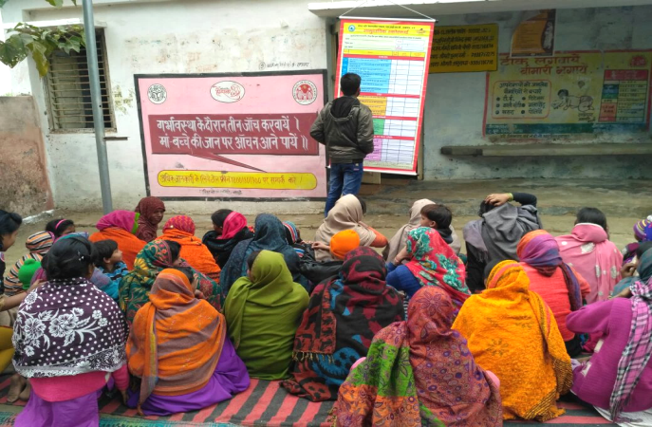
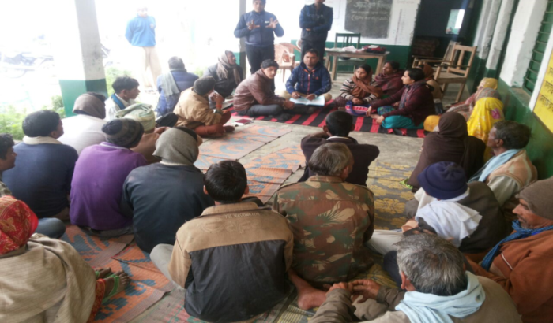
Activity Photograph

Slide 23
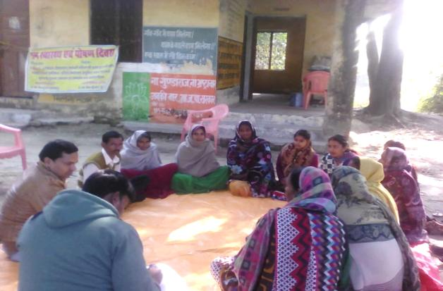
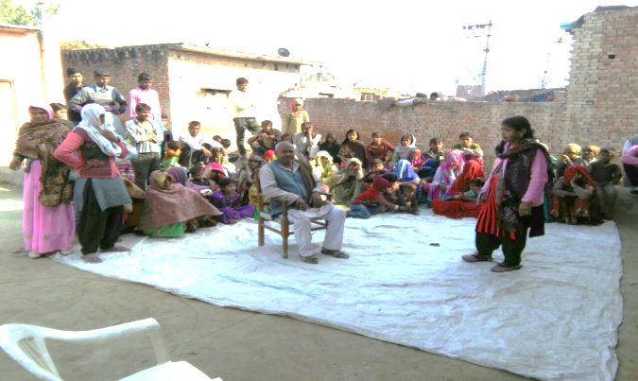
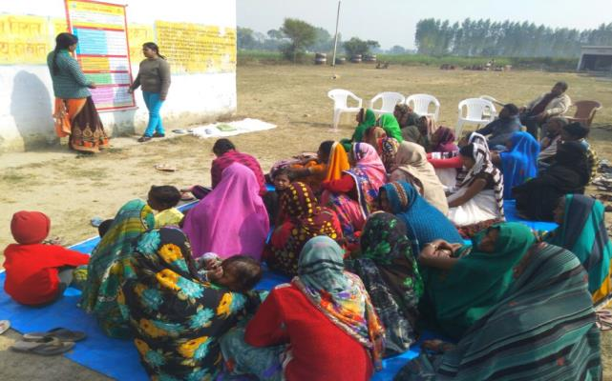
Activity Photograph

Slide 24
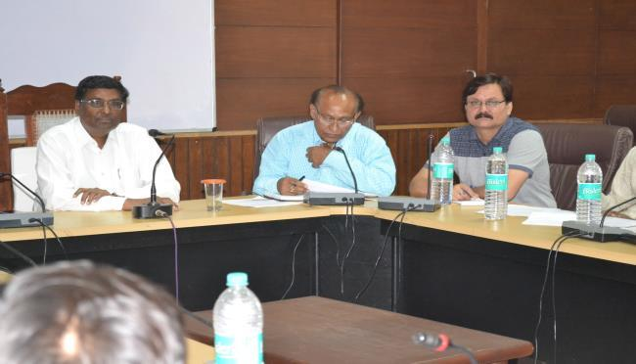
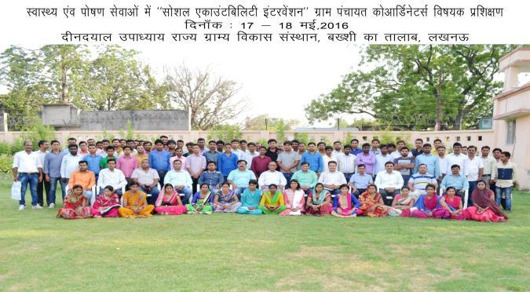
Activity Photograph

Slide 25
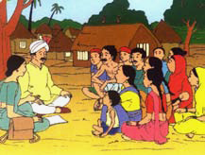
Thanking You!
25

