Slide 1


Involvement of
MAHILA AROGYA SAMITI(MAS) in community monitoring
NUHM-ODISHA

Slide 2
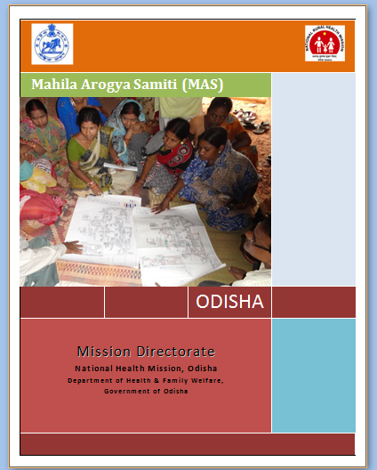
MAS
Mahila Arogya Samiti (MAS) A community based group, responsible for promotion of behavior change and demand generation related to health and hygiene in the slum.
Coverage 100 HHs/500 slum population
Consisting of 11-15 women members
ASHA & Anganwadi Worker are the member of MAS.

Slide 3
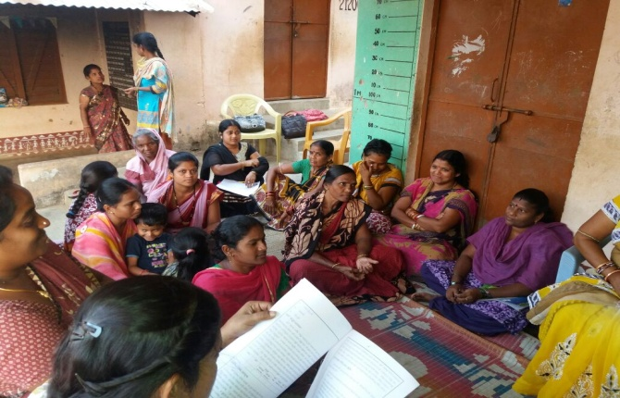
PLANNING PHASE
City level selection/core committee
Selection of local NGO to support formation & Strengthening
Mapping, HH survey and finalization of HH/area and timeline
Engagement of City level Nodal officer
Awareness meeting in the slum
Selection MAS members, president, secretary and treasurer
Opening of zero frill SB A/C in nationalized bank

Slide 4
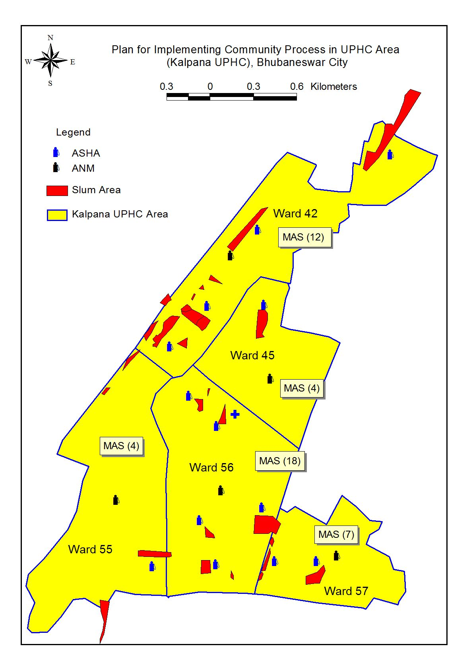
UPHC PLANNING( ANM, ASHA, MAS)
No.of MAS in ANM and UPHC area

Slide 5
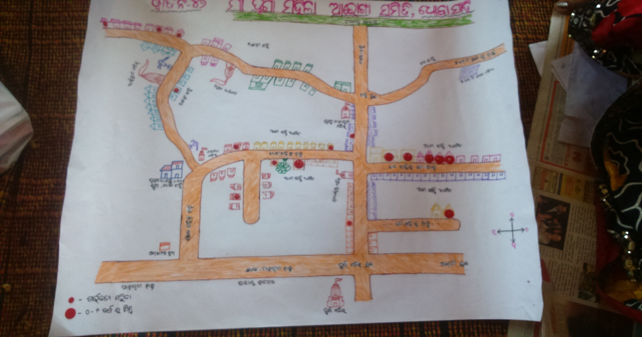
Resource Map of MAS
M3:9HH
M1:8HH
M2:6HH
M4:8HH
M5:8HH
M9:12HH
M7:12HH
M10:14HH
M6:11HH
M11:9HH
M8:11HH
Dhoba Sahi Basti,Ward:42 ,Cuttack HH:108

Slide 6
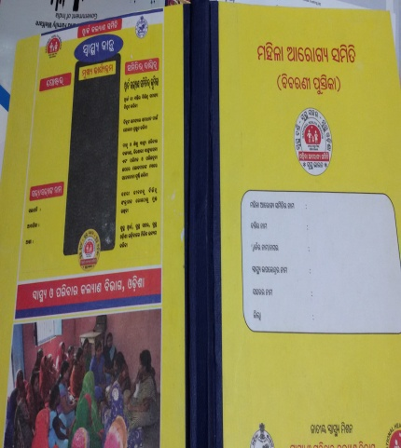
MANDATE OF MAS
Ensure 100% institutional delivery
Ensue 100% immunisation
Full attendance of beneficiary in UHND and immunisation session
Construction/use of toilet, ensure open defecation free and slum
Monitoring of UHND, immunisation and UPHC services
Planning and proper utilisation of untied fund
Co-ordination with front line workers and line departments
Use the composite register

Slide 7
BEST PRACTICES
Monthly meetings to resolve local health issues
Motivate for institutional delivery, UHND, immunisation & outreach camps
Optimum utilisation of referral transport ( 108 & 102)
Linkage to various schemes, programs of Govt.
Performance review of group & individual members (MAS Grading)
Use of toilets by each HH
Use public health facility to reduce
out of pocket expenditure.

Slide 8
CAH under NUHM

Slide 9
Journey so far......
Meeting held with SPMU, CPMU officials, Nodal officers of state and city
Two wards in Bhubaneswar and Cuttack cities selected for pilot intervention
Sensitization meetings held with the Corporator, MAS members and NGO representatives, UPHC officials, ANMs in respective wards
Draft Calendar of activities prepared
Checklist for monitoring customised in local language (UPHC & UHND)
Pilot tested the check list in UPHCs and UHND sites in presence of MAS members, which was facilitated by the Programme Manager, AGCA Secretariat
Monitoring teams formed and orientation conducted
Program launched in December 2016
The response over a period of three months shall be analysed in March 2017.

Slide 10
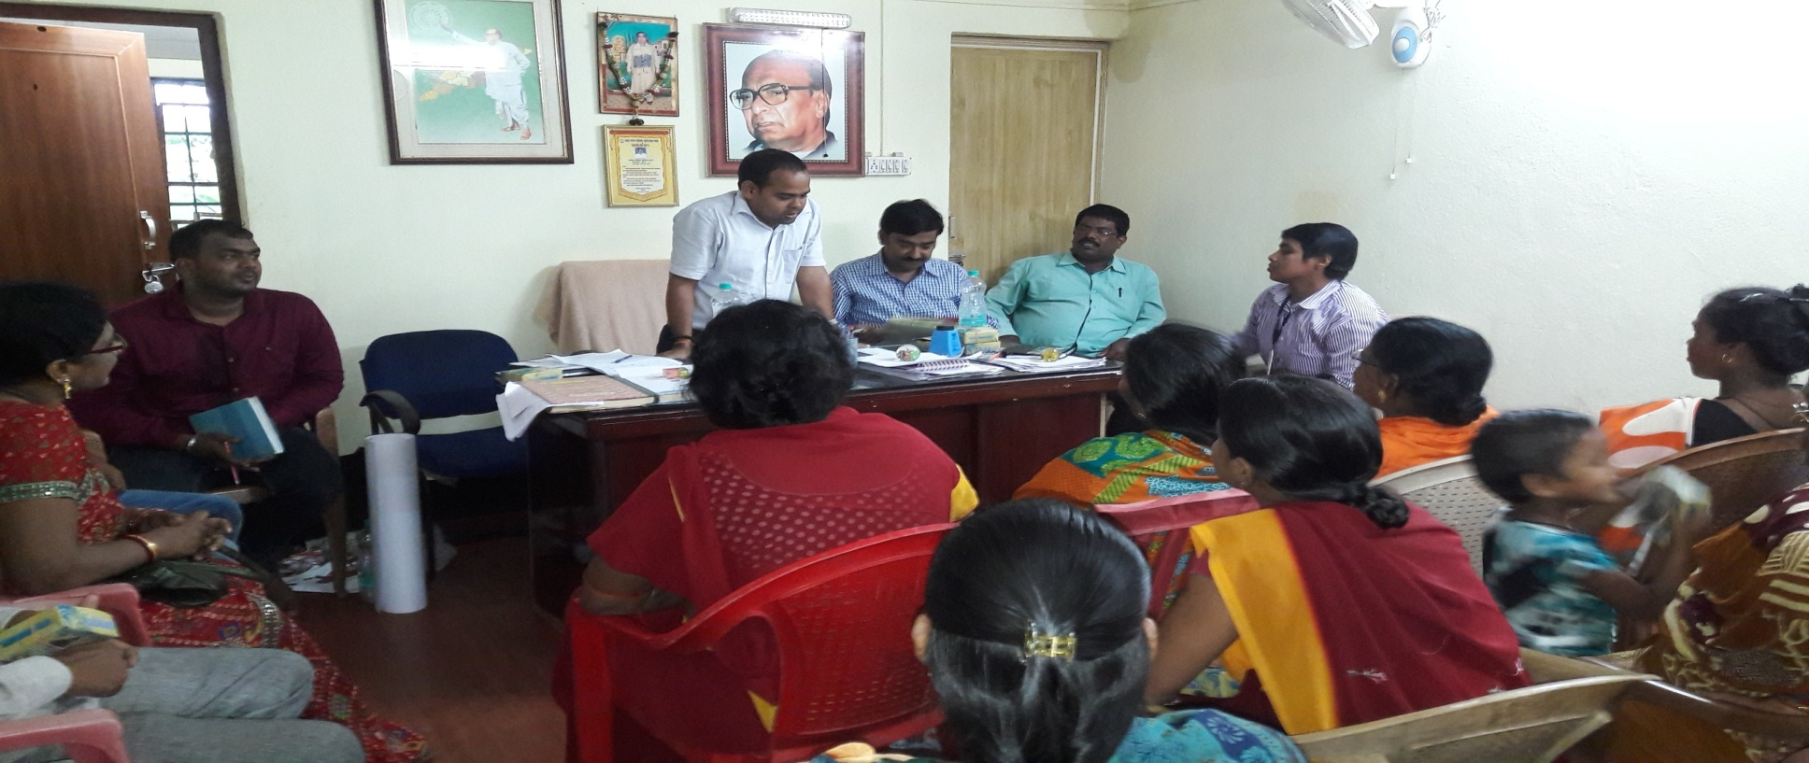
Piloting CAH in two cities
 | Bhubaneswar | Cuttack
Ward No | 12 | 33
Population covered | 13243 | 12543
No. of slums covered | 6 | 7
Slum Household covered | 1013 | 1167
Slum Population covered | 4743 | 8875
No. of MAS | 9 | 10
No. of UHND sites to be monitored | 4 | 6
No. of immunisatation sites to be monitored | 4 | 6
Name of the UPHC to be monitored | Gadakan | Thoria Sahi
Name of the Corporator | Sanjay Sethy | Manoj Sethy
Corporator in Bhubaneswar city sensitise the WKS & MAS members on community monitoring

Slide 11
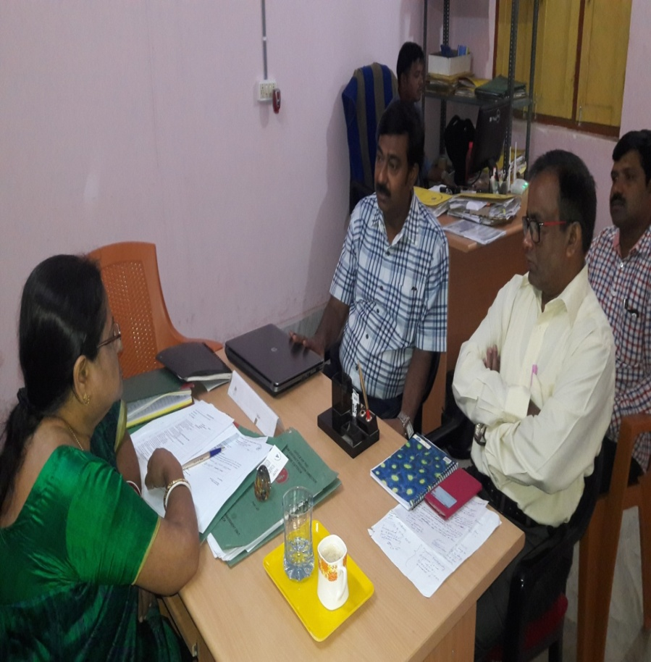
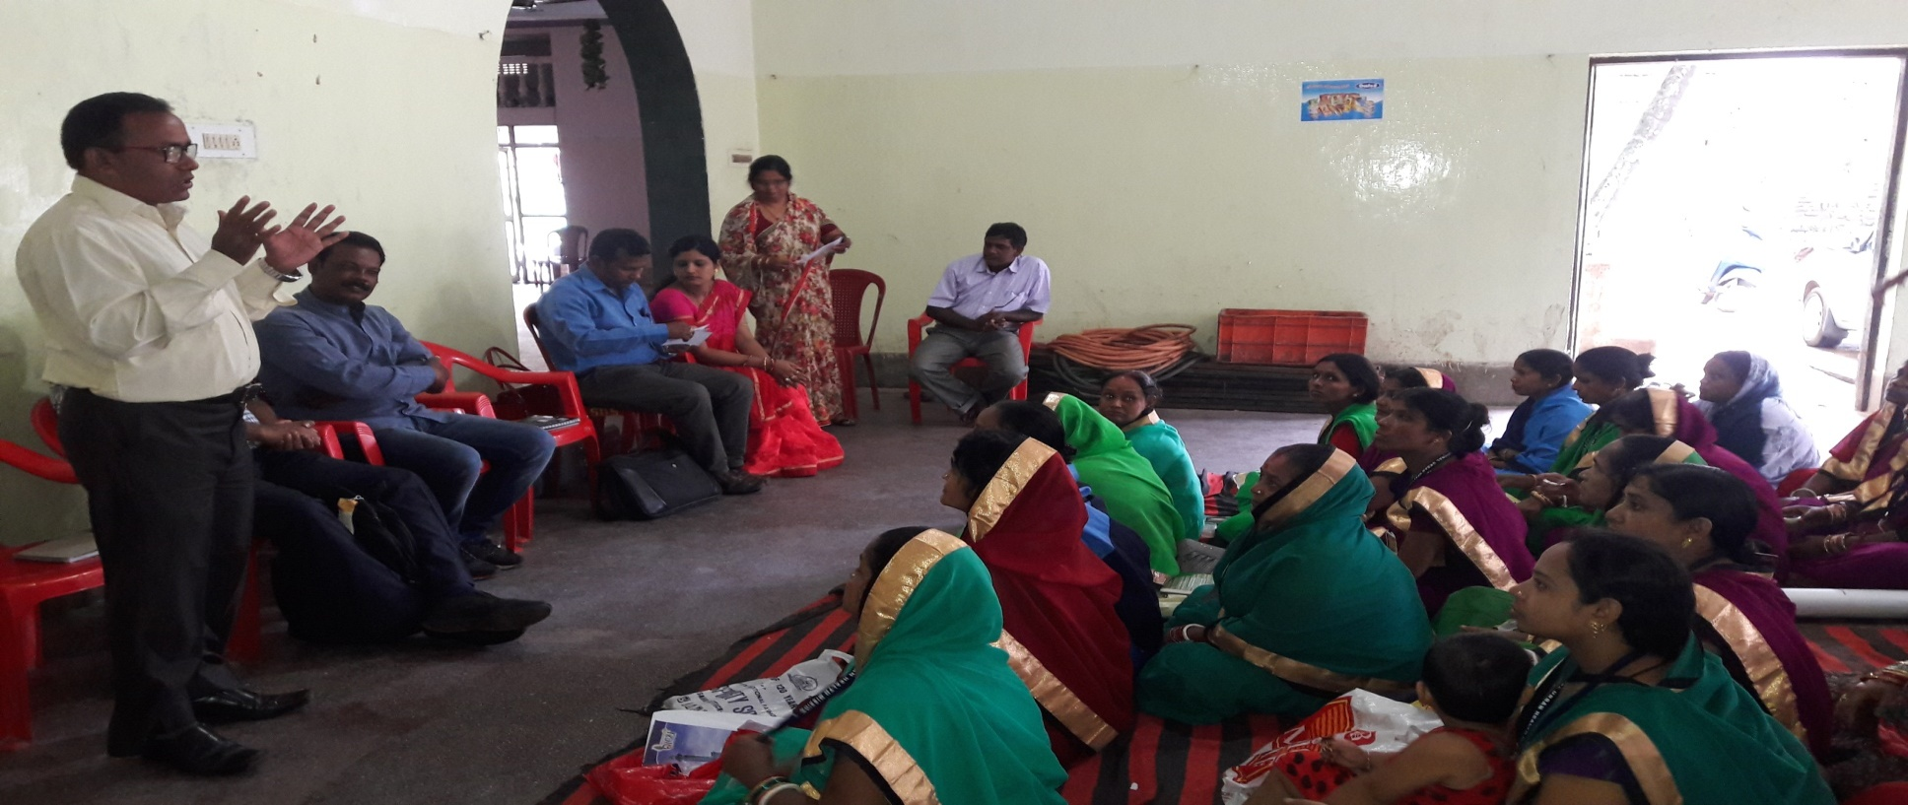
Interaction with City Nodal officer & MAS members
Program manager, AGCA, New Delhi interaction with City Nodal officer, Cuttack for planning of CAH in urban area
Sensitise the MAS members on their role and tools for community monitoring

Slide 12
Way forward...
Findings shall be shared in the meetings of CHS/RKS
Replication in other NUHM cities/towns
Proposal to be included in the PIP

Slide 13
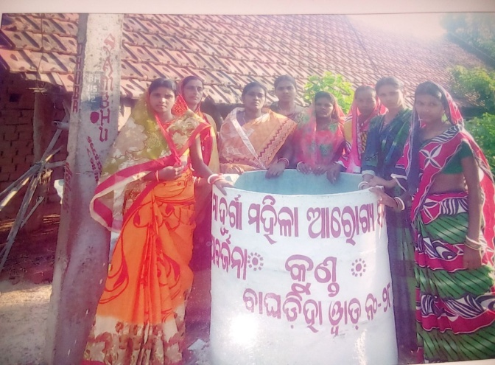
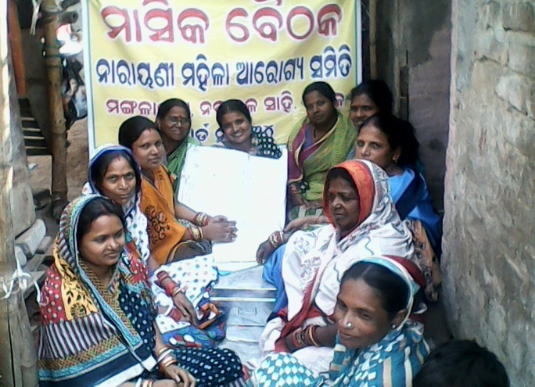
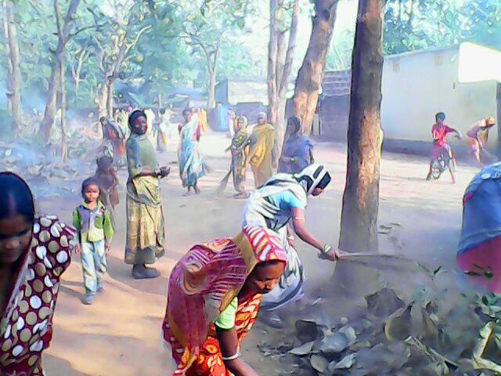
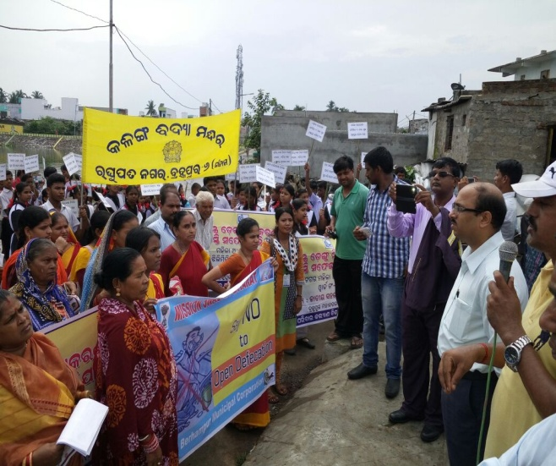
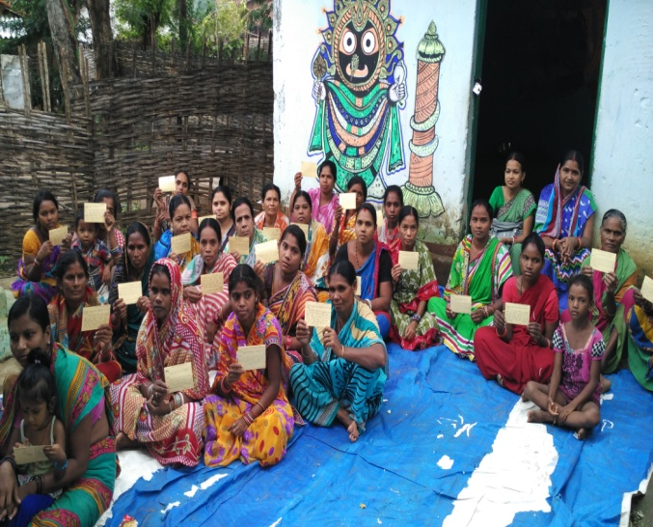
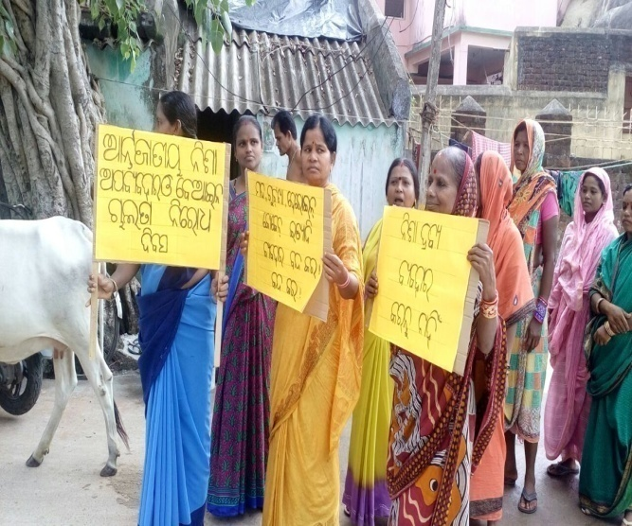
MAS Activities
Use of Dustbin
Monthly MAS meeting
Cleanliness Drive
Awareness Rally
Postcard Campaign
Padayatra

Slide 14
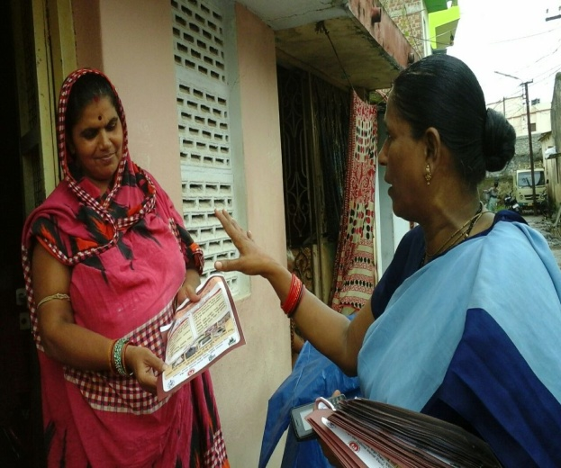
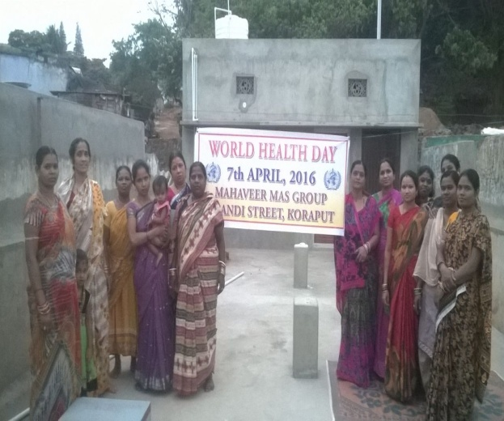
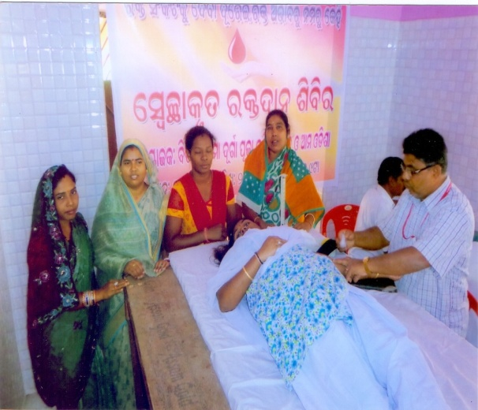
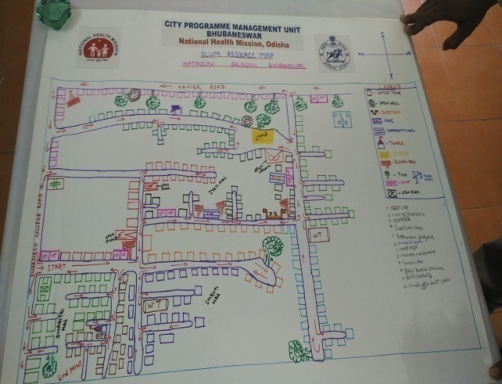
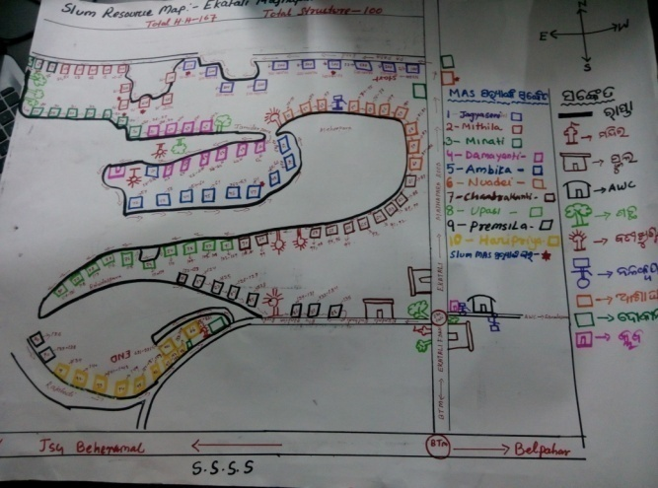
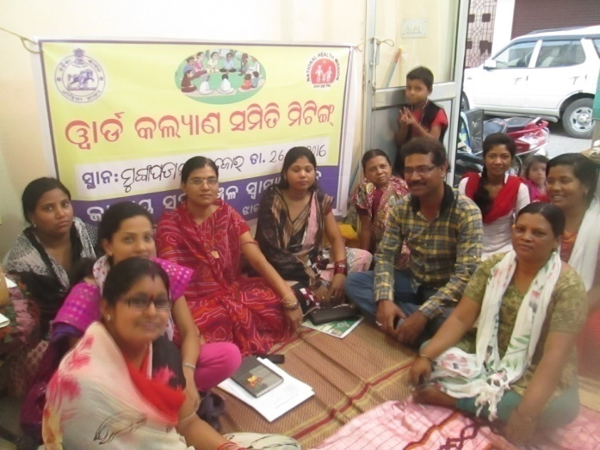
MAS Activities
IPC on Jaundice
World Health Day
Blood Donation Camp
Slum Resource Map
Listing of HH
Participation in WKS

Slide 15


