Slide 1

COMMUNITY ACTION FOR HEALTH
SIKKIM
Dr. M.L.Lepcha
ADHS cum NO.NHM
Sikkim
24.01.17

Slide 2
Demographic Profile Census 2001, 2011
INDICATORS | SIKKIM |  | INDIA
 | 2001 | 2011 | 2011
Population (lakhs) | 5,40,493 | 6,10,577 | 12,101.93
Decadal growth rate (%) | 33.06 | 12.36 | 17.64
Sex Ratio (Adult) | 875 | 890 | 940
Child Sex Ratio | 963 | 957 | 918
Literacy Rate (%): | 68.81 | 82.20 | 74.04

Slide 3
Health Facilities in Sikkim.
STATE LEVEL | STNM Hospital CRH Manipal
DISTRICT HOSPITALS | 4
COMMUNITY HEALTH CENTRES | 2
PRIMARY HEALTH CENTRES | 24
SUB CENTRES | 147
URBAN PHC | 1
URBAN HEALTH POST | 6

Slide 4
Progress Made By Sikkim In Health Care
INDICATORS | SOURCE | SIKKIM | INDIA
Crude Birth Rate | SRS 2015 | 17 | 20.8
Crude Death Rate | SRS 2015 | 5 | 6.5
Infant Mortality Rate | SRS 2015 | 18 | 37
Maternal Mortality Ratio | 2016-17 (Till 2ND quarter) | 9 (absolute no.) | 167(SRS 2015)
Total Fertility Rate (TFR) | NFHS IV(2015-16) | 1.2 | 2.3

Slide 5
Constitution & Composition of State AGCA/SMG
The state has reconstituted and expanded the existing ASHA Mentoring Group to Community Process Mentoring Group– and notification published on 05/1/17. It encompasses all four component of community process

Slide 6
Composition- State
Director General cum Secretary Chairperson
Mission Director Executive Chair person
SPO, RCH Member
Councilor, representative
from GMC Member
JD, ICDS Member
SPM ,NHM Member
State Facilitator RRC-NE Member
Ex. Director, VHA Member
President /Secretary, Rotary club Member
President Rotary, Inner wheel club Member
President /Secretary, Red cross Member
Nodal Officer Community Process Member secretary

Slide 7
District
Zilla Parished Representative Chairperson
CMO Ex. Chairperson
Line department and NGO Members
NGO representative Member Secretary
Block
Representative Zilla Panchayat Chairperson
Medical Officer Ex. Chairperson
Government Organization
Representative Member Secretary

Slide 8
Profile Community Process
ASHA | 666 *641 (ASHA) & 25 (LINK WORKER)
VHSNC | 641
RKS | 31
MAS | 15

Slide 9
Institutional Mechanism For Implementation Of The CAH
State Community Process Mentoring Group
District Community Process Mentoring Group
Block Community Process Mentoring Group
State ASHA trainers
District Coordinators
District trainers
Block coordinators
DPM /BPM
Nodal officer. Community Process
Councilors of Municipal corporation chairperson of MAS
ASHA,VHSNC,RKS

Slide 10
Approach To Key Processes Under CAH
  Awareness generation on entitlements:
  -ASHA, VHSNC,VHND,IEC,RKS.

Slide 11
Measures for strengthening VHSNCs/MAS
641 VHSNC constituted & operational Joint accounts opened for all VHSNC
Untied funds @ Rs. 10000 per VHSNC annually have been disbursed to all the 641
Members of VHSNCs have been imparted orientation training on NHM and community process
State is working towards giving ownership to make their respective ward healthy on all major health issues.
Selection of 15 number of MAS/UHNC has been completed

Slide 12
Strengthening of Rogi Kalyan Samiti, Planning and Monitoring Committees or equivalent:
RKS Training completed in three Districts,
North, West and East . South District RKS to be trained.
The trainings were conducted in conference Hall of District hospitals, Hotels,
One day training attended by Zilla Adakshya, DC, BDOs and other members.

Slide 13
  Community enquiry and Jan samwad and follow up action:
State level TOT was done in the year 2013-14
Community monitoring was taken up in the state in the year 2013-14.
Three District conducted the enquiry process and the Jan samwad in the year 2013-14.
In the year 2014-15 fund not approved for the same.
2015-16 Jan samwad approved but not conducted .
2016-17 fund for the same not approved.

Slide 14
Constraints In Community Monitoring
The NGO was not well equipped for conducting community monitoring further Capacity Building required.
Though the community is very well involved in the Health ,forming of monitoring committee and training them on their health rights and Government schemes required and capacity building required.

Slide 15
  Mechanisms To Address The Gaps Identified
Monthly meeting
Quarterly Review meeting
Monthly ASHA dewas
Monthly VHSNC meeting
Quarterly RKS meeting
Village Level meetings/Gram Sabha

Slide 16
  Grievance Redressal Mechanisms
Grievance Redressal Mechanism is present in all 4 district
The ASHAs are provided with the phone numbers of the MD, NHM and NO, NHM and in cases of problems they make a call directly to the MD and NO
District Level:
Five member committee in place at the District Health Society under the leadership of CMO .
2 member Representatives from NGO
2 member Representatives from Govt. (non health Sector)
1 member Nominee of CMO
suggestion/Complaint box installed in all facilities.

Slide 17
  Progress Under CAH As Per Approved
  Rop FY 2016-17
ASHA – 23 replaced ASHA given Round I training on HBNC 6th and 7th Module
Monthly VHSNC meeting
Quarterly RKS meeting

Slide 18
  Best Practices In Community Action
Community participation in Sikkim has brought about great changes in the health system
Home deliveries have been brought down to 1.4% in the state due to active participation of VHSNC and ASHA and community.
RKS committee have encouraged many private organisation for PPP and companies have donated in kind (example: Renovation of Maternity section at District Hospital Singtam.(NHPC), Inverters (Alkem), Ambulance, fridge etc (Golden Cross) at District and PHC.
Renovation and painting of Health facilities
Collection of fund from private donation , Household collection thereby increasing VHSNC funds.

Slide 19
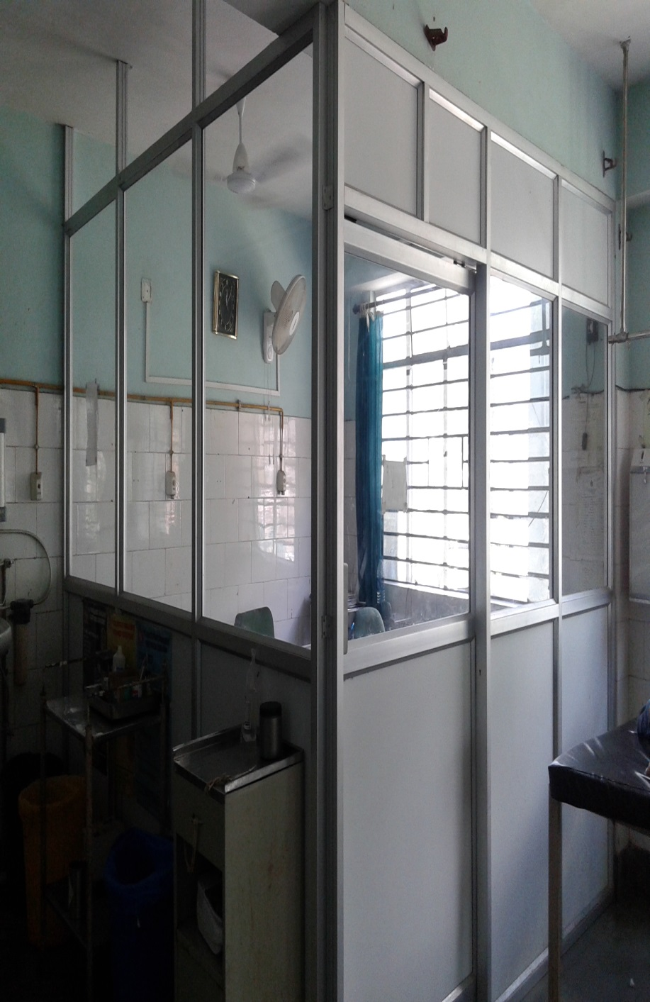
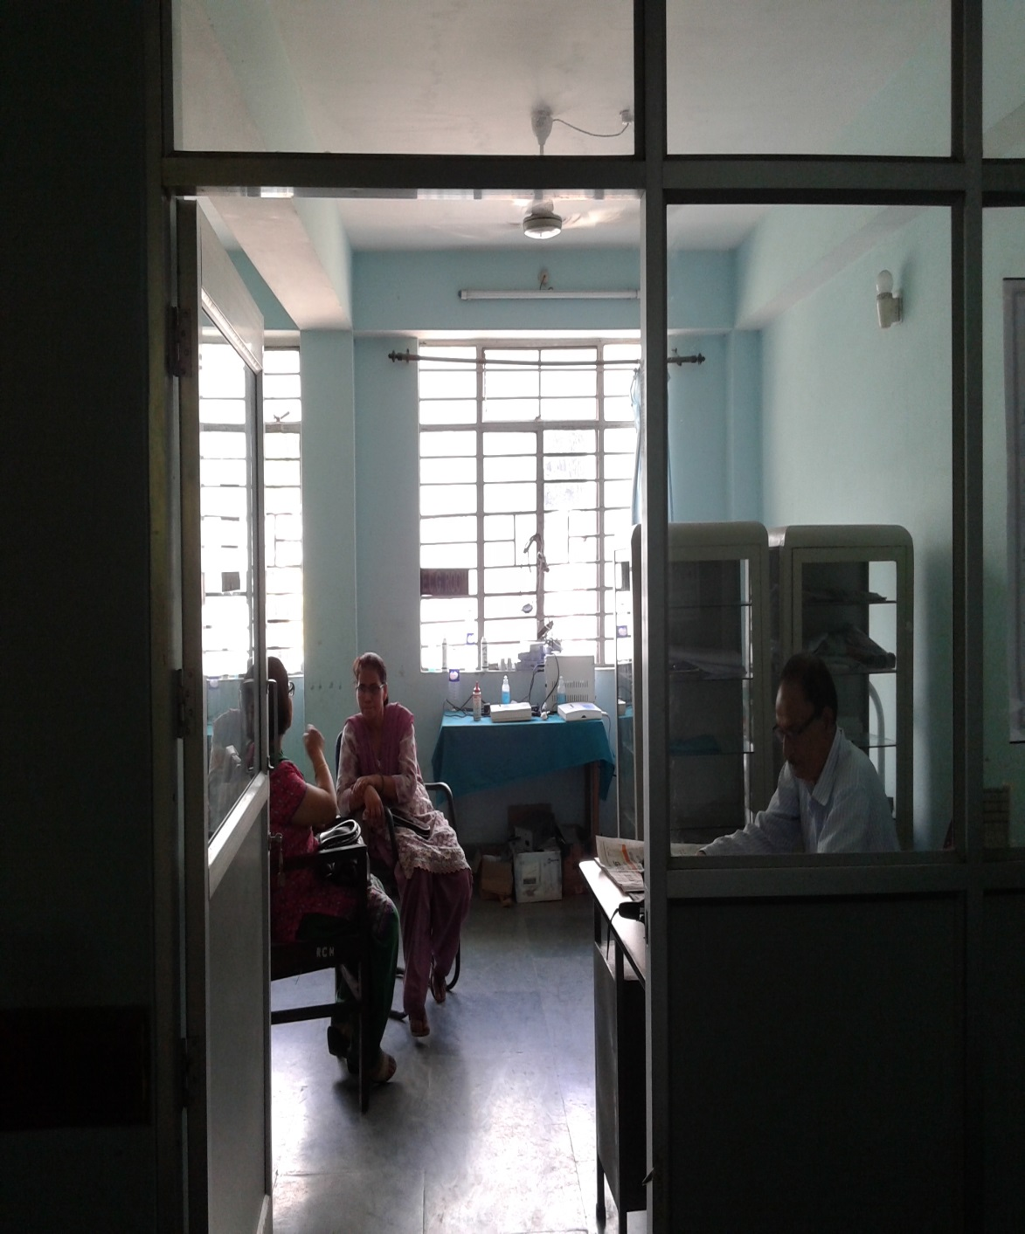
DOCTORS DUTY ROOM (TRAUMA SECTION)

Slide 20
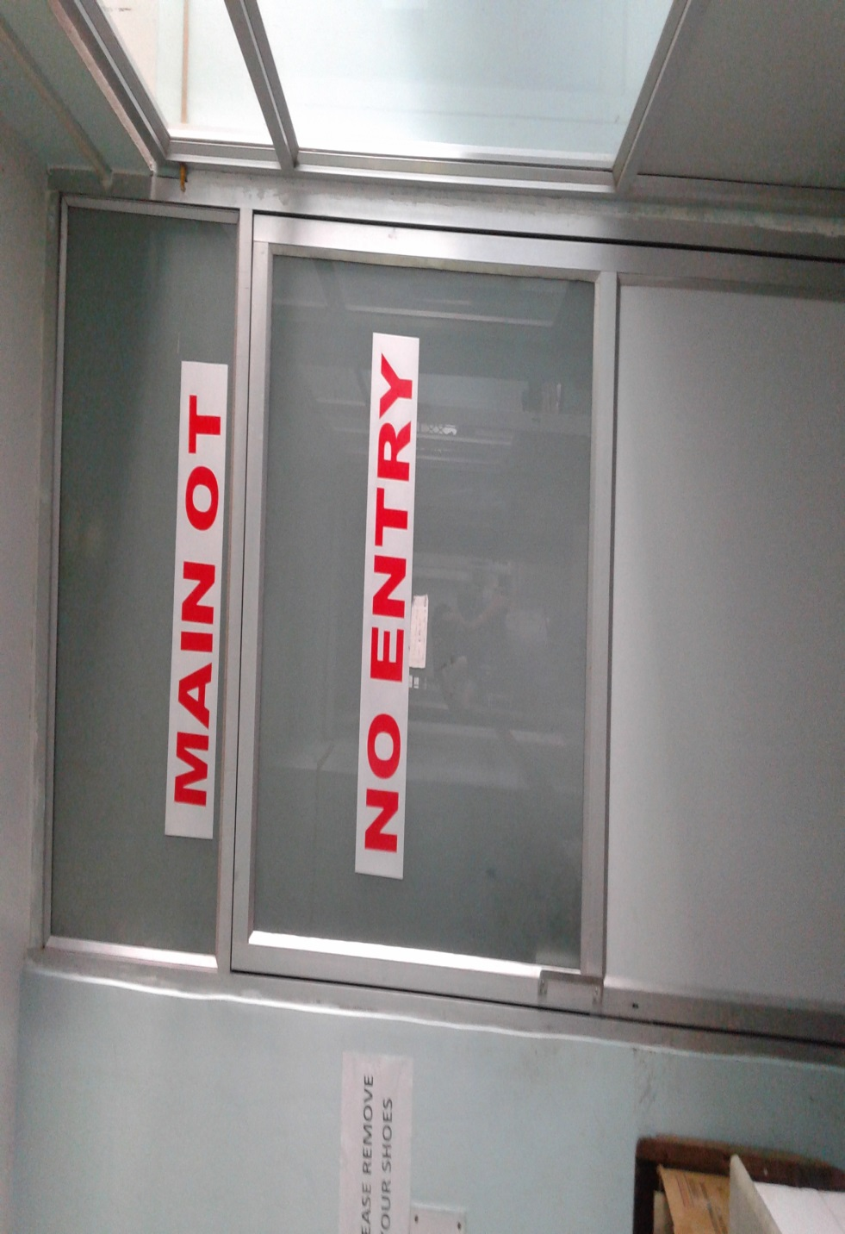
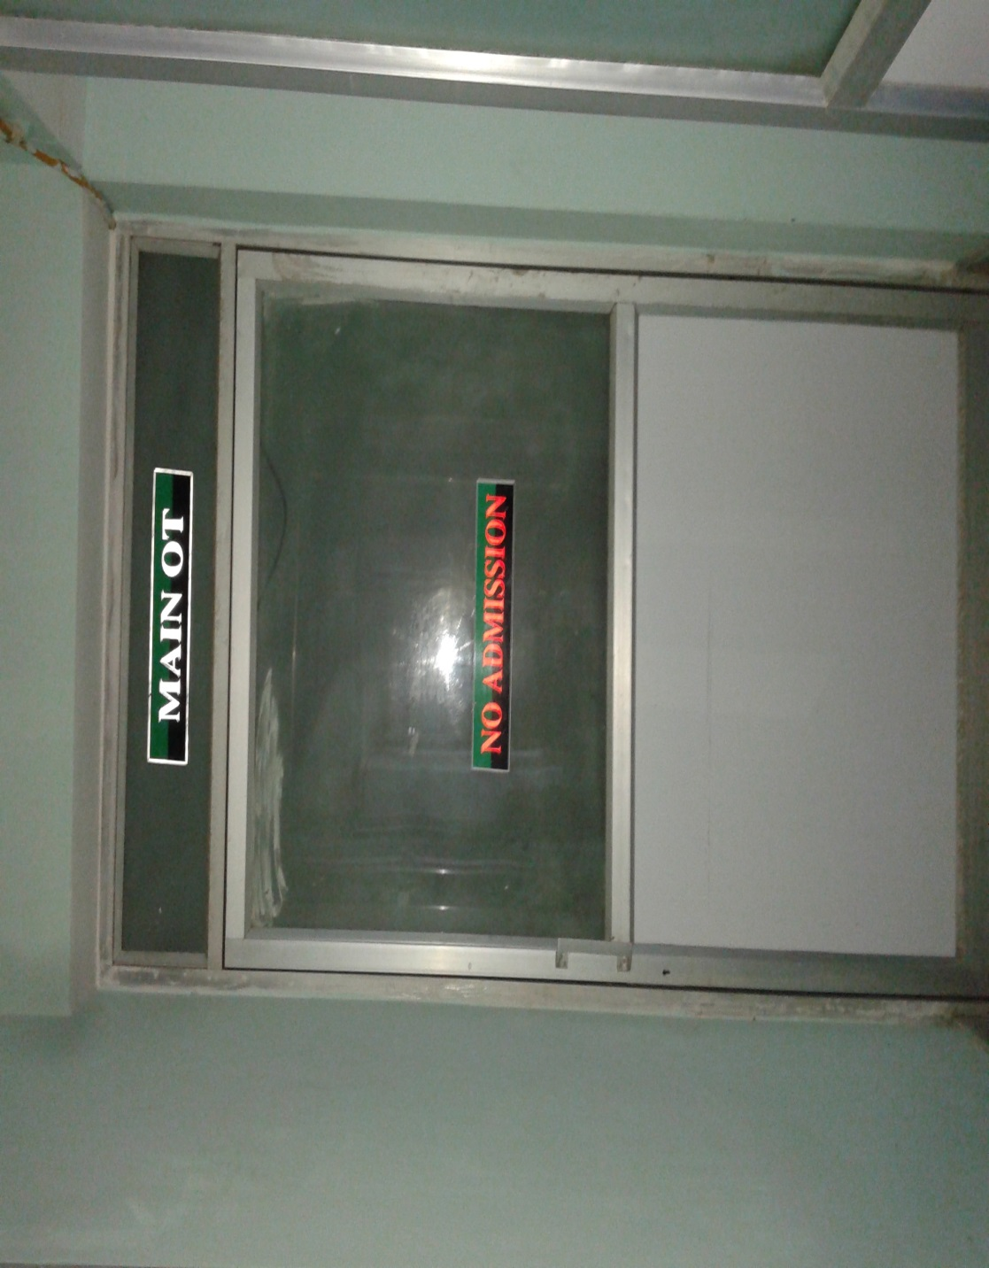
MAIN OT:

Slide 21
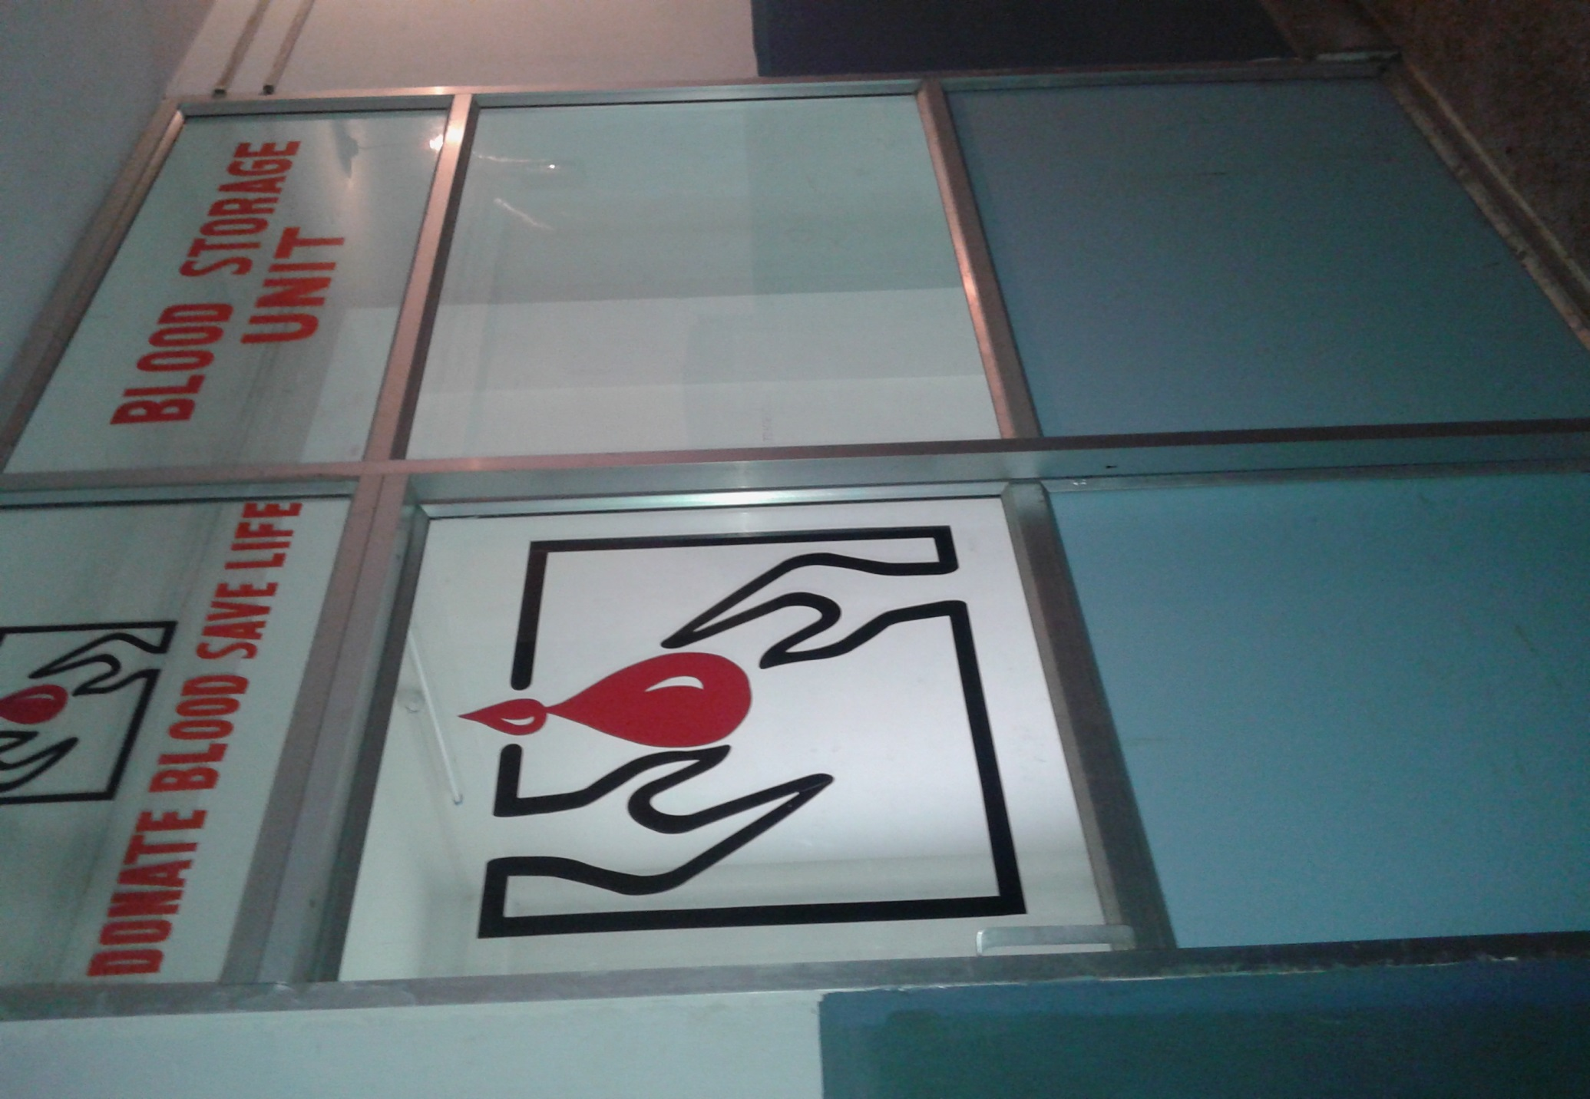
BLOOD STORAGE UNIT:

Slide 22
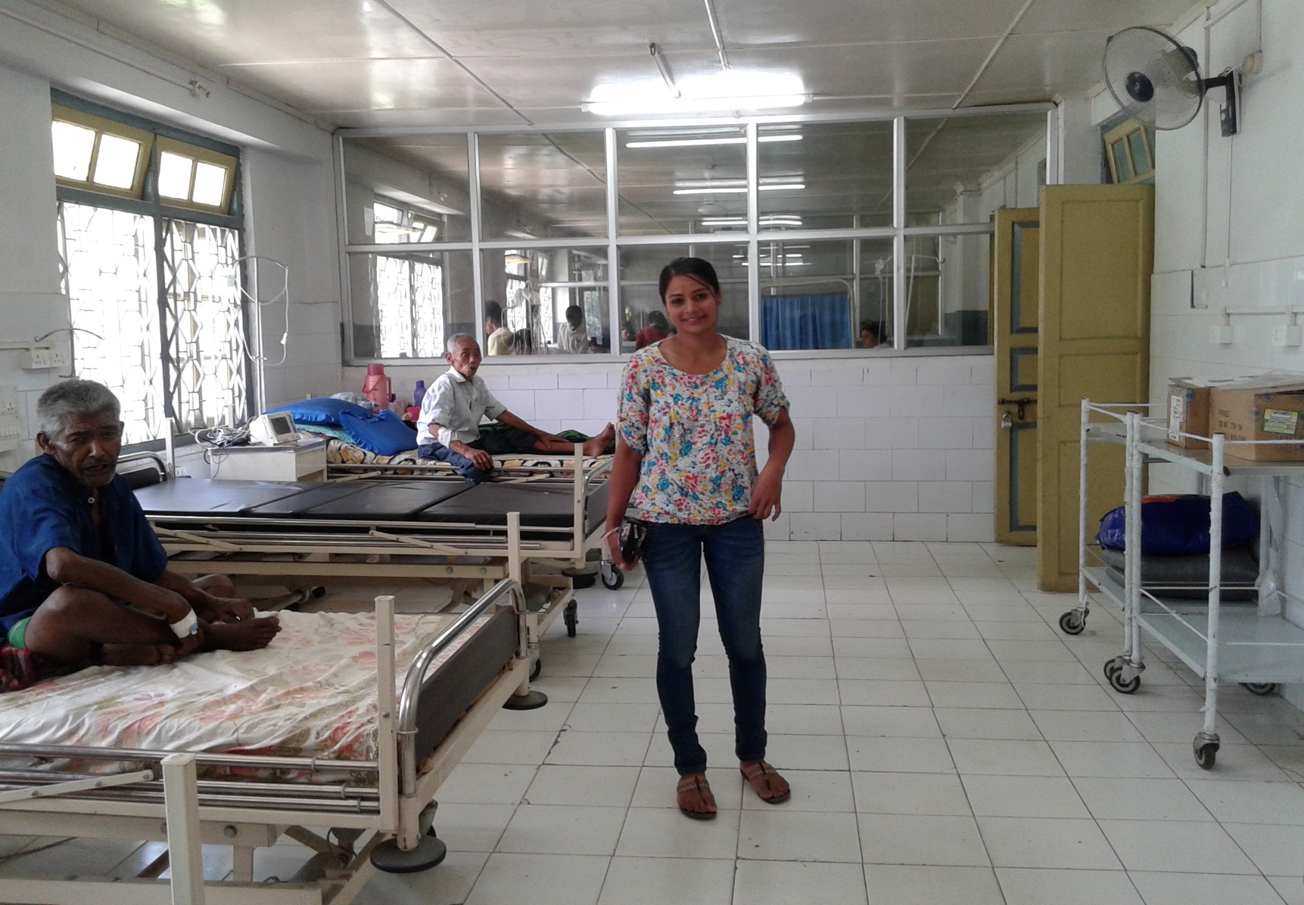
RENOVATION OF MALE MEDICAL WARD:

Slide 23
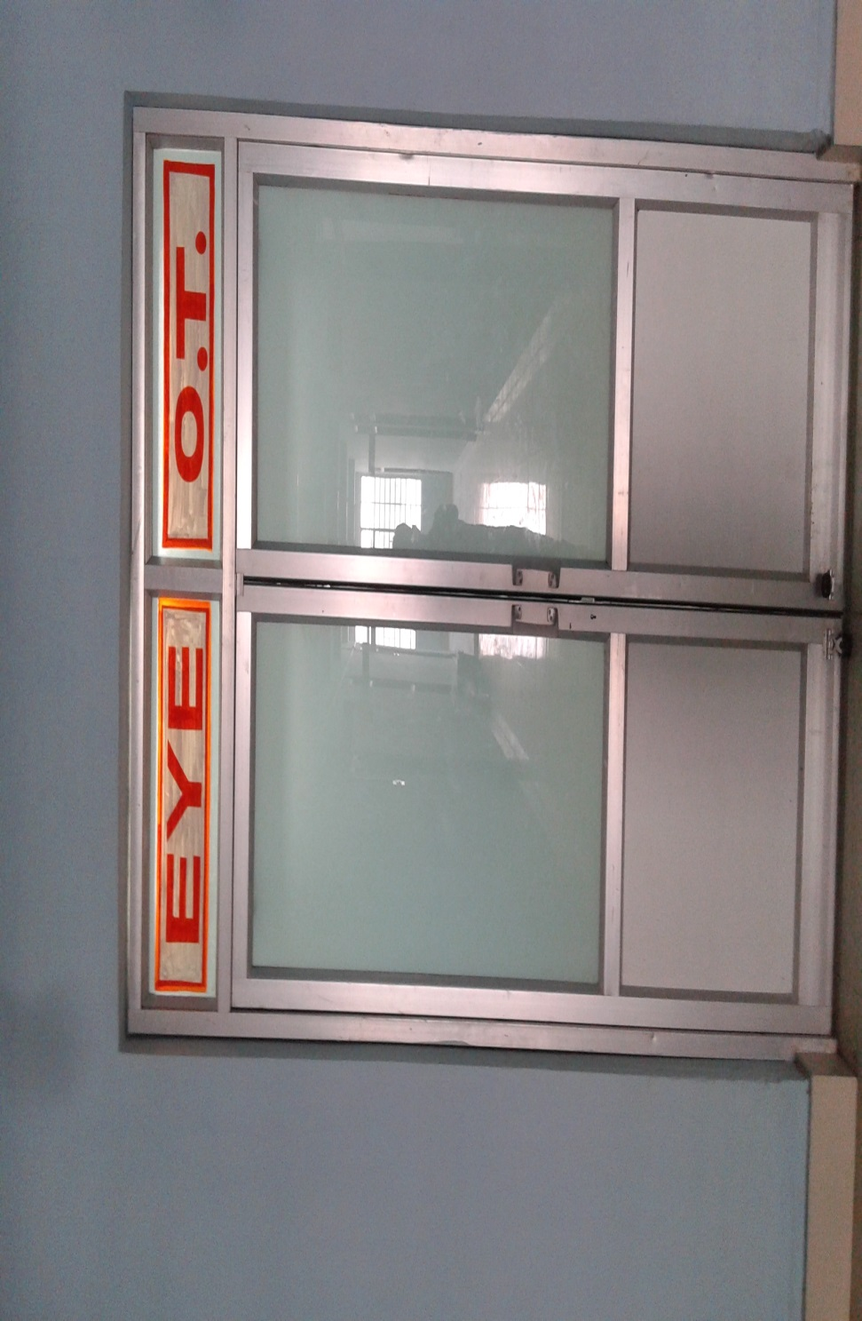
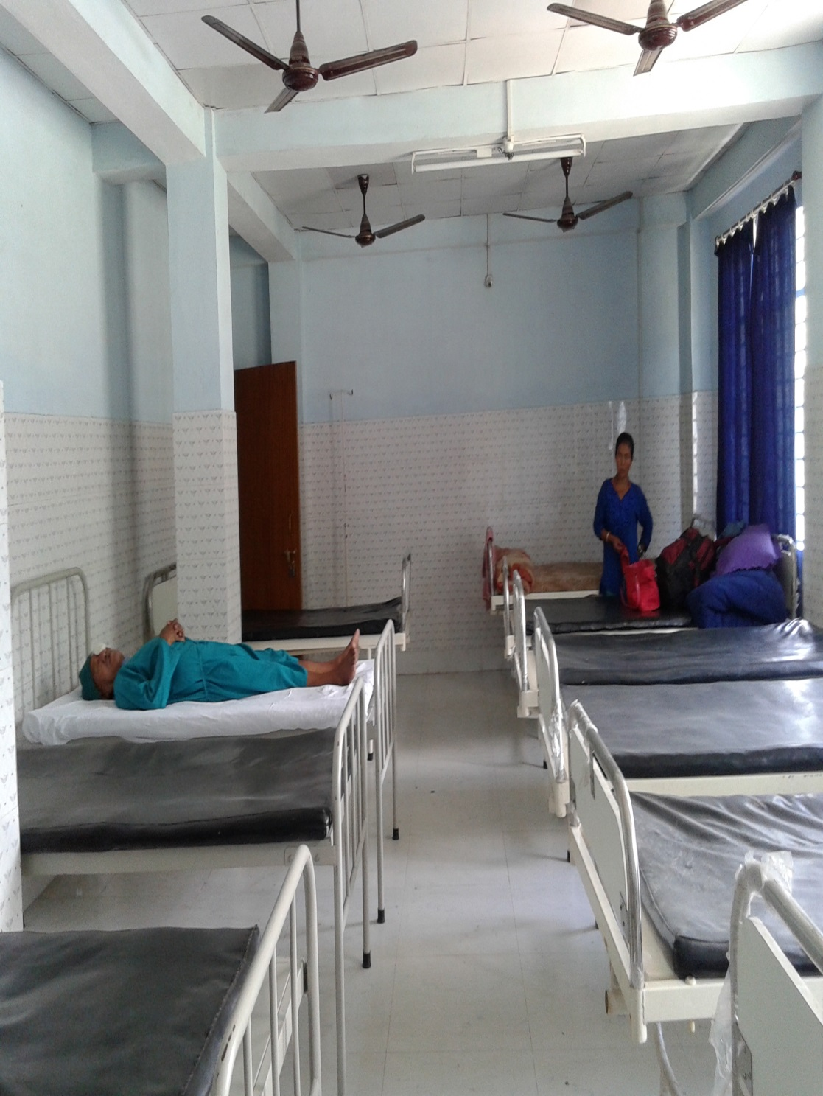
EARTHING OF EYE OT:

Slide 24

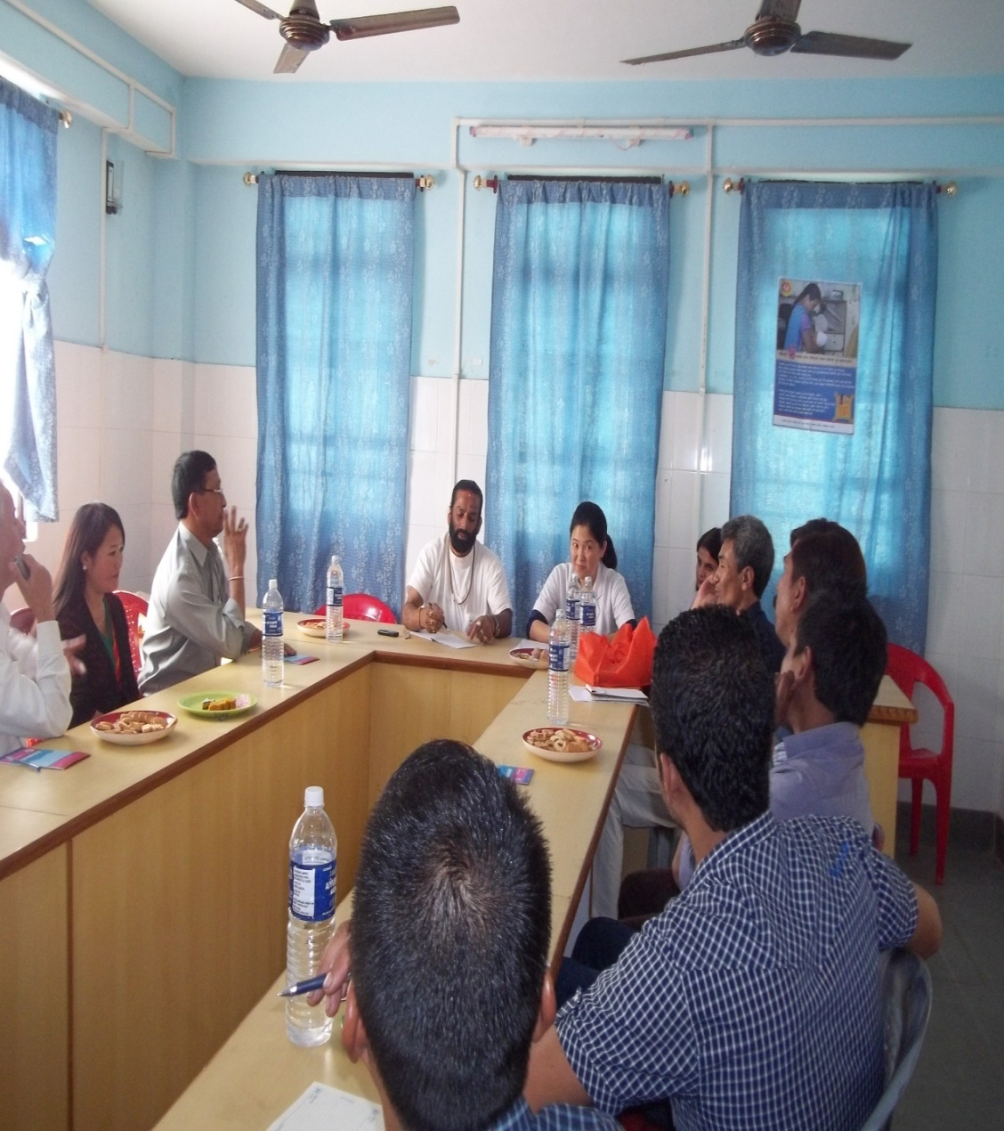
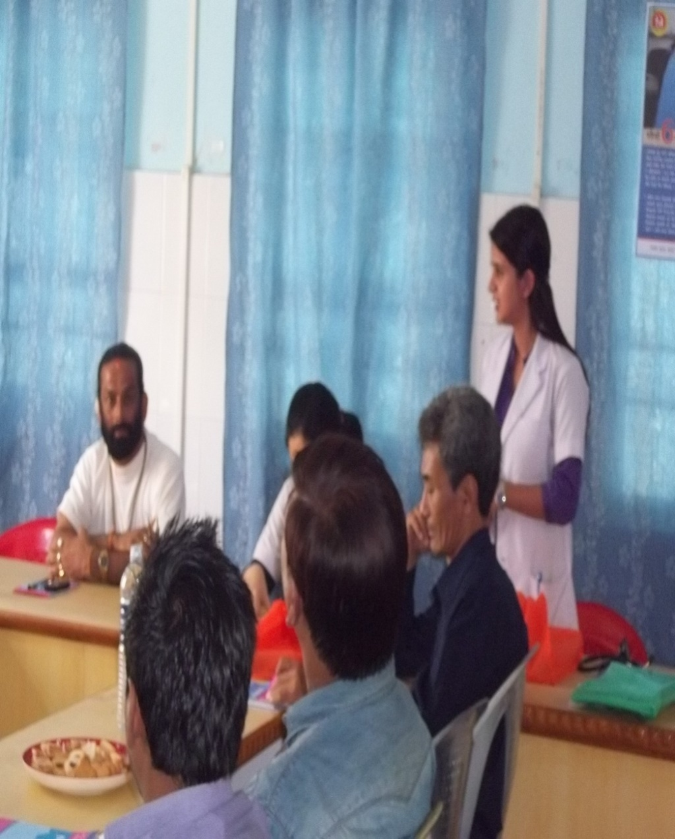
RKS MEETING

Slide 25
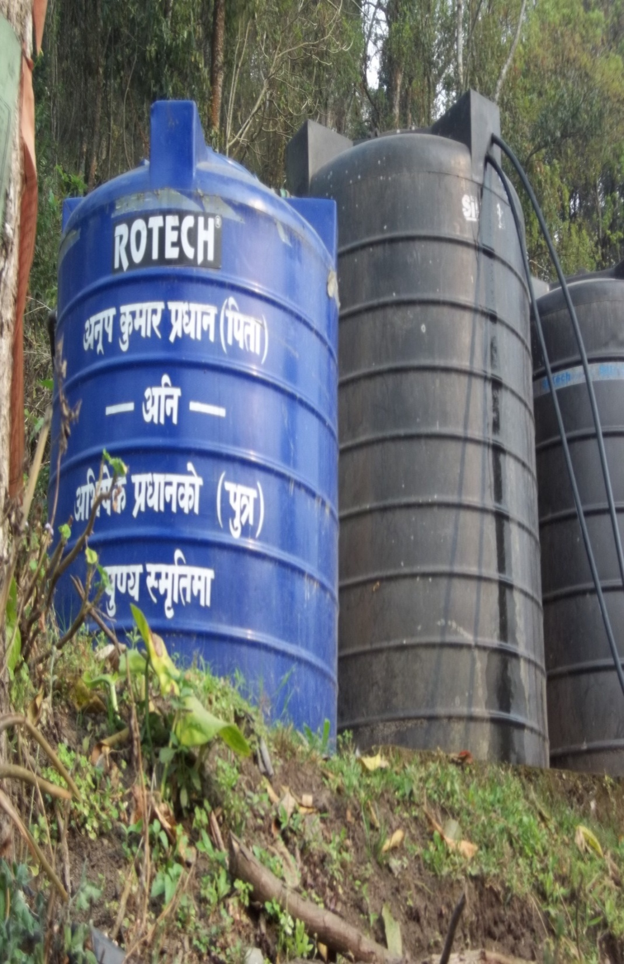
Gifted By MLA Cum Chief-whip, 20th Chujachen (2014)

Slide 26
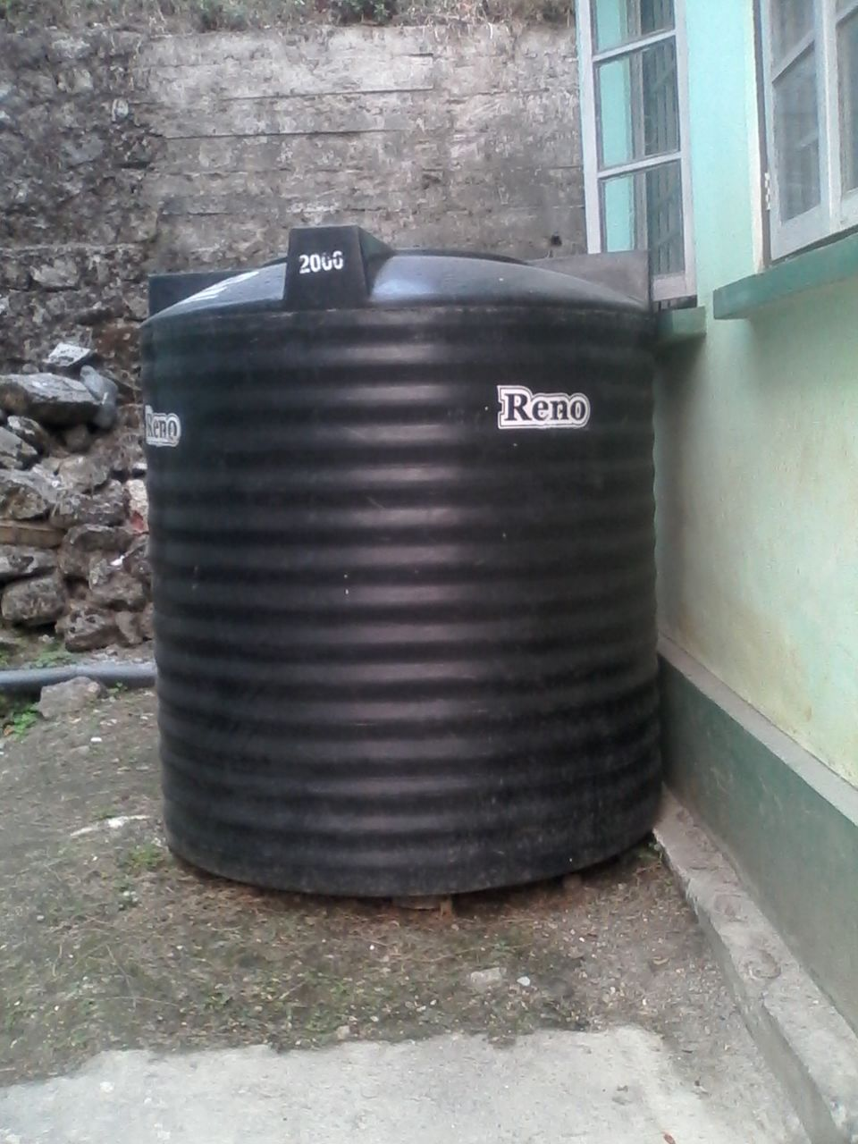

Slide 27
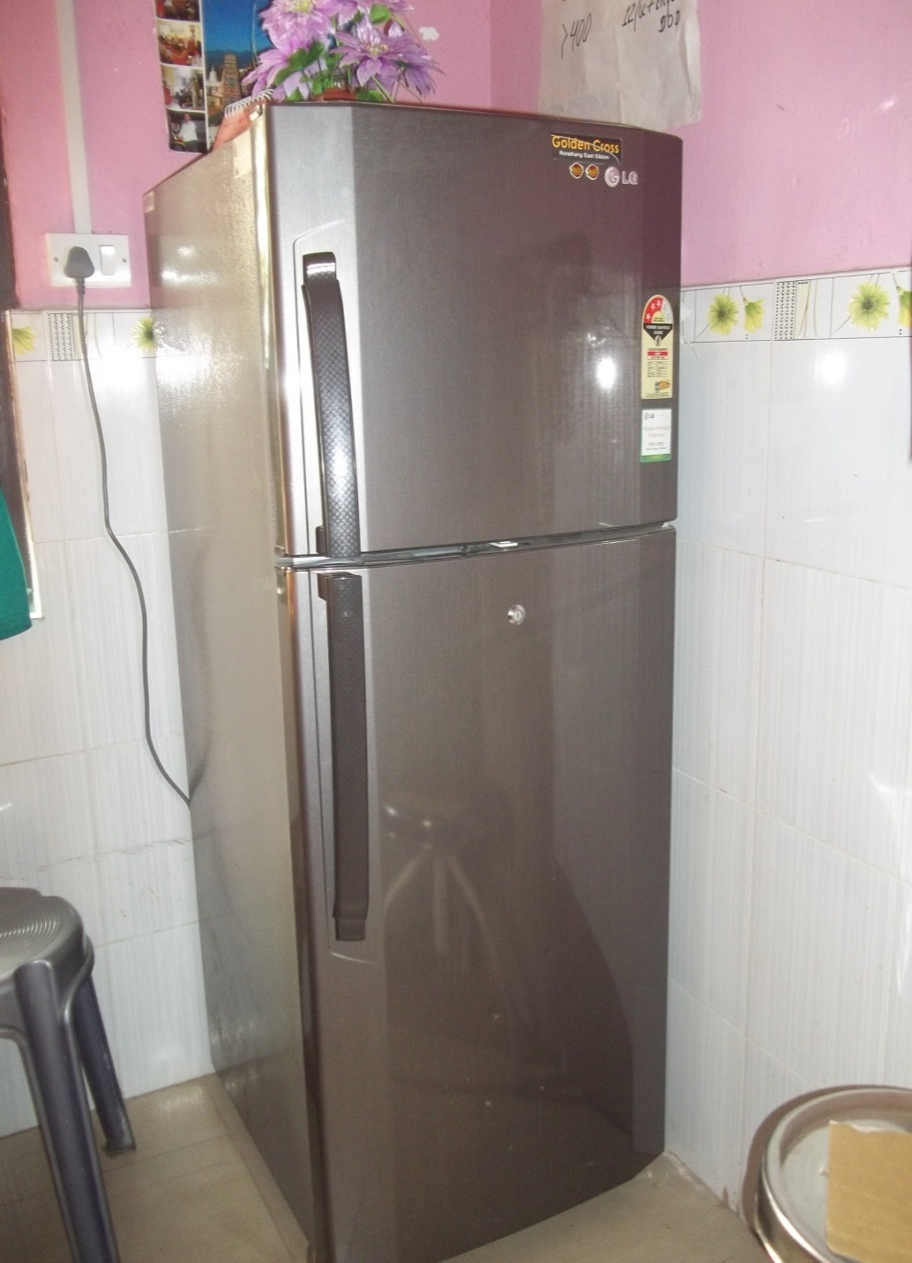
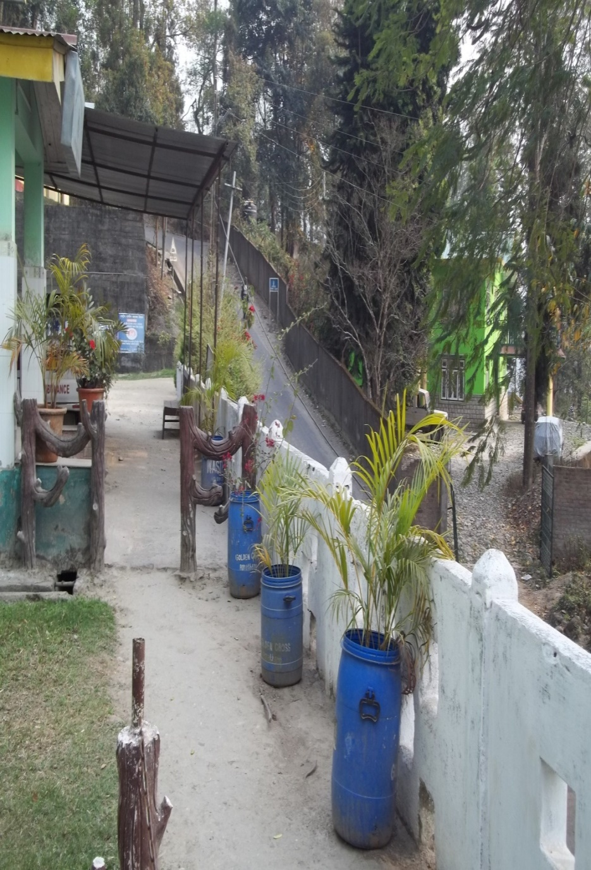
Donated By Golden Cross

Slide 28
  Status Of Fund Utilization In
  FY 2016-17
COMPONENT | FUND APPROVED (in lacs) | UTILISED
ASHA | 113.74 | 18.86
VHSNC | 64.10 | 56.6
RKS | 90
COMMUNITY MONITORING | 1.15 | 0

Slide 29
  Plans For Scaling Up In FY 2017-18
Certification of ASHA
Establishment of State training cum Resource Centre for community process

Slide 30
Issues and Challenges
Training Centre / Resource centre
Selection of ASHAs
Dedicated HR under Community Process in State and districts

Slide 31

THANK YOU

