Slide 1
Regional Consultations on Community Action for Health Mumbai
31st Jan – 1st Feb 2017.
Dr. Parul Goel, Nodal Officer
CAH & ASHA Programme NHM Uttarakhand

Slide 2
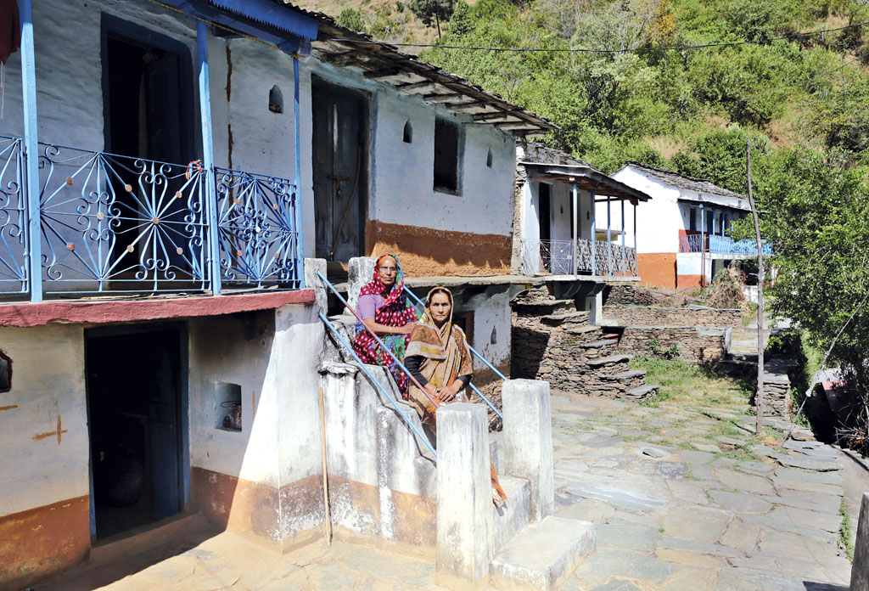
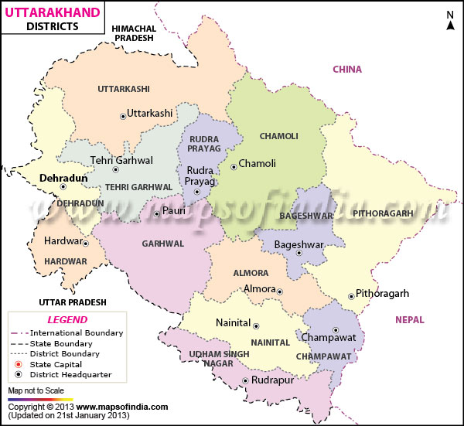
Uttarakhand map

Slide 3
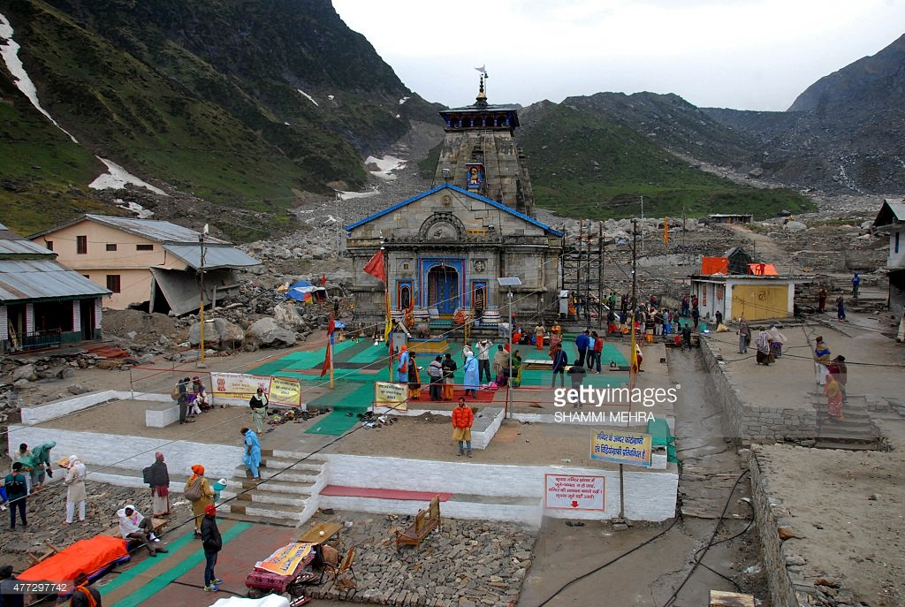
Demographic Profile of Uttarakhand
Uttarakhand Population (census 2011) 10,116,752
Number of District 13
Number of Block 95
Number of Revenue Village 14,625
Number of ASHA 11,086
Number of VHSNC 15,296
Number of Trained VHSNC 374

Slide 4
State level AGCA Structure of Uttarakhand
Health Minister President
Member of Vidhan Sabha Member
Principal Secretary of Health Member
Secretary of Health Chairman
Mission Director NHM Secretary & Convertor
Director General of Health Member
Director of NHM Member
Director of WCD Member
Director of Medical Education Member

Slide 5
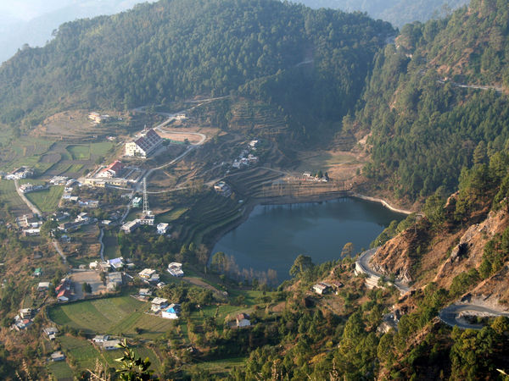
status of state level AGCA meeting
State AGCA first meeting was organized on 14th June 2016 at Secretariat of Uttarakhand. During the agenda discussion rollout plan for implementation of CAH Process of the state was done.
Mr. Daman Ahuja. Programme Manager AGCA, represented GOI in the meeting.

Slide 6
scale of implementation
District Level- The district level TOT under the CAH programme has commenced at district Haridwar, Almora Rudraprayag.
During the training the National & State level Trainers decided that all 03 district should make the plan as per schedule given below.
All the blocks should collect data from 01 PHC, 02 Sub Centers and 10 villages. The plan is being implemented in the above 3 districts.
The plan will also be implemented for the remaining 10 districts.

Slide 7
mechanism for implementation of the CAH
The CAH Programme has been undertaken by the Health & Family Welfare Society which is a part of the Health & Family Welfare Department of Uttarakhand.
At state, district & block level the existing staffs under ASHA Programme will be utilized in implementing the CAH Programme.

Slide 8
Progress under CAH as per approved RoP FY 2016-17
State Level - District level TOT has been completed at the District Haridwar, Almora & Rudraprayag.
The State has decided that TOT of remaining 10 districts will bee organized at the State Level.
Block Level – One day orientation workshop of ASHA facilitator has been completed at district Haridwar, Almora, & Rudraprayag.

Slide 9
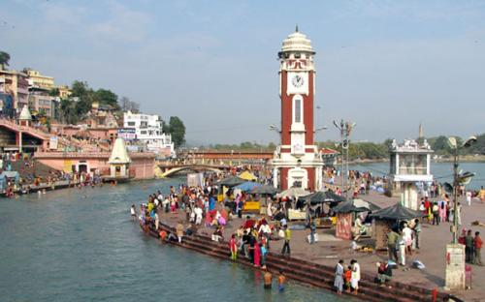
status of fund utilization in fy 2016-17
TOT of State level under the 10 district has been completed in the last week of January 2017.
TOT of district level will be done in the second week of February 2017.
Data collection process will be done last week of February 2017.
Jansamwad process will be done month of March 2017.

Slide 10
plans for scaling up in FY 2017-18
All VHSNC concerned members will be trained.
State level refresher training will be organized.
Exposure visits of concerned staffs to best performing State under CAH Programme.
Printing of guidelines & community enquiry tools for further training of staffs.
Jansamwad will be organized at all district and block level.

Slide 11
THANK YOU
THANK YOU

