Slide 1
NATIONAL HEALTH MISSION – MADHYA PRADESH
COMMUNITY ACTION OF HEALTH
January 31 – February 1, 2017
Young Men Christian Association (YMCA)
Mumbai - Maharashtra

Slide 2
Constitution of Mentoring Group for Community Action in MP
Advisory Group for Community Action were constituted in 2007
ASHA Mentoring Group were formed in 8th Oct 2008.
State ASHA Mentoring Group and Advisory Group for Community Action is merged and renamed as Mentoring Group for Community Action in 22nd October2010 because majority of civic societies members were same in both group & they work on same goals and objectives.
MD NHM took decision in 1st State level meeting that MGCA will work at 51 Districts and 313 Block level also.
Voluntary Structure with involvement of CBO supporting communitization process to reduce MMR, IMR, TFR etc.

Slide 3
Goal for Community Action of Health
Establishment of Planning & Monitoring committees at Blocks, Districts & State involving MGCA members from civil societies & PRI members.
Establishment of Grievance Redressal Mechanism through above committees
Ensure the access, quality, demand/needs, denial and negligence of health care services (Drugs, Diet and Diagnostics) at Public Health facilities

Slide 4
COMPOSITION of MGCA - PLANNING AND MONITRING COMMITTEES
Composition | State (55 members) | District ( 175 members) | Block ( 717 members)
Chair person | MD, NHM MP Bhopal | District CMHO | Block Medical officer
Secretary | DD ASHA | DCM / ( if not than DPM) | BCM (if not than BPM)
Special Invitee | PS, Health commissioner, JD & DD of Health & FW | Zila Panchayat member of sub health committee
Members | Director NHM | MCH Coordinator/ NRC in charge
 | State Community Mobilizer consultant | State ASHA cell consultant | DCM
Representative | NHSRC, New Delhi | District Awarded ASHA - 2 | Block Awarded ASHA -2
 | AGCA and ARC New Delhi | State MGCA- 2 members | Self help Groups
 | Panchayat, WCD & Education Dept | Panchayat, WCD & Education Dept | Panchayat, WCD & Education Dept
 | Donor Partners in health | NGO s (health) – 3 member | 3 NGO field workers
 | PSM dept. Govt. Med. Coll. | VHSNC – 2 members
 | Departments of Sociology & Regional planning

Slide 5
Frequency of the State MGCA (AGCA/SMG) meetings during FY 2016-17
* Bhind, Chhindwara, Badwani, Sidhi, Betul, Agar and Chattarpur
 | Meetings | Frequency | Workshops
State | State Planning & monitoring committees meeting with MGCA | Biannually planned 01 achieved | 2 workshop
Districts | One day Districts Planning & monitoring committees meeting with MGCA & line dept | Biannual a total of 102 planned out of which 35 finished | 44 workshops
Blocks | One day Blocks Planning & monitoring committees meeting with MGCA | Biannual a total of 626 planned out of which 368 achieved
 |  | 21 Trainings for 7 districts Data collection & Jan -samwad | Out 21 blocks in 15 completed

Slide 6
Scale up of CAH in MP

Slide 7
Strategy of CAH for yr 2016-17
State has initiated the activities in year 2013-14 and continue to do so through NGOs and MGCA partners to improve the state health services.
In MP it is planned in two ways for 2016 -17
7 Districts – Bhind, Chhindwara, Betul, Sidhi, Badwani, Chattarpur and Agar
Intervention | Districts | Blocks | PHCs | VHSNCs
Intensive | 05+02=07 | 21 | 63 | 315
Non-Intensive | 44 | 292 | - | 49252
Total | 51 | 313 | 63 | 49567

Slide 8
Community Action of Health Process
CAH
State TOT & WS
facilitation, visioning planning exercise , tool development
District Workshops strengthening capacities of stakeholders on implementation process
Block workshops for trainings of tools , community process to VHSNC & MGCA members
Data Collections in villages
Compilation & Report card generation at states
Jan Samwad
Action taken report
Sharing of reports at village levels

Slide 9
Institutional mechanism for implementation of the CAH
Voluntary structure
SMGCA
DHS
DH/CH
NHM
ASHA Cell
DMGCA
DPMU
CHC
CAH- MP
Levels
State
District
BPMU
BMGCA
Block
PHC
Village
VHSNC
Convergence of stakeholders especially PRIs, ICDS , civic societies etc.

Slide 10
COMMUNITY ACTION FOR HEALTH – 2015-17)
District level workshop
(Block MGCA
line department)
Chhindwara
Data collection
45 villages
Block level workshop -3
(PHC committee + VHSNCs)
Sidhi
District level workshop
(Block MGCA+
line department)
Block level workshop -3
(PHC committee +VHSNCs )
Data collection
in 45 ivillages
Betul
District level workshop
(Block MGCA+
line department)
Block level workshop -3
(PHC committee + VHSNCs)
Data collection
In 45 villages
District level workshop
(Block MGCA+
line department)
Block level workshop 3
(PHC committee +VHSNCs)
Data collection
in 45 villages
Barwani
District level workshop
(Block MGCA+
line department)
Block level workshop - 3
(PHC committee +VHSNCs)
Data collection
in 45 villages
Bhind
3 Jan Samwad
Tamia
Parasia
Junnardeo
3 jansamwad
Sehra
Bhimpur
Bhaisdehi
3 jan samwad
Majohli
Semariya
kusmi
3 jansamwad
Pati
Silawad
Niwali
3 jansamwad
Gohad
Mehgoan
foop
CAH
State level workshop (4)
Non Intensive 292 blocks of 51 District
1-CMHOs (22),2.- DCMs(42),
3 - MGCA & Div CM, 4.-DPM (38)
State level ToT
Intensive 15 blocks of 5 Districts Participants-38

Slide 11
Indicators |  | GREEN | YELLOW | RED
ASHA Support Services |  | 134 | 90 | 1
MH-ANC |  | 209 | 16 | 0
MH-Deliveries |  | 162 | 59 | 4
MH-Diagnosis & JSSK Services |  | 160 | 56 | 9
Perception of ASHA for MH |  | 155 | 67 | 3
Adolescent Health Services |  | 94 | 109 | 22
Quality of Care in Health Services |  | 78 | 146 | 1
VHSNC FUNCTIONING |  | 51 | 109 | 65
Behavior & Co-operations OF Health personnel |  | 162 | 62 | 1
ICDS-Nutritional Gurantee |  | 157 | 59 | 9
ICDS-G rowth Monitoring |  | 124 | 92 | 9
ICDS-Refferal Services |  | 175 | 37 | 13
ICDS-Other Services |  | 182 | 36 | 7
ICDS-Community Participation |  | 75 | 110 | 40
ICDS-Discrimination |  | 116 | 13 | 96
Child Health Services |  | 154 | 69 | 2

Slide 12
Report Card Generation

Slide 13
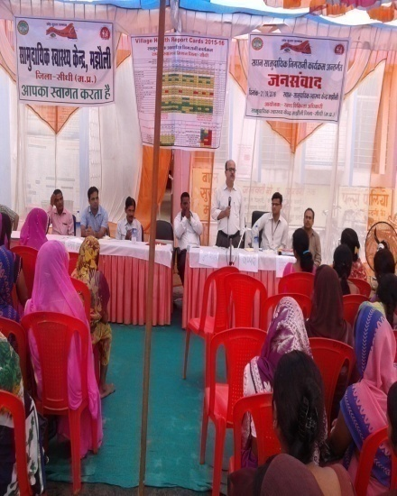
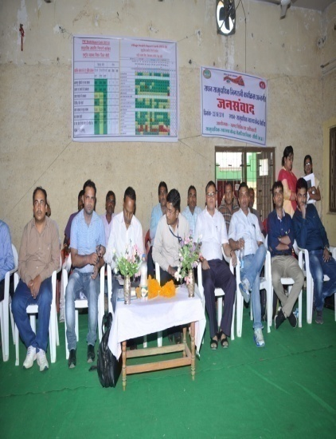
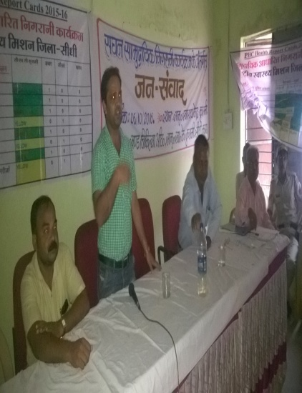
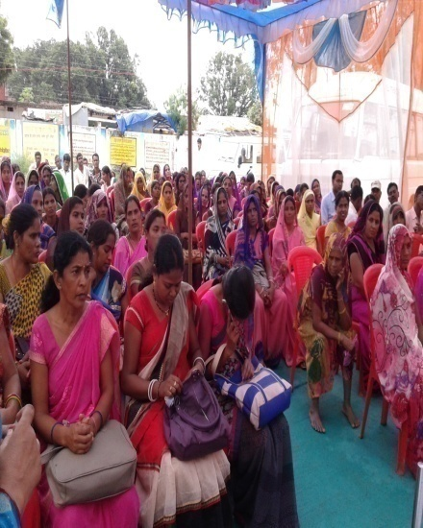
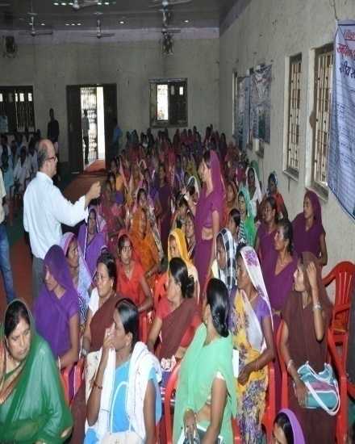
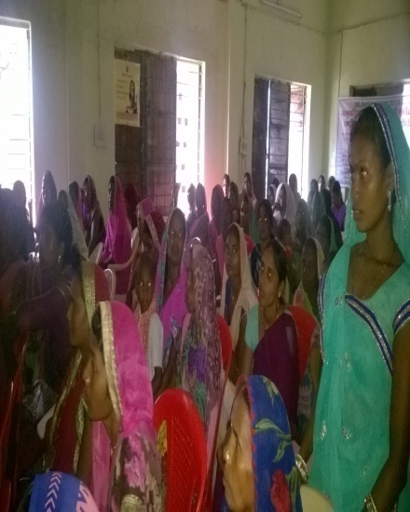
Jan Samwad Sidhi
Majholi -29-09-2016
Semariya- 23-09-2016
Kusmi - 22-09-2016

Slide 14
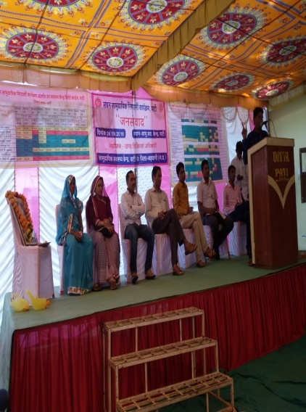
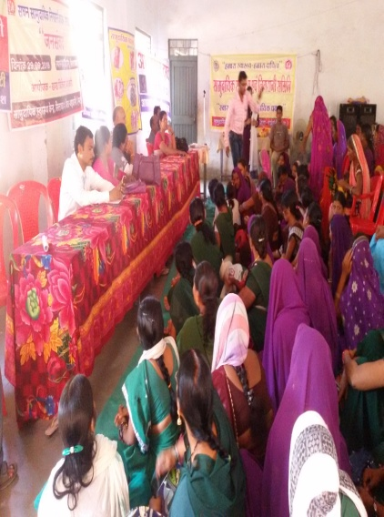
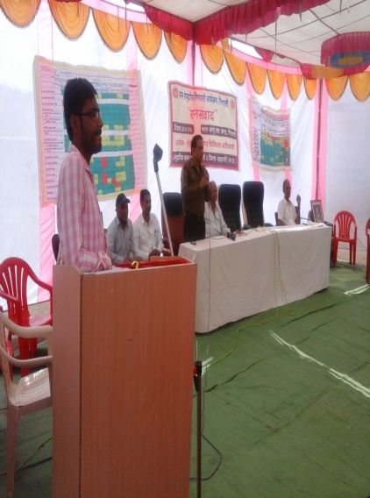
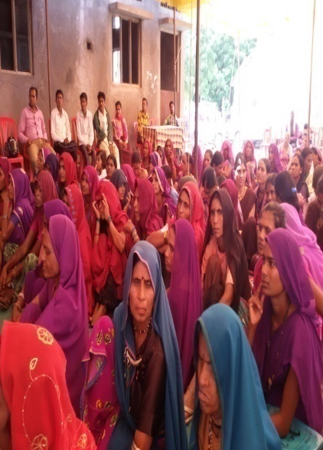
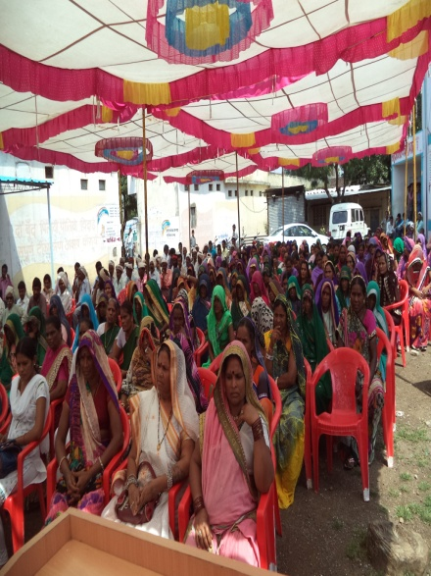
Jan Samwad Badwani
Pati 24-09-2016
Silawad 29-09-2016
Niwali - 28-09-2016

Slide 15
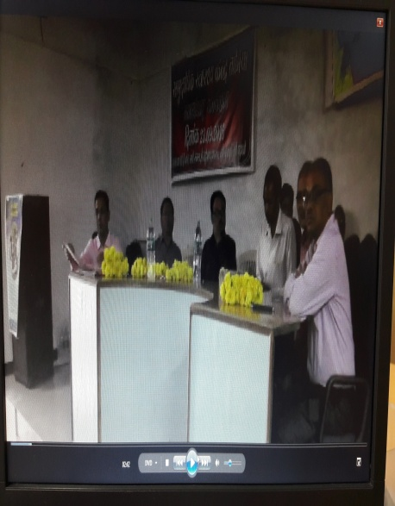
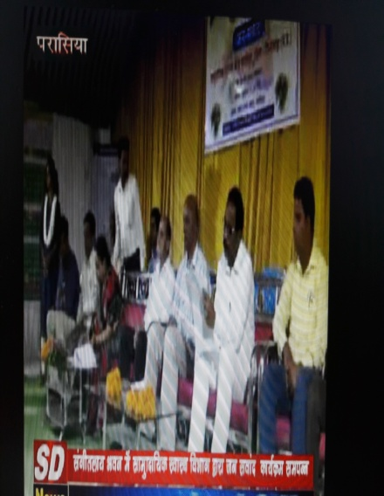
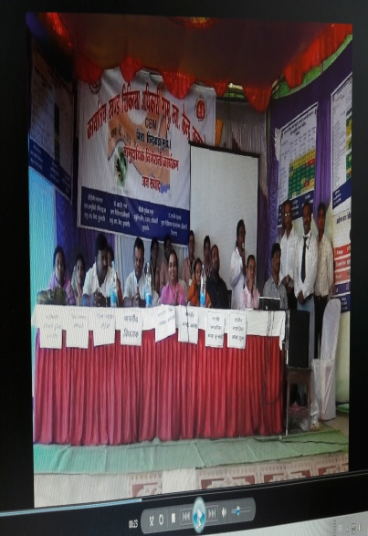
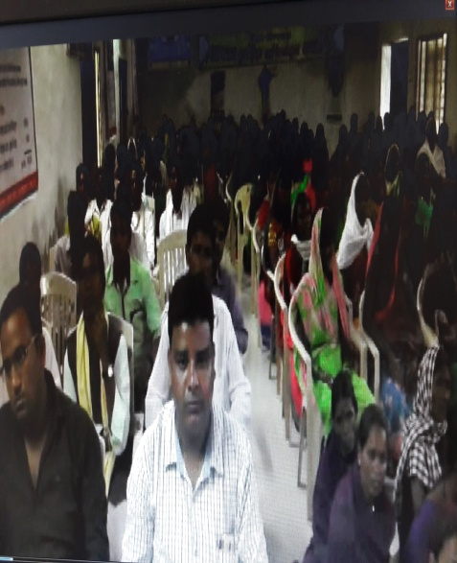
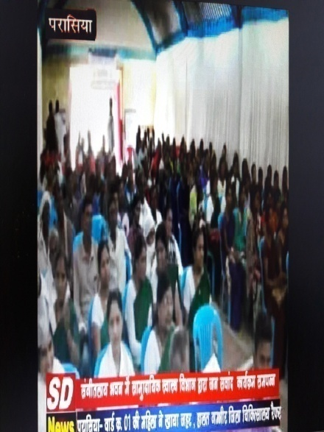
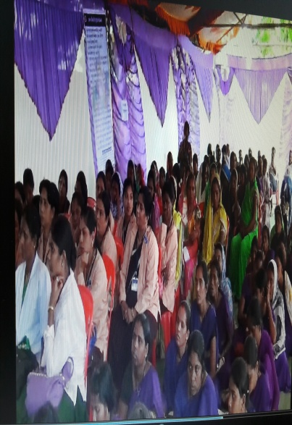
Jan Samwad Chhindwara
Tamia 23-09-2016
Parasia 26-09-2016
Junnardev 28-09-2016

Slide 16
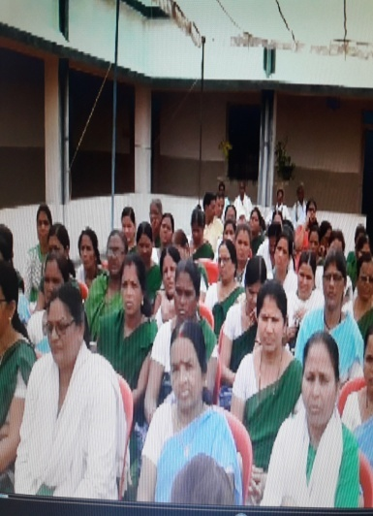
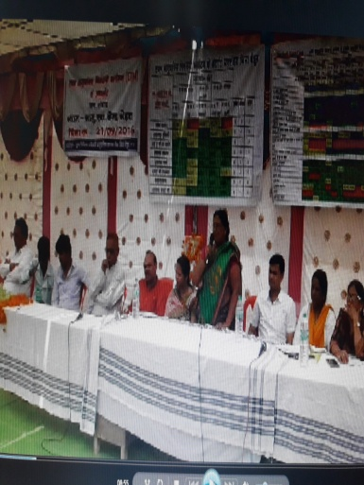
Jan Samwad Betul
Sehra 21-09-2016

Slide 17
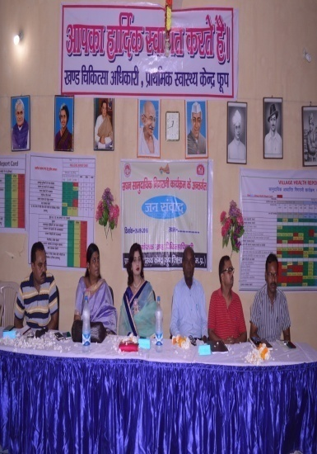
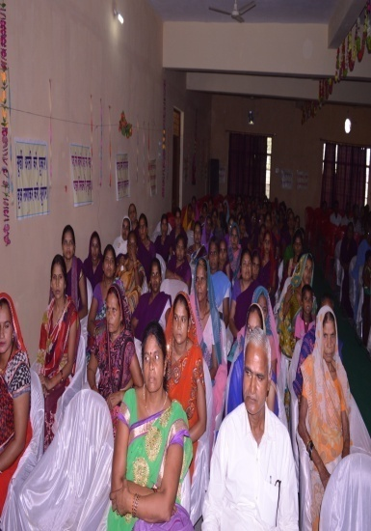
Jan Samwad Bhind
Foop 28-09-2016

Slide 18
Community Action for Health, Action Plan for Year -2016-17
FMR Code | CAH-Planning, Implementation & Monitoring | Physical Target | Achievement | Unit Cost | Financial Target (Rs in Lakh) | Achieve-ment
B15.1.1.1 | State level - State Planning & Mon. committees quaterly meetings with MGCA | 4 | 01 | 50,000 | 2.00 | 50000
B 15.1.1.2 | State level Workshops for build the capacity of DPMU. Involving 44 non Intensive Districts with state MGCA, DCMs & DPMs | 3 | 0 | 80000 | 2.40
B 15.1.1.3 | State level Mobility for MGCA (15 MGCA x3 day /Q | 180 visits | 0 | 3000/day | 5.40
B 15.1.2.1 | District MGCA meeting – 1 day biaanually | 102 | 35 | 2500 | 5.10 | 87500
B 15.1.2.2 | District level Workshop – 1 day | 44 | 0 | 20000 | 8.80
B 15.1.2.3 | District level Mobility for MGCA in 44 district -3 MGCA members x 3 days per quarter | 1584 visit |  | 800 / day | 12.67 | 83000
B15.1.2.4 | Jan samwad at non intensive - 44 District s | Not sanctioned
B 15.1.3.1 | Block level MGCA meeting - 1 day biannual | 626 | 368 | 1000 | 6.26 | 368000
B 15.1.3.2 | Block level Mobility for MGCA in 44 districts 3 MGCA Members x3 days twice in a year | 4734 |  | 700 | 33.14
B 15.1.3.3 | Print formats for “Jan Swathya Nigrani Tools” for VHSNCs of 44 districts | 40000 |  | 50 | 20 | 17
B15.1.4.1 | State Community Monitoring Coordinator | 1 | 1 | 30000 | 3.6 | 3.6
B15.1.4.2 | Mobility support for state Community Monitoring Coordinator | 0 | 0 | 0 | 0 | 0
B15.1.4.5 | District level training | 21 | 3 | 5.25
B15.1.4.7 | Jan Samwad (public hearing) | 21 | 15 | 40000 | 8..4 | 5.86
 |  |  |  |  |  | 39.27 %

Slide 19
Time line of Proposed Activities
S. No | Activities for CAH | Apr-17 | May-17 | Jun-17 | Jul-17 | Aug-17 | Sep-17 | Oct-17 | Nov-17 | Dec-17 | Jan-18 | Feb-18 | Mar-18
1 | State level - State Planning & Montoring committees bi-annually meetings with MGCA | I visioning & planning meeting
2 | State level Workshop for action plan of CAH involving 51 Districts with state MGCA, DCMs /DPMs
3 | Divisional training cum Workshop – 1 day
4 | District level PMC with MGCA meeting – 1 day biannual
5 | Block level MGCA meeting - 1 day
6 | Village data complielation and Jan Samwad
7 | Action taking report

Slide 20
Community Action for Health, Action Plan for Year -2017-18
FMR Code | CAH-Planning, Implementation & Monitoring | Unit Cost | Physical Target | Finance proposed (Rs in Lakh)
B15.1.1.1 | State level - State Planning & Mon. committees bi-annually meetings with MGCA | 50,000 | 2 | 1.0
B 15.1.1.2 | State level Workshops for build the capacity of DPMU involving 51 Districts with state MGCA, DCMs & DPMs | 50,000 | 1 | 0.5
B 15.1.1.3 | State level Mobility for MGCA – 15 MGCA x3 day | 3000 | 180 visit | 5.40
B 15.1.2.1 | District level PMC with MGCA meeting – 1 day biannual | 3000 | 102 | 3.06
B 15.1.2.2 | Divisional training cum Workshop – 1 day | 7260 | 22 | 15.85
B 15.1.2.3 | District level Mobility for MGCA in 51 district x 5 MGCA members x 3 days per quarter | Rs 800/day | 612 days | 24.48
B15.1.2.4 | Jan Samwad | 51 | 2000 | 1.02
B 15.1.3.1 | Block level MGCA meeting - 1 day | 626 | 1000 | 6.2
B 15.1.3.2 | Block level Mobility for MGCA in 44 districts, 3 MGCA Members x 3 days twice in a year | 700 per/day | 4734 | 39.43
B 15.1.3.3 | Print formats for “Jan Swathya Nigrani Tools” for VHSNCs of 51 districts | 0 | 0 | 0
B15.1.4.1 | State Community Monitoring Coordinator | 0 | 0 | 0
 |  |  |  | 96.94

Slide 21
Outline of the presentation
Resource material produced under CAH such as IEC, films, booklets, manuals etc.
Case studies
Best practices in community action

Slide 22
Outline of the presentation
Constitution & Composition of State AGCA/SMG
Frequency of the state AGCA/SMG meetings during FY 2016-17
Scale of the implementation of CAH-districts, blocks, panchayats, VHSNCs
Institutional mechanism for implementation of the CAH (detailed in next slide)
Approach to key processes under CAH:
Awareness generation on entitlements
Strengthening of VHSNCs including availability of untied fund, training and regular mentoring
Strengthening of Rogi Kalyan Samiti, Planning and Monitoring Committees or equivalent
Community enquiry
Jan samwad and follow up action
Mechanisms to address the gaps identified
Grievance redressal mechanisms in place
Progress under CAH as per approved RoP FY 2016-17
Resource material produced under CAH such as IEC, films, booklets, manuals etc.
Case studies
Best practices in community action
Status of fund utilisation in FY 2016-17
Plans for scaling up in FY 2017-18

