Slide 1
Community Action for Health
National Health Mission Assam

Slide 2
History of Community Action for Health in
Assam
Assam was one among 9 states which was selected for the pilot phase of CAH.
State NHM was supported by the State nodal NGO, District and block NGOs to implement the programme.
Pilot phase-3 Districts and 9 blocks in 2008-09.
Second small scale up- 5 districts and 34 blocks covering 5678 VHSNC (2013-14)
Key strategy was to mobilise community, establish planning and monitoring committees, building capacities of committees, monitoring of health services using tools, preparation of report cards and organizing Jan samwads.

Slide 3
Activities under taken during first phase
State and district level visioning workshops
Training of master trainers at the state level and NGO functionaries .
Media workshops at the state and district levels
Constitution and trainings of Village Health, Sanitation and Nutrition Committees (VHSNCs) and Planning and Monitoring Committees at the PHC, block and district levels
Collection of data and preparation of report cards at the village, PHC, block and district levels
Organisation of Jan Samwad at the PHC and block levels.

Slide 4
Second Phase of CAH
A small level scale up was taken up in 2012-13.
It was implemented 5 districts and 34 blocks covering 5678 VHSNC.
Second phase of CAH was implemented with support from VHAA as state Nodal NGO.

Slide 5
Implementation Strategy
Community mobilization through rallies and street plays
Informal meetings with key stakeholders (leaders of CBOs, women leaders and village pradhan) were held to get information on village resource and social mapping, identifying key health problems, map service providers and understand health related expenses
Organising village meetings to share findings, entitlements under NHM and facilitate formation of VHSNCs
Sharing village health service profile with the community
Informing community on NHM/ community monitoring (sharing pamphlets and posters) Focus group discussions, in-depth interview and public meetings. Interviews of both beneficiaries and service providers using specific tools was carried out for data collection.

Slide 6
Current Phase of CAH
Community Action for Health (CAH) is implemented in 18 districts covering all blocks and 40 selected VHSNCs from each Block.
4200 VHSNCs have been covered in 105 BPHCs in 18 districts
These18 districts are clubbed into 4 zones.
Current phase of CAH is implemented with support from VHAA as state Nodal NGO and 4 Zonal NGOs.
Selection of Zonal NGOs for Zones 1 & 2 covering 9 districts is pending.
The current phase will get over by 10th February 2017.

Slide 7
NGOs in Current Phase of CAH
Sl No | Level | Coverage | Selected NGO/ Organization
1 | State Level | All Zones | VHAA (Voluntary Health Association of Assam)
2 | Zone 1 | Barak Valley Zone: Dima Hasao, Cachar, Karimganj, Hailakandi (4 districts) | Pending
3 | Zone 2 | Bongaingaon Zone: Bongaingaon, Dhubri, Barpeta, Kokrajhar, Chirang (5 districts) | Pending
4 | Zone 3 | Darrang Zone: Darrang, Goalpara, Udalguri, Nalbari, Baksa (5 districts) | RWUAA (Rural Women Upliftment Association of Assam)
5 | Zone 4 | Jorhat Zone: Karbi Anglong, Golaghat, Jorhat, Sonitpur (4 districts) | RWUAA (Rural Women Upliftment Association of Assam)
6 | Zone 5 | Dibrugarh Zone: Sivsagar, Dibrugarh, Tinsukia, Dhemaji, Lakhimpur (5 districts) | SCORPION
7 | Zone 6 | Kamrup Zone: Kamrup Metro, Kamrup Rural, Morigaon, Nagaon (4 districts) | RWUAA (Rural Women Upliftment Association of Assam)

Slide 8
Constitution & Composition of
State AGCA/SMG
State Mentoring Group formed with involvement of experts from government and non government organizations. (2007)
State Mentoring Group for ASHA and community processes(Reconstituted - 2015)
Meeting held on 11th January 2016
Discussion & finalization of work plan of CAH.
National AMG member attended.
AGCA member attended.
Next meeting planned on 7th February 2017 to review the progress under CAH and way forward.

Slide 9
Fund Status
Year | RoP Approval (In Lakhs)
2008-09 | 82.74
2012-13 | 151.34
2013-14 | 617.73
2014-15 | 617.73 (Revalidated)
2015-16 | 617.73 (Revalidated)
2016-17 | 617.73 (Revalidated) ( 90% of total fund earmarked has been released to SNA)

Slide 10
CAH at Different Levels
Identification of VHSNC
Ensuring & facilitate Bank Account for each VHSNC
Ensuring regular VHSNC meetings
Ensuring presence of VHSNC members in VHND
Handholding in preparation of minutes of VHSNC meeting.
Handhold & Facilitate Maintenance of registers under the VHSNC
Maintenance of VHSNC account & Cash Books
focus to form Model VHSNCs.
VHSNC

Slide 11
CAH at Different Levels
Strengthening of Sub centre functioning with the inclusion of RHP and 2nd ANM at the sub center.
Ensure support to ANMs by LHV/LHS for better service delivery
Sub Centre

Slide 12
CAH at Different Levels
Convergence meetings with other line departments and stake holder for health promotion & promotion of CAH.
Cleanliness drives, basic transportation
Block review meetings, partnering in the health campaigns, resource persons for the VHSNC member, ASHA trainings etc.
Ensure support to ANMs by LHV/LHS for better service delivery
Block Level

Slide 13
CAH at Different Levels
More pro active role of district administration to bridge the gap to ensure quality health services.
convergence at the district level with all concerned Line Departments.
CAH agenda in the district review meetings, partnering in the health campaigns, resource persons for the VHSNC member, ASHA trainings etc.
District
Level

Slide 14
Mentoring of VHSNCs at District/Block/SC Levels
DPMU
District ASHA Nodal Officer (Addl. CM&HO)
supported by District Community Mobilizer District Coordinator (NGO supported)
Facilitation support by State Nodal Agency and Zonal coordinators (from NGOS)
BPMU
Block ASHA Nodal Officer (SDM&HO)
supported by Block Community Mobilizer, Block Facilitator (NGO supported)
ASHA Supervisor /ANM / AWW / ASHA
VHSNC members

Slide 15
Activities initiated under CAH
4200 no of VHSNCs are selected based on parameters.
2. Meetings: State & District Level:
Orientation on Community Action for Health.
3. Mapping & identification of Trainers for Community Action for Health
VHSNC trainer pool issued for this activity
4. Development of resource material:
Capacity building of DCM, BCM, NGOs on Community Action for Health.
Planning on Community Action for Health.
Systematic and vigorous IEC activities supported by Material & Content development.

Slide 16
Progress under CAH
Member strength of VHSNC meeting have gone up from 5-6 to 15 and their participation is improving satisfactorily.
All districts have reported holding of VHSNC meeting regularly and encouraging to note that Maternal and Child health issues have started getting priority attention.
IEC activities have gone up and I Card have been provided to members which boost up their confidence level.
Status of Untied Fund has been documented well and findings shared at Block and district level.
Grievance redressal mechanisms in place, District & Block level committee is reconstituted.
Strengthen 104 ASHA Helpline.

Slide 17
Progress under CAH
Identification and profiling of Mothers groups in tea garden is complete. Taken up advocacy with Labour Welfare Officers.
Cleanliness drive ,practise of safe drinking water and hand washing in AWCs, Schools ,Sub centers and community .
Sensitization of VHSNC members regarding their participation in VHND.
VHSNCs members are trained.
Efforts initiated to converge with RD & PR department/SIRD to integrate health agendas in the GPDPs.

Slide 18
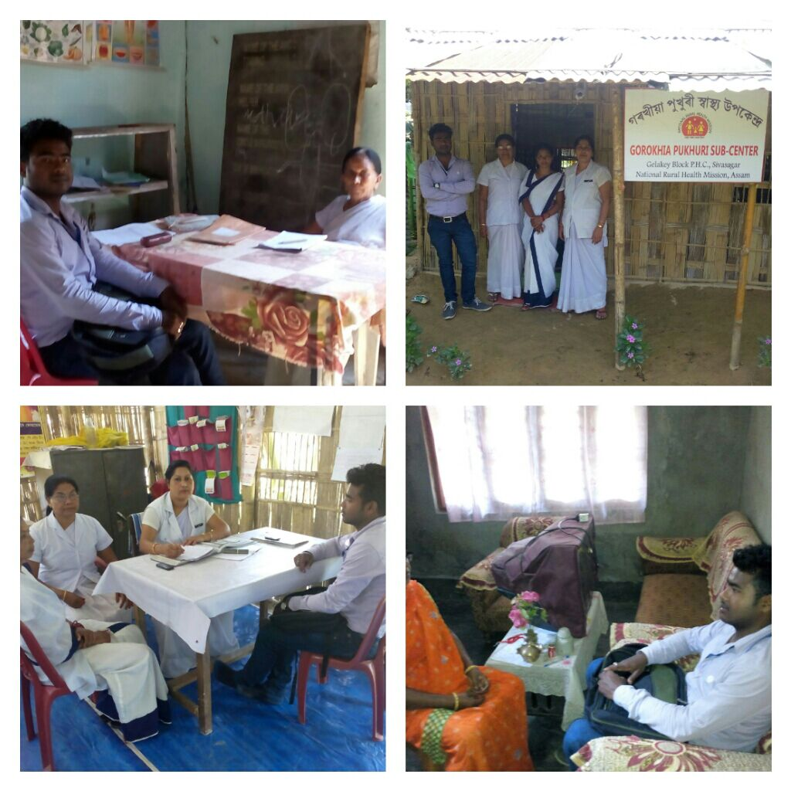
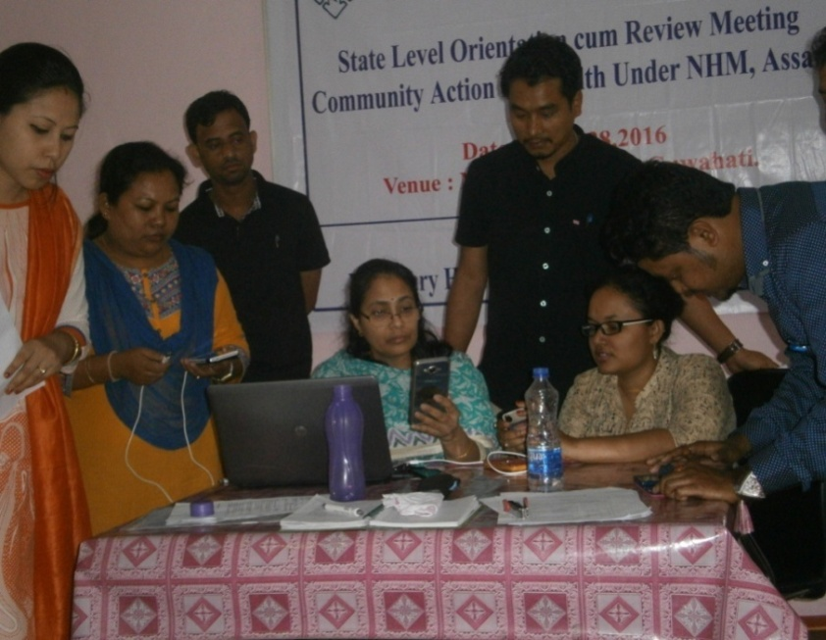
An Initiative to Prepare Baseline on Status of Functionality of the VHSNC and the RKS An Initiative to Prepare Baseline on Status of Functionality of the VHSNC and the RKS
This is a new initiative with support from AGCA as no baseline in the context of the Community Action for Health (CAH) was done in the state. The findings can now be used for providing support to VHSNCs in a more specific way. The findings have provided clarity in areas where VHSNCs require advance support for scaling up their performance. Besides this, it can be carried out in rest of VHSNCs as well.

Slide 19
An Initiative to Prepare Baseline on Status of Functionality of the VHSNC and the RKS An Initiative to Prepare Baseline on Status of Functionality of the VHSNC and the RKS
The key objectives for the Baseline Survey were to :
Identify the critical gaps that need to be addressed during the implementation of the programme.
Prepare intervention plans based on the identified gaps.
Follow up on the improvements over the gaps periodically.
A set of 5 checklists and support guidelines were developed by AGCA Secretariat.
Baseline tools and mobile based software CS pro 6.0. The mobile app CS pro was used to ease the data collection and collation for generating reports for the analysis.
interview of VHSNC Members
Anganwadi Centre level
Checklist at Sub-Center level
Checklist for RKS of Block PHC
Checklist for Block PHC

Slide 21
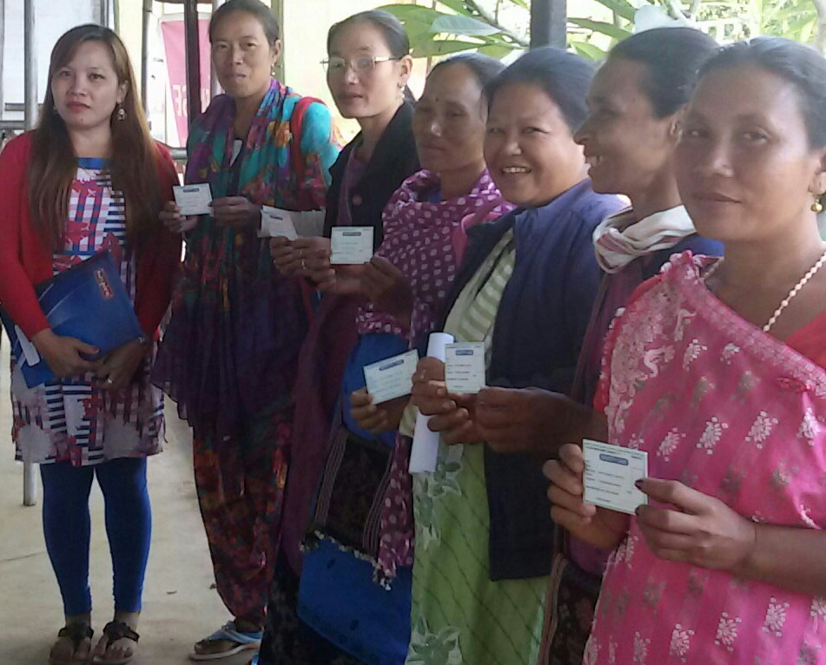
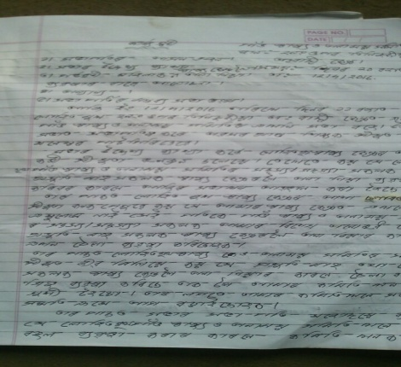
Best Practices
Profile of Mothers Group.
Identification and profiling of 32 Mothers group is complete. Facilitation of linkages with concerned VHSNC is completed. Mobilising mothers’ groups in tea gardens and linking them with the VHSNCs with the focus on addressing maternal mortality among tea garden workers.
I card to VHSNCs. VHSNC availing Cheque facility
Arrangement of local transportation (Thela) for pregnant women through VHSNC
A sample of the manner in which VHSNC meeting Proceedings are being maintained post CAH initiatives towards strengthening VHSNCs
Mothers Club profile
General Name of the Garden Name of the Mothers Group(MG) When was it formed? D/M/Y No of House hold covered by the MG Name of nearest VHSNC Name of nearest AWC Name of Nearest Sub Health Center Name of Nearest PHC/MPHC/BPHC Name of Nearest CHC Name of the Tea Garden Hospital( if ,Hospital is in place) Any other( why was it formed?who is the key person?etc)
Minutes of VHSNC meeting

Slide 22
The major challenges/bottlenecks faced for implementing CAH activity
Tender process took time for which the selection of NGOs was delayed.
Identification/verification of relevant NGOs was time consuming and hence delayed
Ownership at all level is also seen as a major challenge.
Effective convergence at all levels.
existing report card format needs modification as per ground reality.
Specific measurable indicators.

Slide 23
Way Forward
The CAH programme in the state has got a significant momentum and to continue with this we will adopt some new strategies involving SNA to work directly in the selected area in four zones with the help of the fellows.
Community Action for Health Fellowships
About the fellowship:
The fellows at the block and district level will be mentored by one state nodal agency identified by the NHM, Assam. The state nodal agency will support state NHM in training the fellows on regular basis as the requirement of the programme. The state NHM will provide necessary funds for the fellowship programme for one year which may be extended depending on its results. This strategy will not require need for engaging the zonal level NGOs and instead we may place two professionals in the SNA itself to guide and mentor the fellows placed in the field. This will make the SNA responsible for the progress and the state will also have better control over the outcomes of the programme.
Unspent Fund will be revalidated in PIP 17-18.

Slide 24
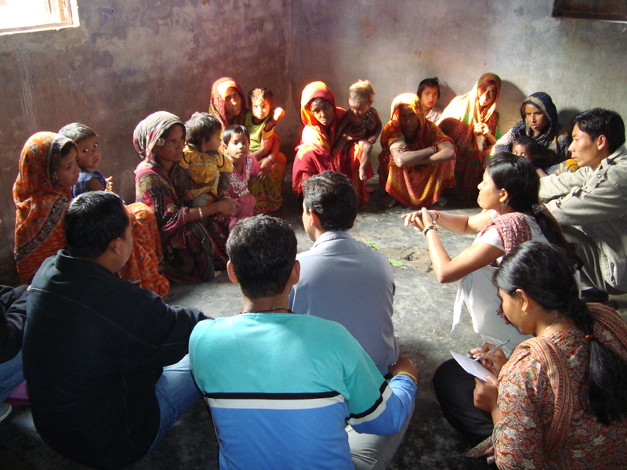
Thank You

