Slide 1
CAH JHARKHAND
Regional Workshop on Community Action for Health
Guwahati, 24th & 25th Jan. ’17
Dr. Pradeep Baskey,
Nodal officer CP, Jharkhand

Slide 2
CAH Activity in Jharkhand
Constitution & Composition of State AGCA/SAMG – 16 Members including MD-NHM, DIC, Development partner, Health directors, Social activist, NAMG members, representative of National trainer, State trainer and Sahiya.
Frequency of the state AGCA/SAMG meetings during FY 2016-17 – Biannually along with SAMG meeting, last meeting held on 3 Nov. 2016.
Scale of the implementation of CAH-districts, blocks, panchayats, VHSNCs – all Four level

Slide 3
CAH Activity in Jharkhand
Approach to key processes under CAH:
Awareness generation on entitlements – Approach through All level
Strengthening of VHSNCs including availability of untied fund, training and regular mentoring – till date trained 23129 VHSNC members of 12624 VHSNC in GOI VHSNC Module.
Strengthening of Rogi Kalyan Samiti, Planning and Monitoring Committees or equivalent – Proposed in PIP 17-18.
Community enquiry – Called Community Base Monitoring (CBM)
Jan samwad and follow up action – We covered 110 block Jan sanwad and 24 district Jan sanwad.
Mechanisms to address the gaps identified – Gaps finding as per prescribed check list per survey done by the team and present the findings to community through Jan sanwad at each level.

Slide 4
CAH Activity in Jharkhand
Grievance redressal mechanisms in place – We have district grievance redressal committee at district level in 16 district out of 24, but need support in strengthening. State CM cell along with HR cell also act as grievance redressl unit for community process at the state level. Toll free No. 104 also in place for redressal.
Progress under CAH as per approved RoP FY 2016-17 – Total 702 lakh budget approved, till date expenditure 34 %
Resource material produced under CAH such as IEC, films, booklets, manuals etc. – Sahiya Sandesh, VHSNC Module, CBM Manual and PRI booklet.
Status of fund utilization in FY 2016-17 - Total 702 lakh budget approved (B.15 Planning, Implementation and Monitoring Expenditure Status) exp. till date expenditure 34 %
Plans for scaling up in FY 2017-18 – Scale up in NUHM

Slide 5
Case studie - Village Health nutrition and sanitation committee Topchanchi
Topchanchi village is one of the 112 revenue villages in Topchanchi block of Dhanbad district. The famous Grand trunk road passes through the village and it is the market place for nearby villages. The population mainly comprises of small and medium entrepreneurs and farmers and govt. employees of block and other deptts.
Under communitiszation process of NRHM Village health committee was constituted by Gram- Sabha in 2009 and untied fund of Rs. 10000/ was provided to it. But hardly any meetings happened and with the migration of the Chairperson of the committee it virtually collapsed. After the election of the PRIs in Jharkhand, the representatives took the decision to reform the committee. After the intervention of VSRC the committee was reconstituted and all PRI reps were added to the old one. The new committee took several steps as - Selection of two more Sahiyas as there were only 3 Sahiyyas in the village of 5500 population, Monthly review of Sahiyas started.

Slide 6
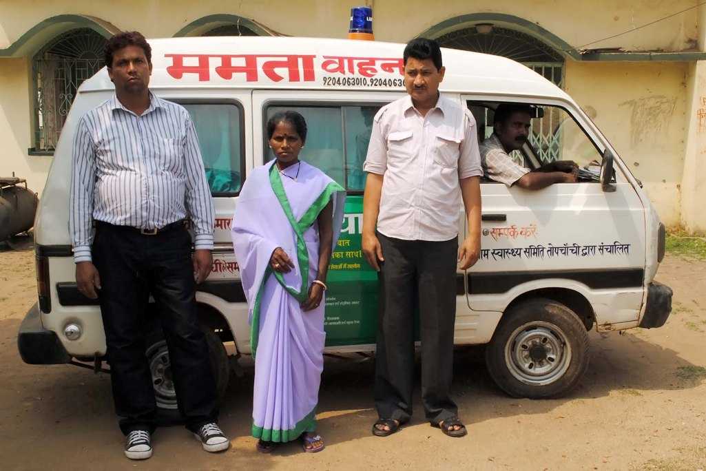
Help to 10 needy families for transportation and drugs were provided. The spray of DDT ensured in all households as this falls under Malaria zone. All the JSY beneficiaries were provided with their due payment
The committee then received the next instalment of untied fund and decided to revive the unrepaired ambulance lying unused in PHC. The ambulance was provided by the local MP. The committee then approached the HMS of PHC, got it repaired and it was handed over to the VHSNC for proper use. The committee fixed rates for its movement and did a MOU with the deptt. for this to be registered as Mamta Vahan. Now in 2 Months the ambulance has earned more than Rs. 21000/. The driver is being paid a salary of 3000/ per month and the needy families gets the services apart from the delivery facilities which are free as package of Mamta Vahan, in subsidsed rates. Now the committee has decided to provide all Anganwadis with water filter and weighing Machine. The Programme for healthy baby show is also in the process.

Slide 7
Best practices in community action
Community mobilization using Participatory Learning & Action (PLA) cycle approach to reduce maternal & neonatal mortality in high mortality area.
Sahiya conducting PLA group meeting in her catchment area having average population of 500
Average participants in each meeting is around 30 women of reproductive age group
Each group meets once a month for PLA meetings
A manual has been developed to help Sahiya in implementing the program
Meetings were focused on improving maternal and newborn health

Slide 8
Institutional mechanism for implementation of the CAH
Implemented through Community Process support structure/civil society/mixed – Mixed
State level - Yes
District level - Yes
Block level - Yes
Sector level/panchayat level - Yes
Village level - Yes
Convergence with stakeholders esp PRIs, ICDS etc. – Yes but need to be strengthen.

Slide 9
Update on Career opportunities for ASHAs in CAH area
Number of ASHAs selected as PRI,AF,AWW & Siksha Mitra
PRI representative | AFs | AWW | Siksha Mitra
338 | 2189 | 11 | 5

Slide 10
THANKS

