Slide 1
COMMUNITY ACTION FOR HEALTH IN SIKKIM
Dr. M.L. LEPCHA
JD CUM NO .NHM

Slide 2
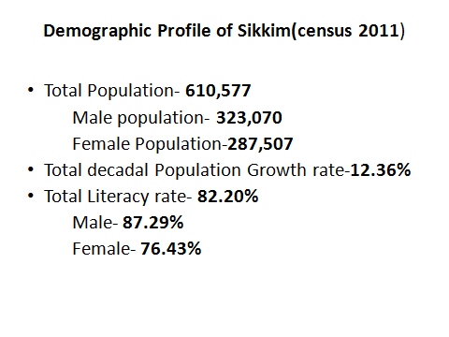
SIKKIM

Slide 3
PROGRESS MADE BY SIKKIM IN HEALTH CARE
INDICATORS | SOURCE | SIKKIM | INDIA
Crude Birth Rate | SRS 2013 | 17.1 | 21.4
Crude Death Rate | SRS 2013 | 5.2 | 7.0
Infant Mortality Rate | SRS 2013 | 22 | 40
Maternal Mortality Ratio | 2015-16 (till January) | 7(absolute no.) | 178(SRS 2012)
Total Fertility Rate (TFR) | NFHS III(2005-06) Family Planing Division GoI 2013 | 2.02 1.7 | 2.70 2.4(SRS 2012)

Slide 4
STATUS & SELECTION OF ASHA
DISTRICT | NO OF ASHA (2014-15) | NO OF DROP OUT (2014-15) | RE- SELECTED (2014-15) | ACTUALS
EAST | 199 | 4 | 4 | 199
WEST | 205 | 7 | 7 | 205
NORTH | 84 | 4 | 4 | 84
SOUTH | 153 | 6 | 6 | 153
URBAN | 25 | 5 | 5 | 25
TOTAL STATE | 666 | 26 | 26 | 666

Slide 5
STATUS OF ASHA TRAINING Module 6th & 7th
DISTRICT | NO OF ASHA (2014-15) | COMPLETED TRAINING | TRAIN ING GIVEN ON ROUND I (15-16)
EAST | 199 | 195 | 4
WEST | 205 | 198 | 7
NORTH | 84 | 80 | 4
SOUTH | 153 | 147 | 6
URBAN | 25 | 20 | 5
TOTAL STATE | 666 | 639 | 27

Slide 6
STATUS OF VHSNC
DISTRICT | NO OF VHSNC | BANK ACCOUNT WITH ASHA | TRAINING COMPLETED
EAST | 199 | 199 | YES
WEST | 205 | 205 | YES
NORTH | 84 | 84 | YES
SOUTH | 153 | 153 | NO
TOTAL STATE | 641 | 641

Slide 7
MEMBERS VHSNC
DESIGNATION
President | Panchayat member
Member secretary | ASHA
Members | AWW
Members | ANM
Members | SHG representative
Members | Teacher
Members | Village elders
Members | Local gentry
Members | Local gentry

Slide 8
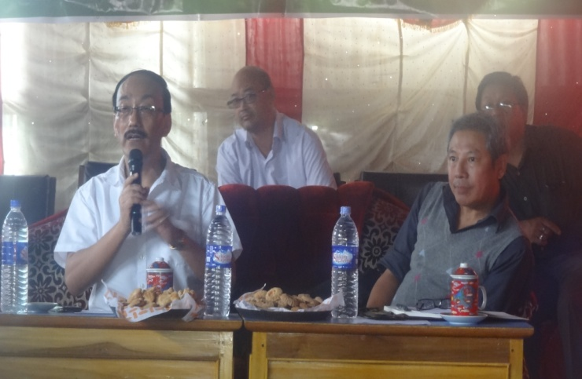
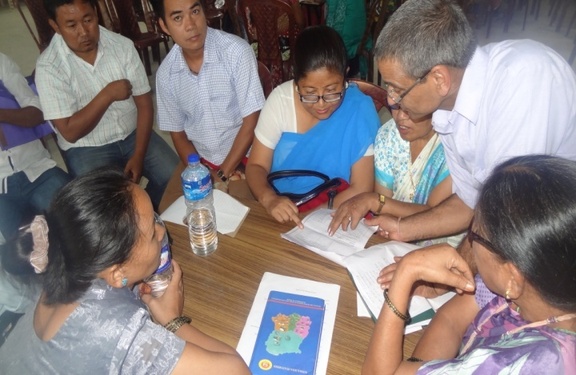
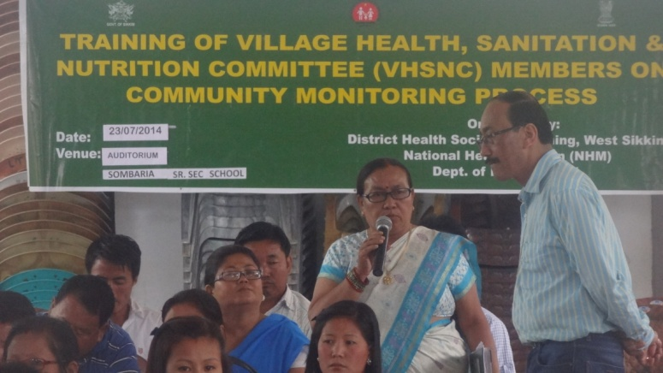
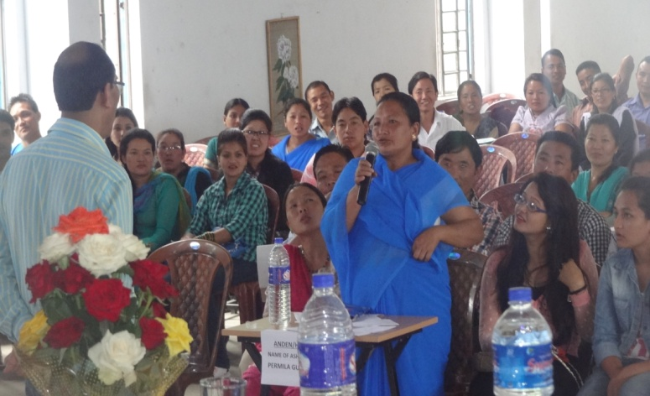
PHOTO SHARING OF VHNSC TRAINING

Slide 9
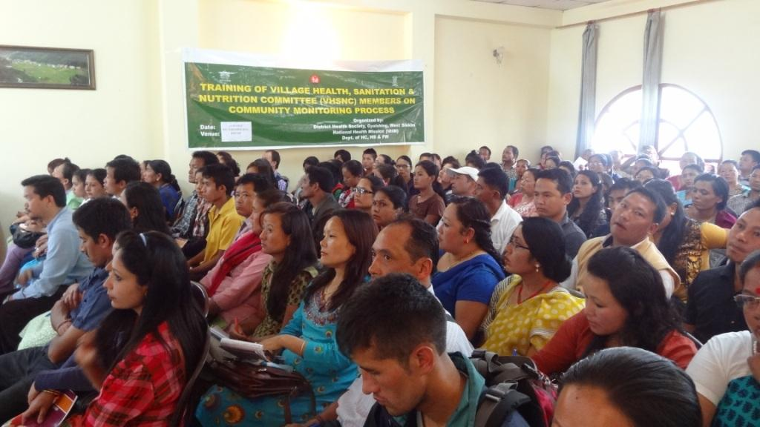

Slide 10
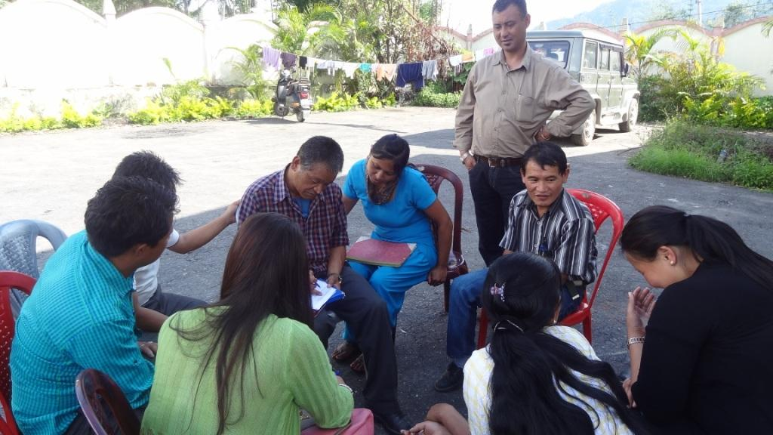

Slide 11
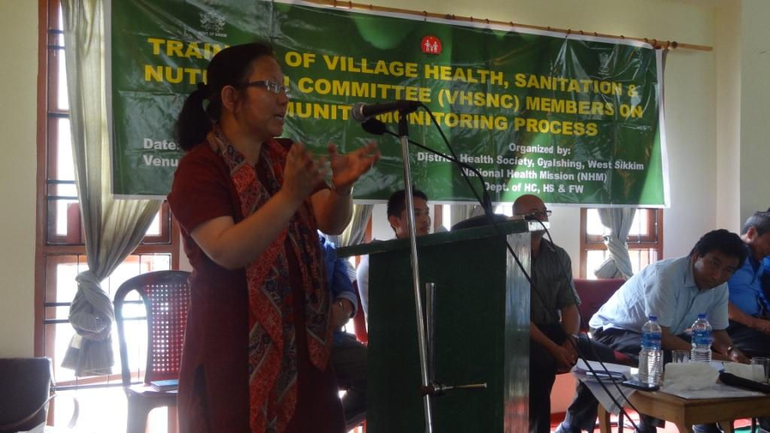

Slide 12
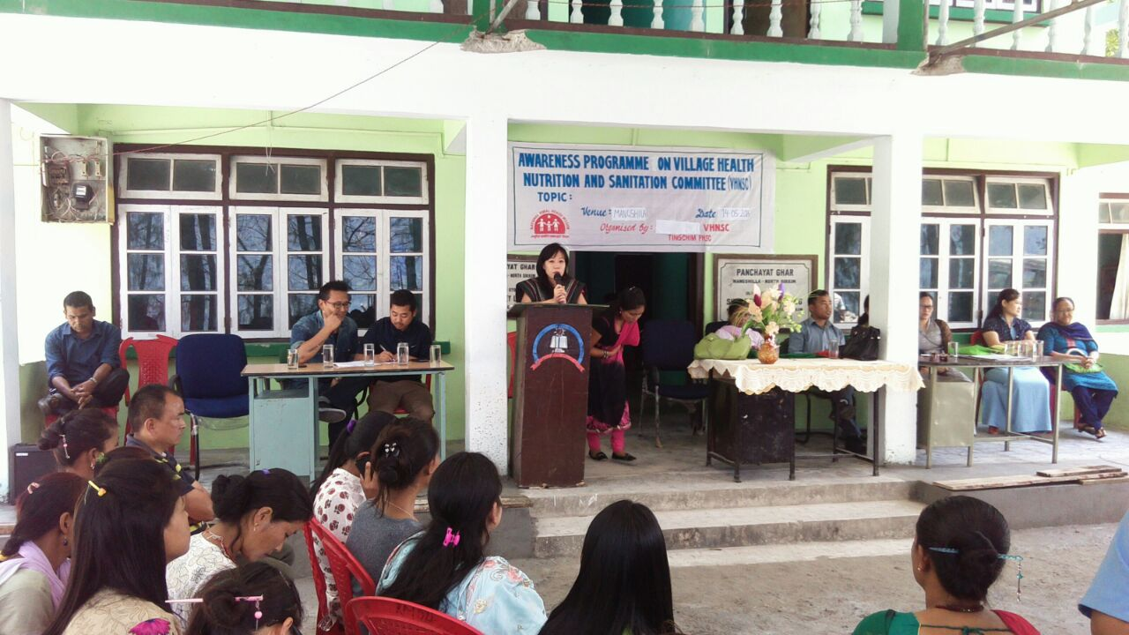
Pictures of the Programme

Slide 13
Pictures of the Programme

Slide 14
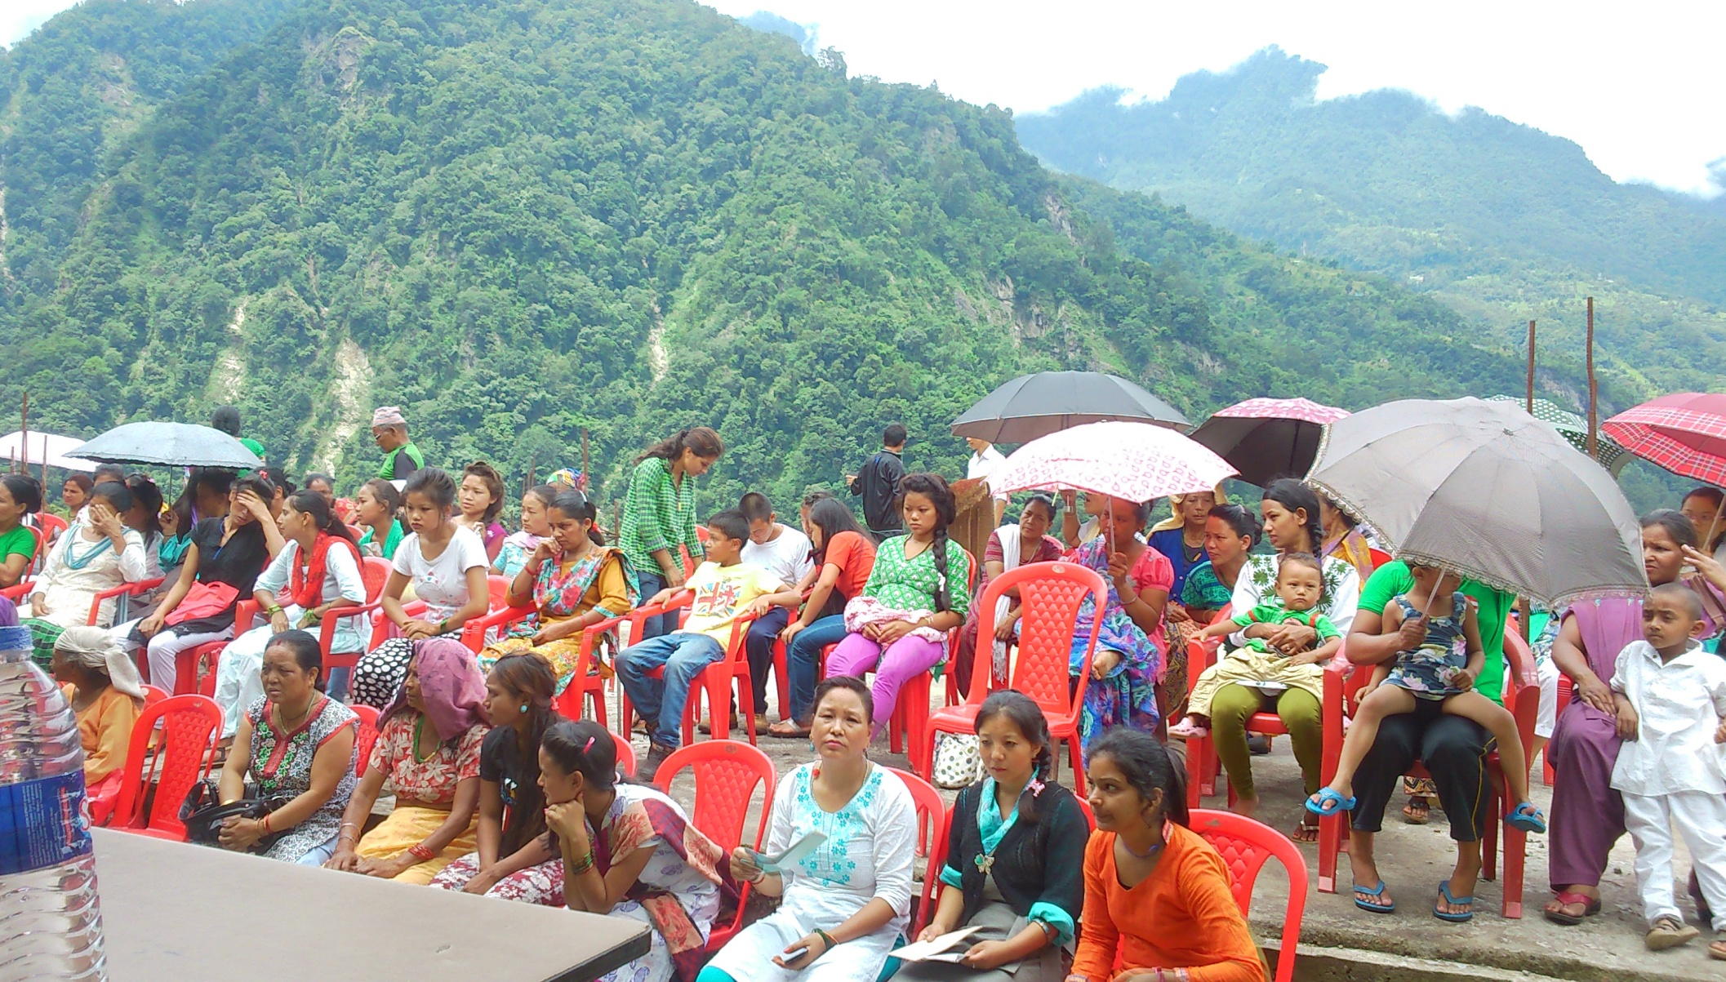
Pictures of the Programme

Slide 15
QUIZ COMPETITION ORGANIZED BY LUM VHSNC

Slide 16
CLEANILESS DRIVE BY LINGTYAM VHSNC

Slide 17
DUSTBIN PROVIDED BY LUM VHSNC
Lum VHSNC dedicated a dustbin on the way to Lum PHSC and Lum JHS. The motive behind is to keep the village and area free from waste of many materials to keep it safe and clean.

Slide 18
INITIATIVE BY VHSNC - LUM
LUM PHSC falls under the jurisdiction of Dikchu Primary Health Centre, North Sikkim and is situated on the Lower Dzongu and caters a population of 368 with maximum inhabitants of Lepcha community. Under Lum there are two villages namely – Lum and Lingtyang. Distance from Lum to Dikchu P.H.C is approx 12 – 14 kms. There is a no transportation route from NHPC Dam to Lum PHSC and have to walk uphill by foot and the distance is approx 4-5 kms.
VHNSC have been doing a wonderful job under the leadership of ward Panchayat Tshering Gyatso Lepcha, staff of PHSC, ASHA, AWW and members of the community.
They have started an initiative of raising the funds of VHNSC with good support of the public there.

Slide 19
They have started a monthly collection of Rs. 20/- each from every household of the area and depositing that amount in the VHSNC A/C. Till date they have raised an amount of approx Rs. 30,000/- through it.
With that amount they use it for the welfare and emergency needs of the community likewise in the times of ANC or delivery where the patient party can’t afford to pay the money, VHSNC give the patient party some amount as a loan to cater the need.
VHSNC also support the patient for transportation to higher facility. As Lum is situated in a very hard to reach area, VHSNC Members along with ASHA head with the patient and look after them.
Similarly VHSNC also give utmost importance on the cleanliness of their respective area and under it they have placed Dustbin on the route from Dikchu NHPC Dam to Lum. If anyone found littering they are punished with a fine.
Each household is given the responsibility of checking each other’s house in order to verify whether the house is kept properly clean or not.
VHSNC have banned the usage of Alcohol in the area and anyone found selling or using alcohol is punished with a fine.

Slide 20
ROGI KALYAN SAMITI
SN | DISTRICT | RKS
1 | NORTH | 6
2 | SOUTH | 8
3 | EAST | 8
4 | WEST | 8
5 | URBAN | 1
 | TOTAL | 31

Slide 21
RKS TRAINING
RKS Training completed in three Districts, North, West and East . South District RKS to be trained.
The trainings were conducted in conference Hall of District hospitals, Hotels,
One day training attended by Zilla Adakshya, DC, BDOs and other members.

Slide 22
CONSTRAINTS RKS
Getting Dates for quarterly meeting from chairpersons and members a problem.
Frequent transfers of BDOs .

Slide 23
BODIES UNDER R.K.S
GOVERNING BODY
CHAIRPERSON | ZILLA ADHAKSHYA
VICE CHAIR | DISTRICT MAGISTRATE
MEMBER SECRETARY | C.M.O
MEMBERS | DISTRICT MEDICAL SUPERINTENDENT
 | PRESIDENT OF NAGAR NIGAM
 | NOMINEE OF ZILLA ADHAKSHYA
 | NOMINEE OF D.C
 | SENIOR MEDICAL OFFICER

Slide 24
CONT…
EXECUTIVE BODY
CHAIRPERSON | C.M.O
MEMBER SECRETARY | D.M.S
MEMBERS | SR MEDICAL OFFICER
 | NOMINEE OF ZILLA PARISHAD
 | NOMINEE OF D.C
 | NGO REPRESENTATIVES
 | ADDITIONAL MEMBERS AS MAY BE CO-OPTED BY THE EXECUTIVE BODY

Slide 25
MONITORING COMMITTEE
CHAIRPERSON | EMINENT CITIZEN NOMINEE OF D.C
MEMBER SECRETARY | SENIOR MEDICAL OFFICER
MEMBER | REPRESENTATIVE OF N.G.O
 | REPRESENTATIVE OF NAGAR PANCHAYAT
 | ADDITIONAL MEMBERS AS CO-OPTED BY THE COMMITTEE.

Slide 26
Rogi kalyan samiti
Total 31 RKS comittees in State.
Quarterly meeting of RKS is being held at District and PHC.
RKS committee have encouraged many private organisation for PPP and companies have donated in kind (example: Renovation of Maternity section at District Hospital Singtam.(NHPC), Inverters (Alkem), Ambulance, fridge etc (Golden Cross) at District and PHC.

Slide 27
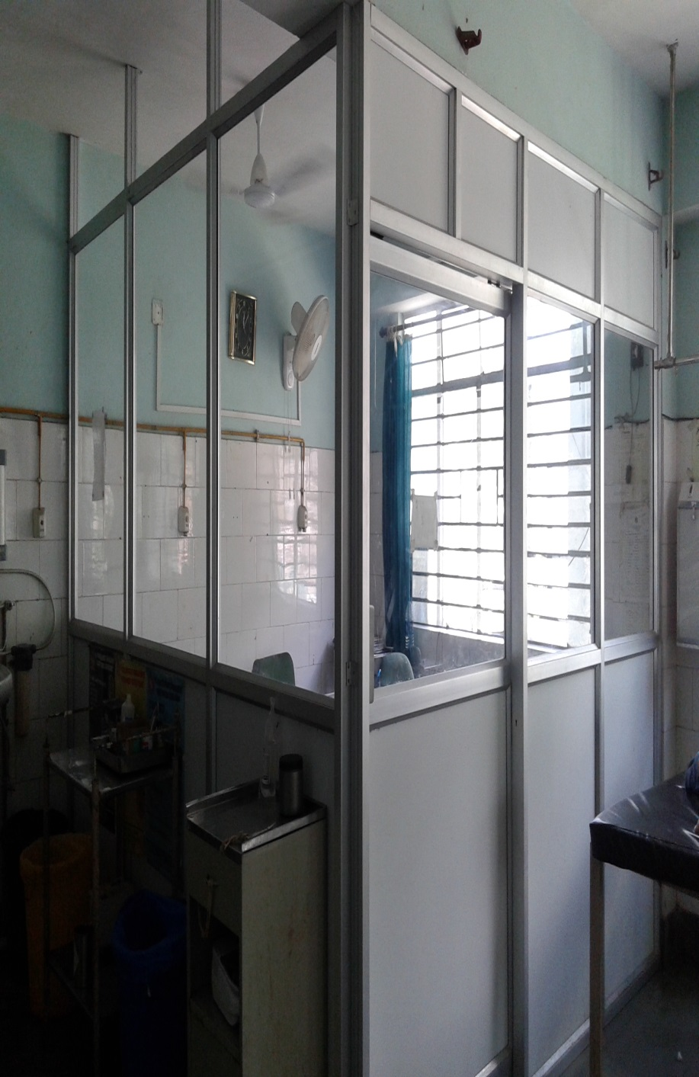
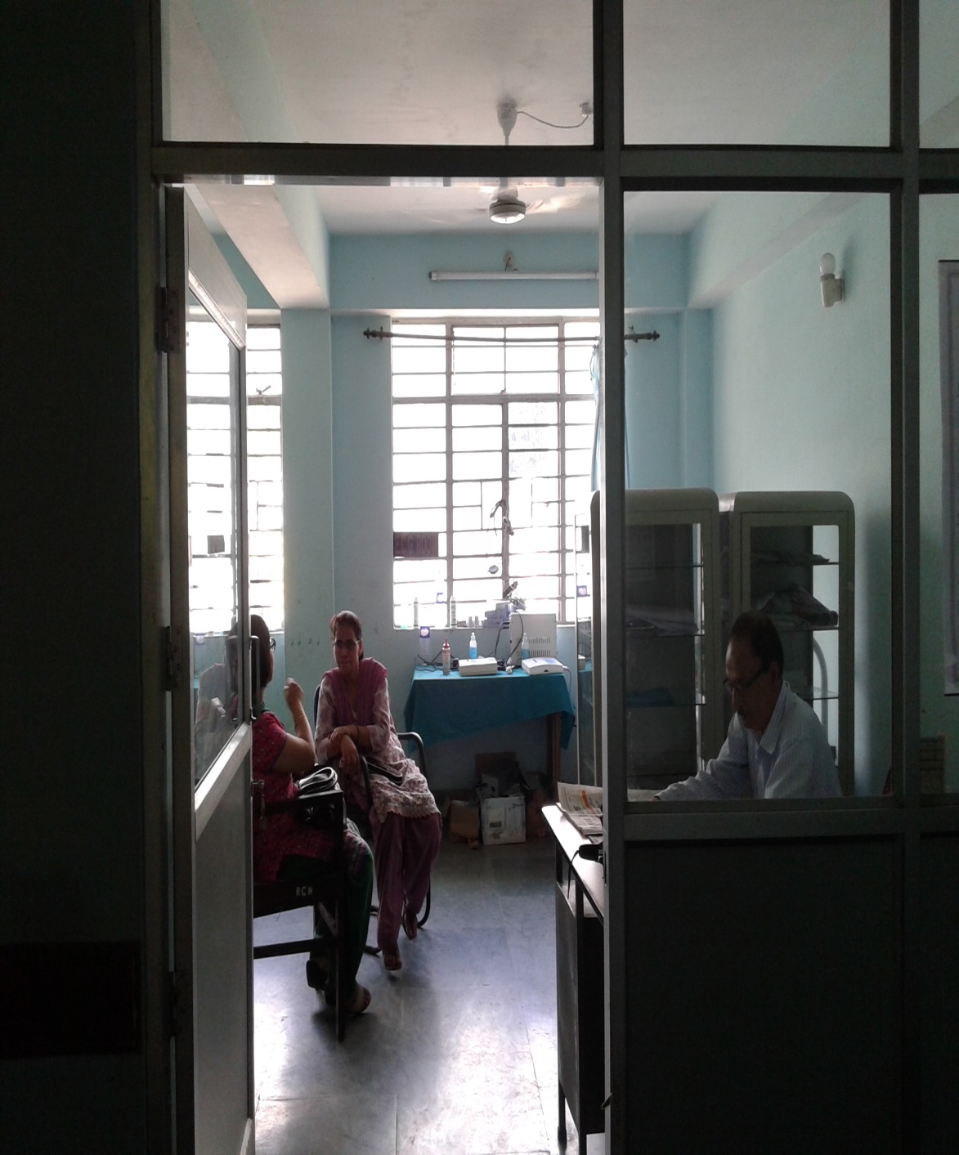
DOCTORS DUTY ROOM (TRAUMA SECTION)

Slide 28
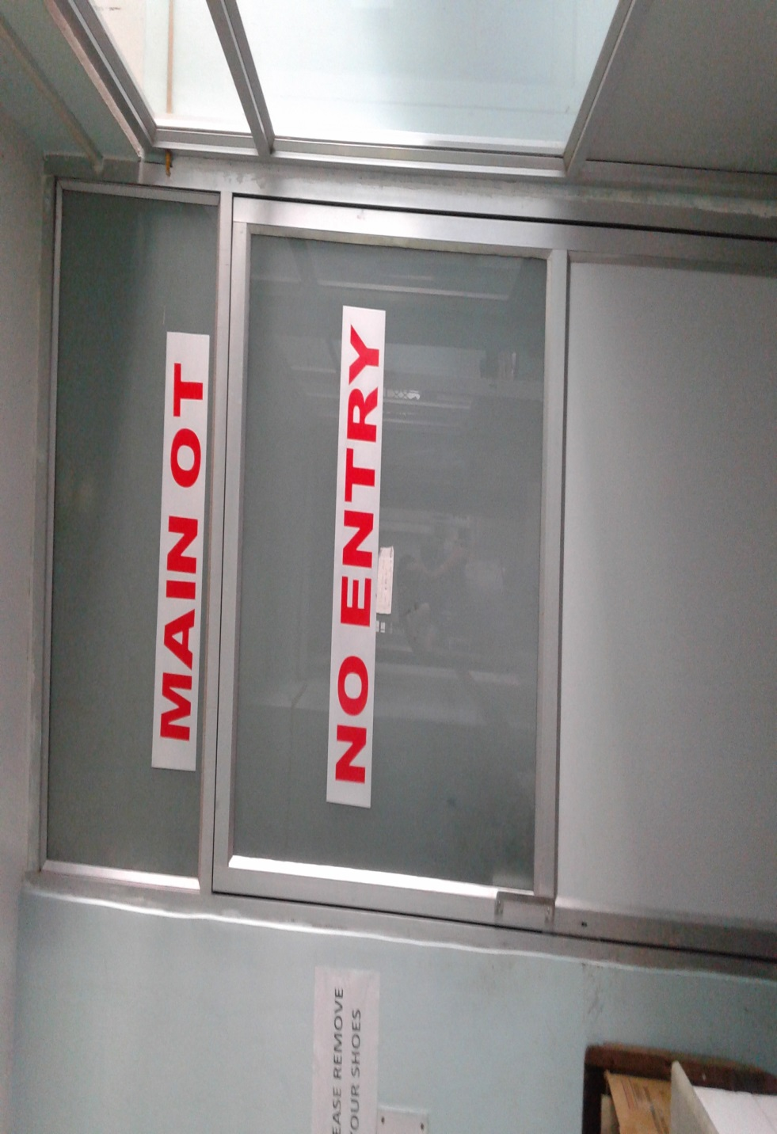
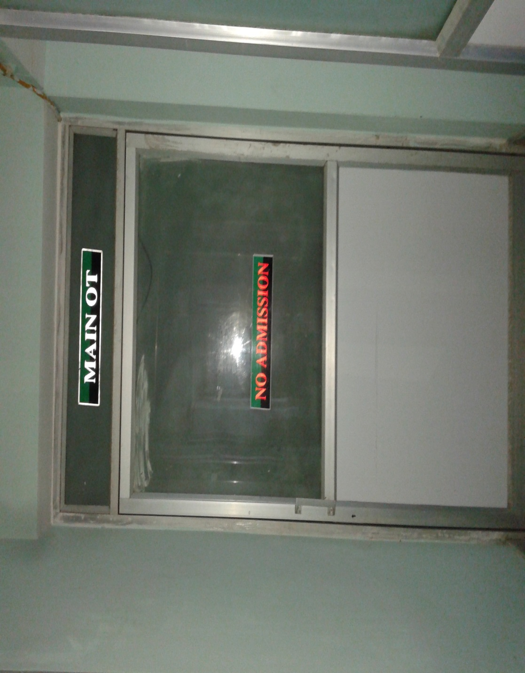
MAIN OT:

Slide 29
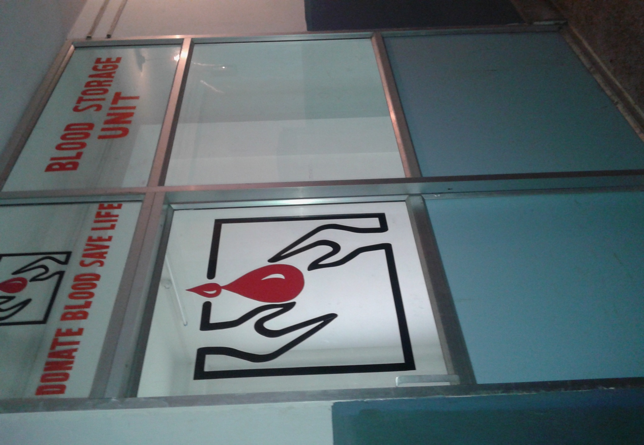
BLOOD STORAGE UNIT:

Slide 30
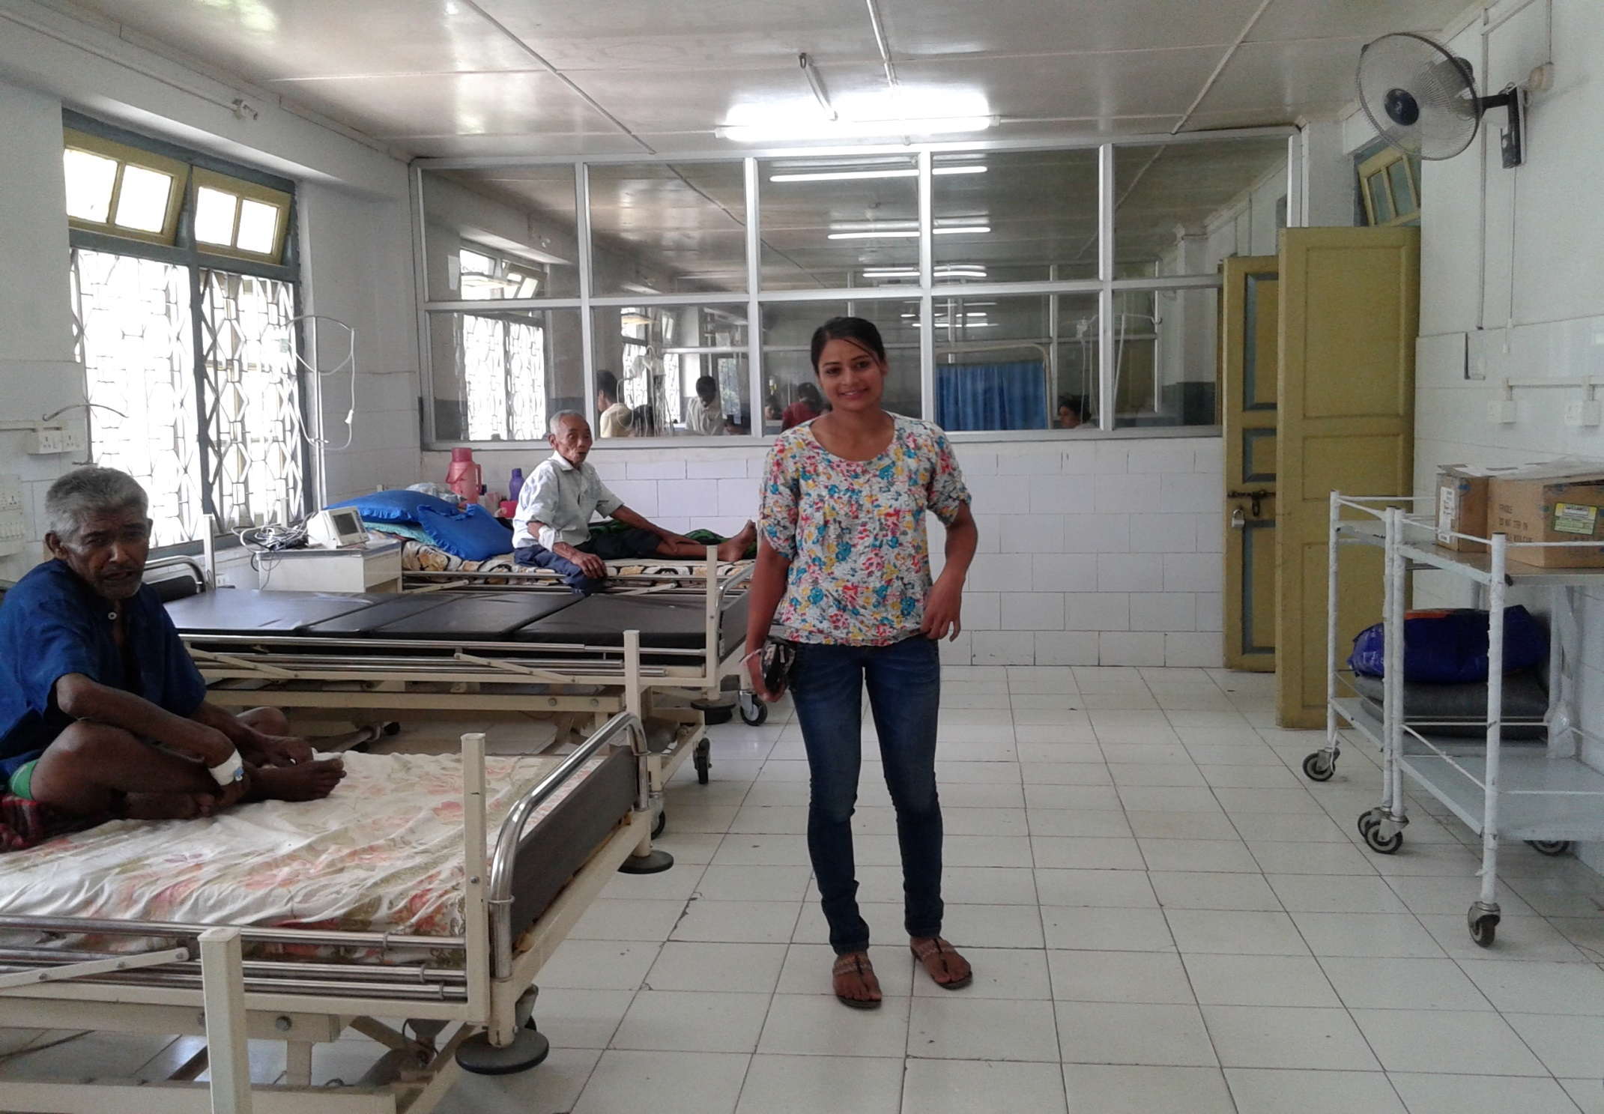
RENOVATION OF MALE MEDICAL WARD:

Slide 31
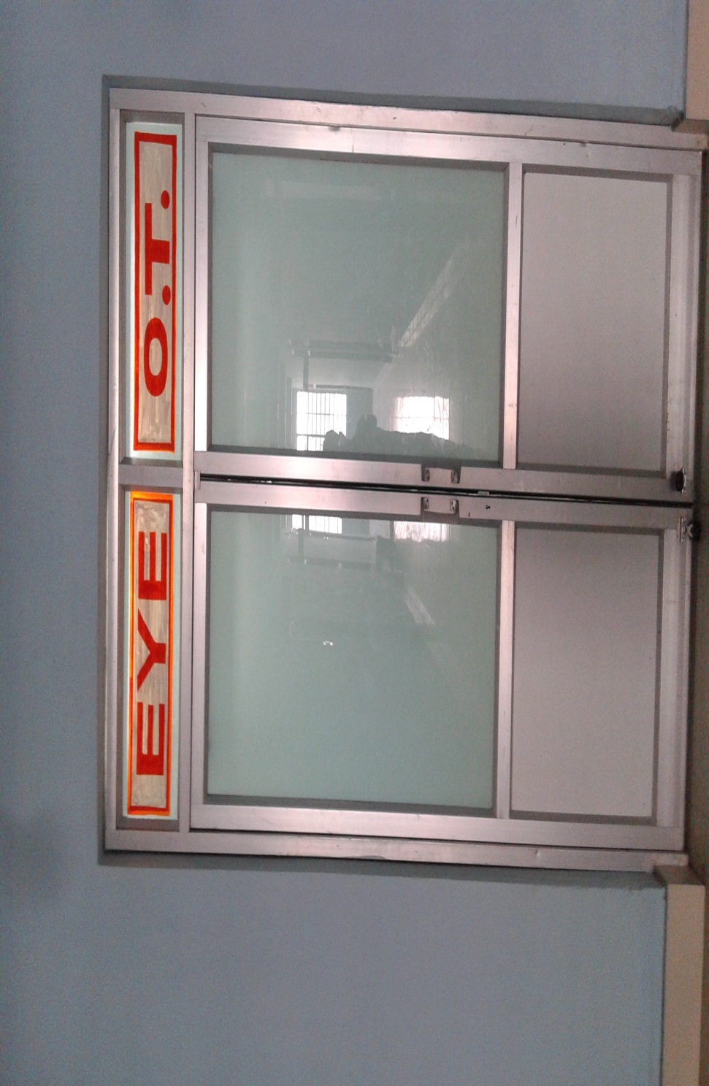
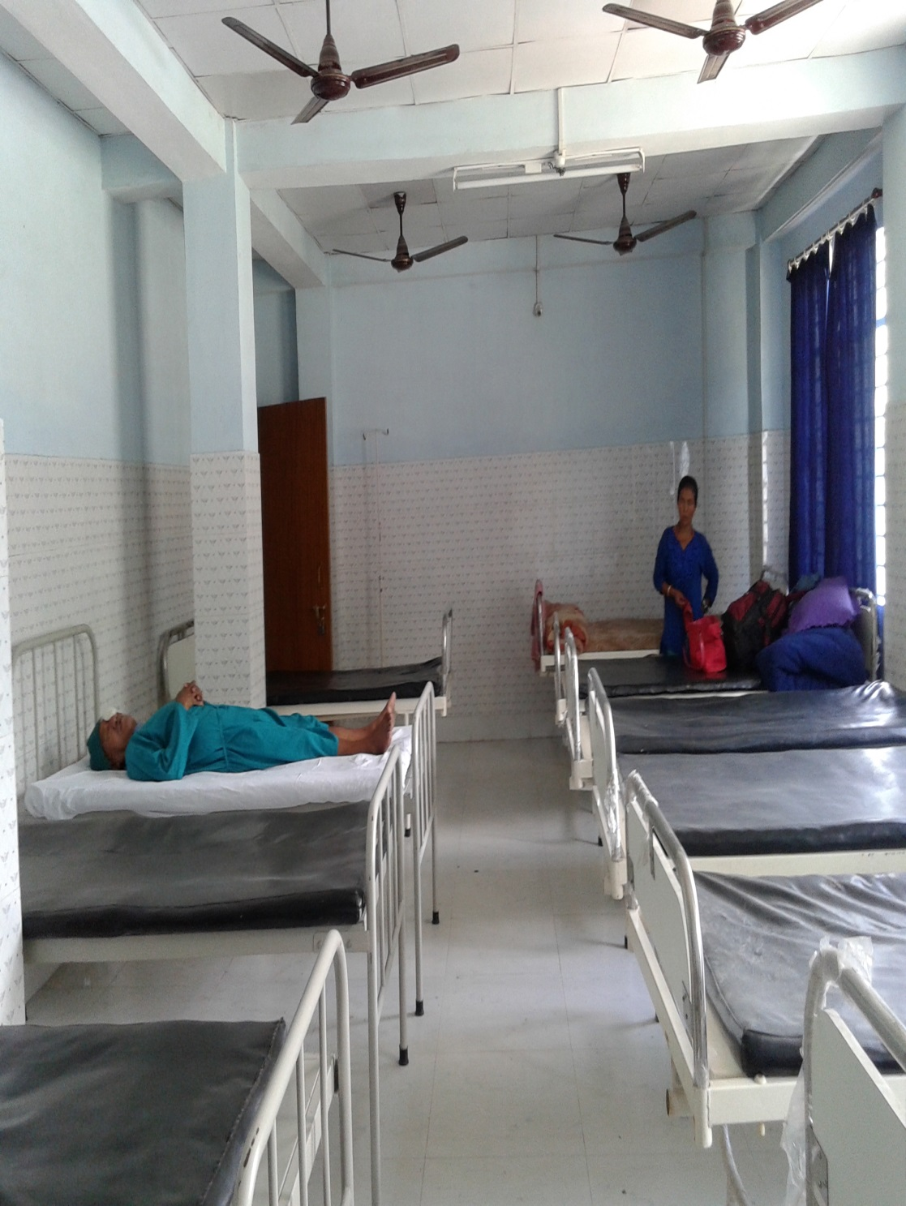
EARTHING OF EYE OT:

Slide 32
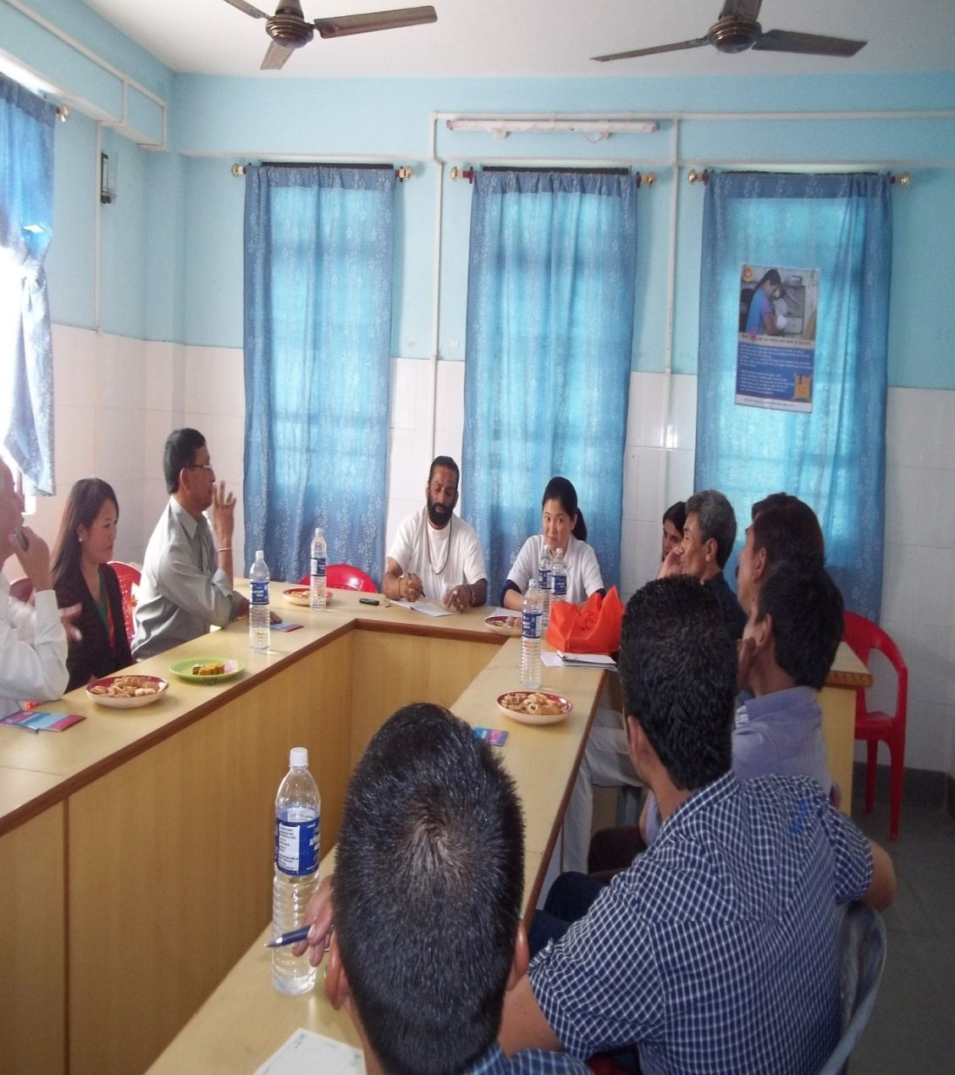
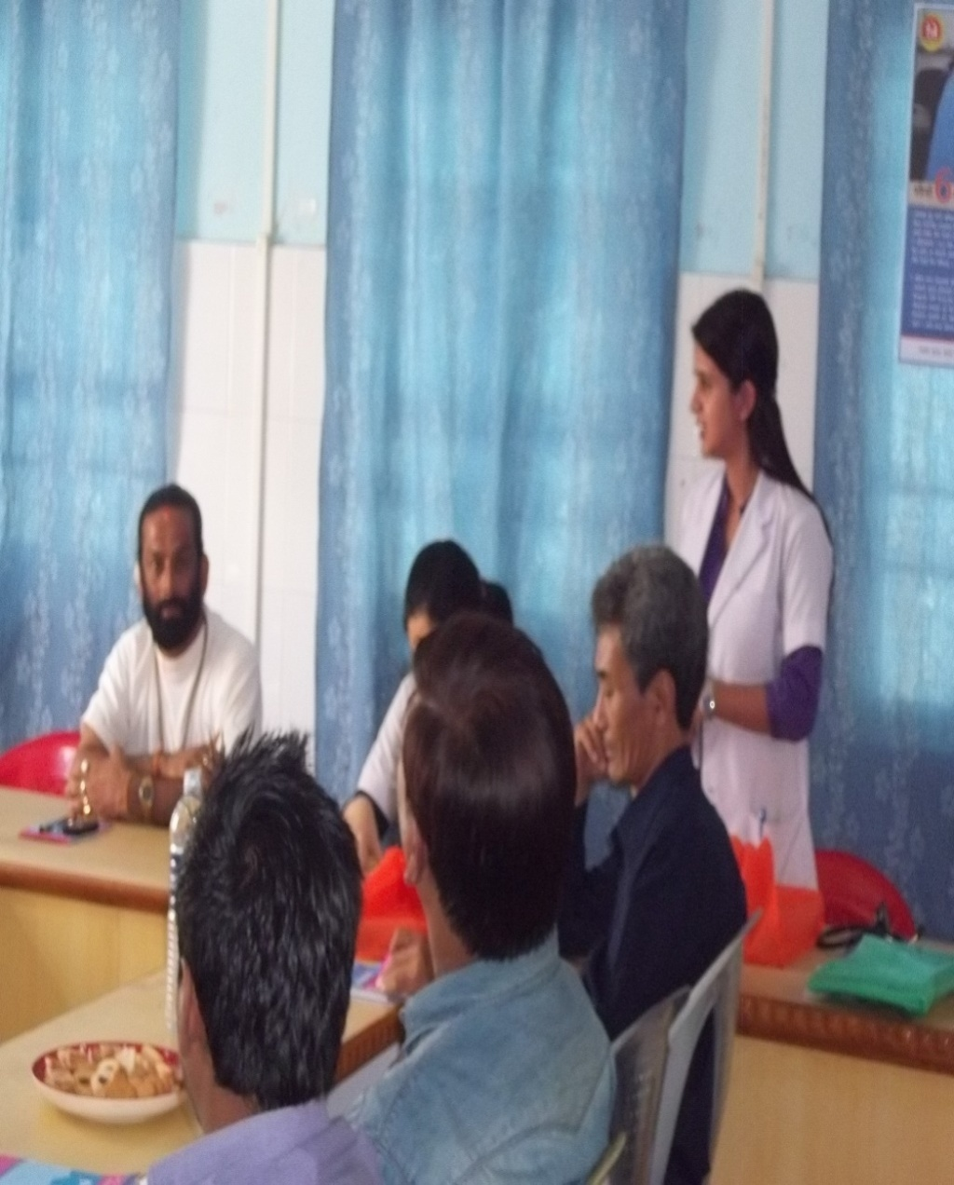
RKS MEETING

Slide 33
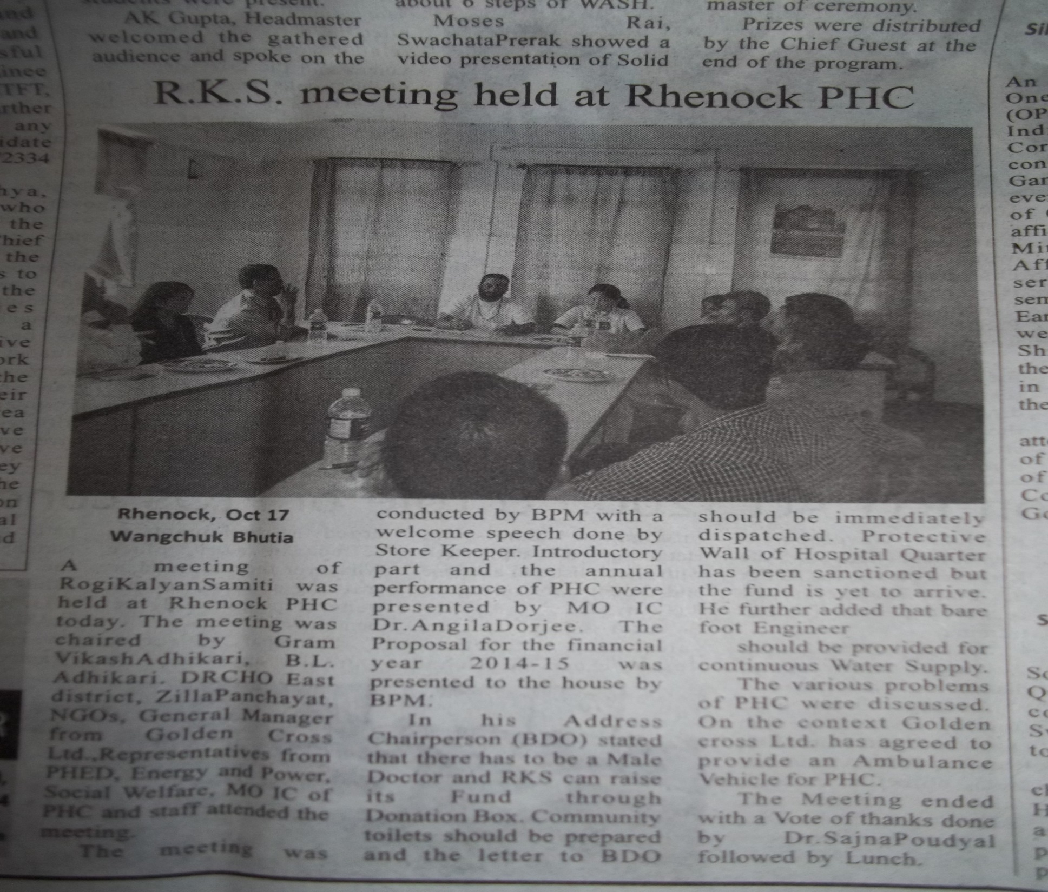

Slide 34
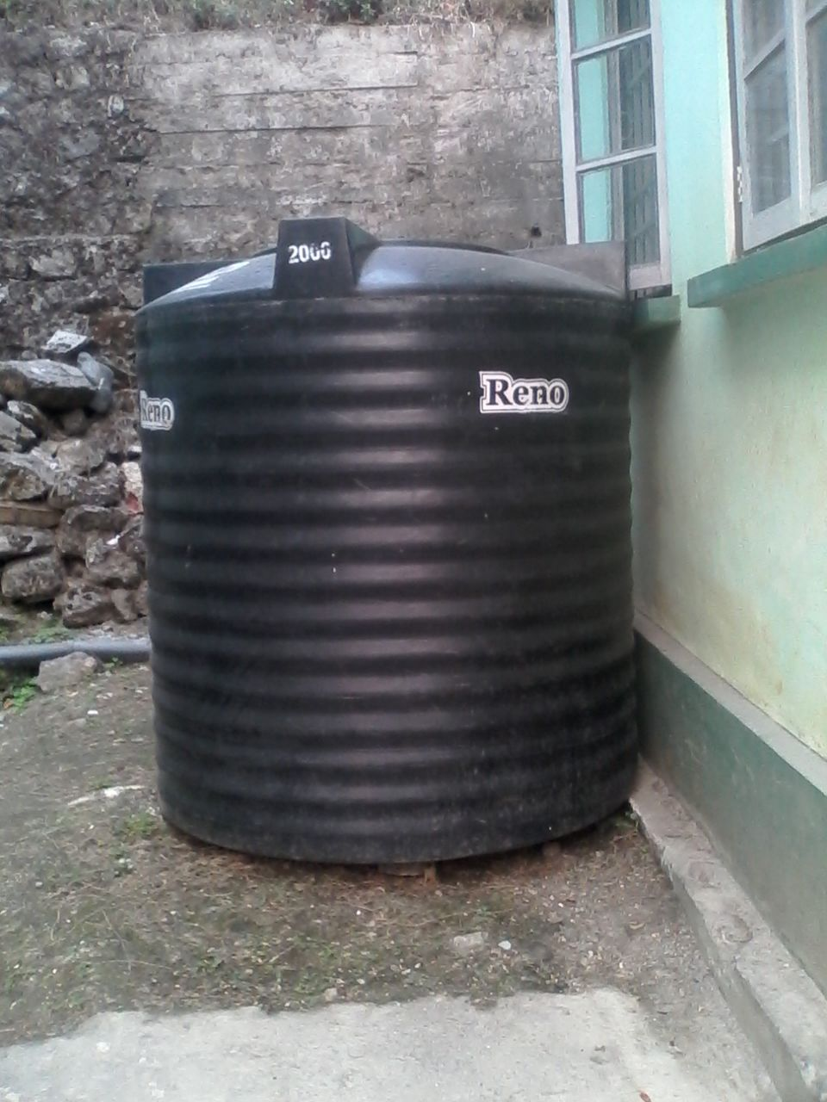
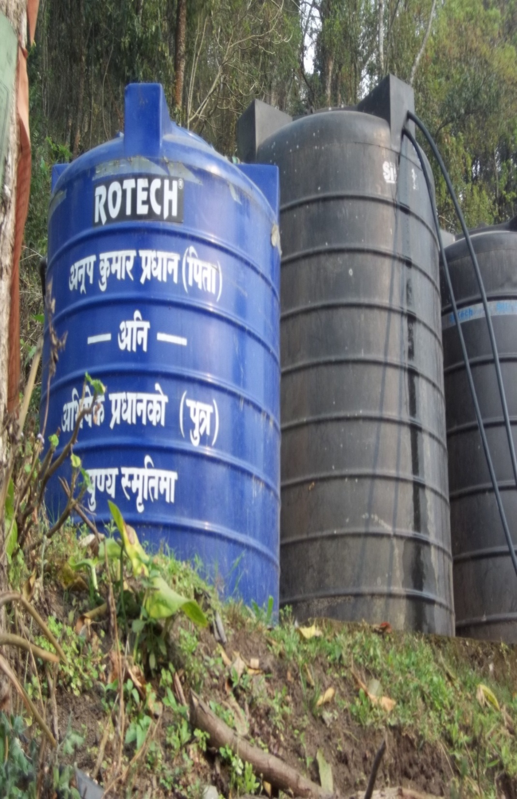
Gifted BY MLA Cum Chief-WHIP, 20th Chujachen (2014)

Slide 35
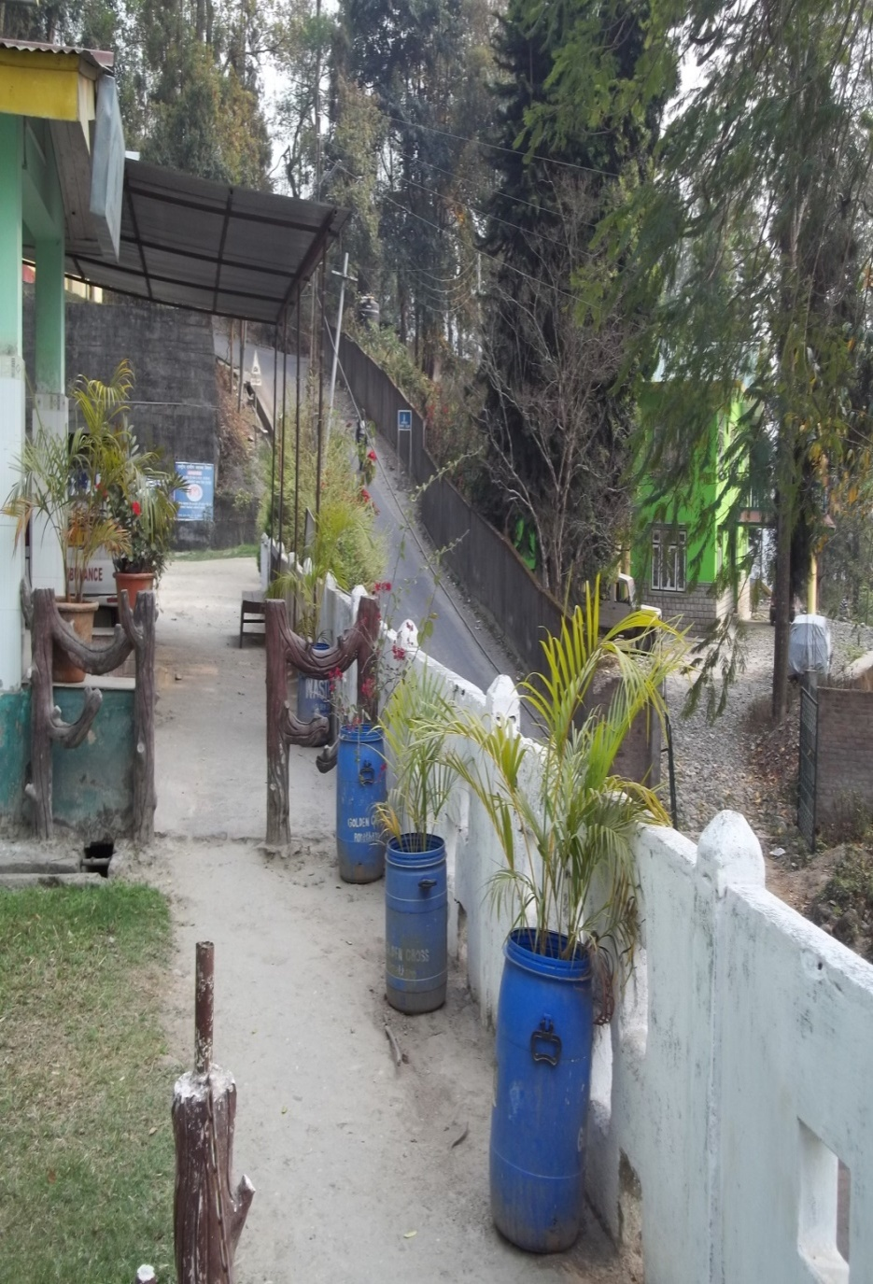
DONATED BY GOLDEN CROSS

Slide 36
COMMUNITY MONITORING
Community monitoring was taken up in the state in the year 2013-14.
State level TOT was done in the year 2013-14
Three District conducted the enquiry process .
In the year 2014-15 fund not approved for the same
and also in2015-16 fund approved only for Jansambad.

Slide 37
The enquiry process was done by NGO named DHRISTI from south district.
The facility included were from each district 2 PHCs were taken ,one farthest from the district HQ and one nearest to the District HQ.
Under each PHC 2 subcentres each were included.
Total
District 3
PHC 6
Subcentre 12

Slide 38
CONSTRAINTS IN COMMUNITY MONITORING
The NGO was not well equipped for conducting community monitoring further Capacity Building required.
Community Monitoring Committee in the District and PHC are yet to be formed.
Though the community is very well involved in the Health ,forming of monitoring committee and training them on their health rights and Government schemes required and capacity building required.

Slide 39
CHALLANGES
State do not have Resource Centre for community action.
Fund being approved only for Jamsamwad since last two years and not for enquiry process.

Slide 40
WAY FORWARD
Revamping of community action by expanding the ASHA Mentoring group of State, District and PHCs and forming State Community process Mentoring Group which will over see all the components of CAH.
Capacity Building of these committees by training them on CAH.
Involvement and close coordination with HRDD and Social Justice Department.

Slide 41
THANK YOU

