Slide 1
Community Participation in Health Care (The Communitisation Approach in Nagaland)
Regional Consultation on ‘Community Action For Health’
3rd February, 2016, Kolkata

Slide 2
COMMUNITISATION
The process of Communitization of health services was initiated in the year 2002.
Goal: Strengthen Health service delivery through community participation in planning, implementation and monitoring of different health activities towards development of ownership of health delivery by the community.
What is Communitization ?
• Involves Partnership between Government and Community including - Transfer of ownership of public resources and assets. - Control over service delivery.
It is - Decentralization, delegation, empowerment and building capacity.
• Based on Triple ‘T’ approach
- Trust the user community
- Train them to discharge their new found responsibilities
- Transfer governmental powers and resources in respect of management

Slide 3
Why Communitization ?
Ever since the attainment of Statehood, many public institution/ facilities in various sectors were made. But they were:
Underutilized
The attendance and performance of the functionaries not up to the mark
Recurring expenditures on items such as repairs/ equipments and procurement of consumables are rarely incurred.
Resulting in disuse or sub-optimal use of facilities
Public expected the Government to deliver quality services
Community asset and potentials were not adequately used

Slide 4
Strategy adopted
At village level:
a. Village Health Committee
b. Common Health Sub-centre Committee
In towns/ urban-based sub-centres
Urban Health Committees were constituted with VHC-like membership to take control and management of all urban-based Health Sub-centres in the State.
At CHC/ PHC level
At CHC/ PHC level Health Centre Managing Committee was constituted with representatives of VHCs and Village Councils of all constituent villages and towns falling within the respective CHC/ PHC areas.

Slide 5
Constitution of Village Health Committee
Person elected/ selected by the Village Council - Chairman
At least 3 Village Council members - Members
Secretary, Village Development Board - Member
2 Health workers of the Sub-centre where there is a
sub-centre and one such worker shall be nominated by
Chairman of Village Council to be Member Secretary
2 persons nominated by the from among woman members - Members
1 Anganwadi worker in the village - Member
1 trained Dhai in the village - Member
1 Pastor of the village church - Member
The Village Health Committee shall meet once every 3 months in a year and a simple majority of the members shall form a quorum.
The members, other than those who are ex-officio members shall be members for a period of 3 years. In the event of mid-term vacancies, new members may be nominated for the remaining term/ period only.

Slide 6
PRESENT STATUS OF COMMUNITIZATION HEALTH UNIT
Sl. No. | Health Unit | Numbers
1 | Sub- Centers | 396
2 | PHC | 126
3 | CHC | 21

Slide 7
Monitoring/ Supervision mechanism
a. State level
State Communitisation Committee
District Supervisors (one for each district)
b. District level
District Co-ordination Committee (DCC) headed by the Deputy Commissioner
Civil Surgeon along with one designated Programme Management Officer
Medical Officers in-charge of CHC/ PHC
c. Village level
Village Councils in respective villages

Slide 8
Decentralised Health Planning process in Nagaland
Capitalising on the existing process of Communitisation, the bottom up approach advocated by NRHM was adopted through a rigorous De-centralised Health Planning Process.

Slide 9
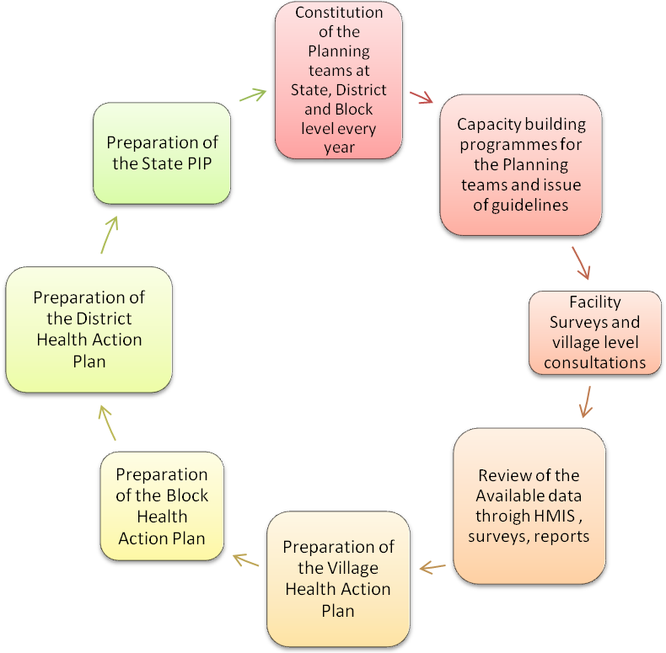
Steps in Decentralised Planning Process

Slide 10
Preparation of the Village Health Action Plan (VHAP)
Selection of the villages (5 villages):
The criteria for selection of these five villages are:
Accessibility especially difficult to reach villages
Its population characterisitcs
Distance from the facility
Village level meetings are held at these selected villages with an aim to get a feel about the general health need and also what best could be proposed with the active participation of the community.
Group Discussions, Health Camps and interviews with key stakeholders is done by the planning team along with the community.
Points of action for the identified health problems are then deduced during the same discussion.
Village Health Action developed
The resolutions passed during the Communitisation Conference (2010) i.e. to attain 100% Immunisation of children below 5 years of age in all the Villages and implement VHND religiously, became the main basis for the preparation of Village Health Action Plans.

Slide 11
Preparation of the Block Health Action Plan (BHAP)
Major inputs for the Block Health Action Plans are received from:
The findings of the discussions, held at village level- VHAPs
The facility survey of all the health facilities that are done by the existing health staff.
The process involves:
A day long consultative and sharing meeting done at the sub division level, where the findings of the village level discussion are shared and suggestions taken.
The Medical Officer of the PHC / CHC submit their respective plans detailing what resources they have, what they need etc.
With detailed discussions the block health action plan is finalized.

Slide 12
Preparation District Health Action Plan (DHAP)
The Block Health Action Plans (BHAP) are compiled at district level to prepare the District Health Action Plan (DHAP). Besides the inputs from the blocks, the DHAP also receives inputs from the vertical program officers (like TB etc.) on their programmatic requirements in the district as per the respective programmatic norms. Due care is taken to reflect the community need as expressed by the community during the consultative meetings.

Slide 13
Preparation of the State Programme Implementation Plan (SPIP)
The State PIP is the compilation of the Village, Block and the District Health Action Plans which is evidence based and need based.

Slide 14
Expected Outcome
With the communitisation process in place and the NRHM support, gaps of the Department to be filled wherever necessary.
The health centres to be well equipped to deliver better health care services to the people.
Effective implementation of all the health programmes, both National and State sponsored.
The VHCs, HCMC to act as facilitator/ link body to motivate the public/ community to have access to the existing facility.
All the Programme officers to have no difficulty in implementing their programme with a fully sensitised and motivated VHC/ HCMC in place.
Reporting from all the health units to improve.
Thereby better health indices of the state i.e. MMR, IMR, TFR, Immunisation etc.

Slide 15
SWOT
Strength: Community ownership Active participation Staff attendance improved Community participation in planning process Better interaction of community with department Community monitoring and auditing | Weakness: Lack of transparency in some area High handedness of VHC Chairman No adequate training due to fund constraint Responsibility and accountability needs strengthening
Opportunity: Training Transparency Community monitoring and social auditing | Threat: Corruption to the grassroots level Monopoly by the Village Chiefs eg. G.B/ Anghs

Slide 16
Thank You

